Slide 1
SSUI F24 Lab 11: Web Frameworks
Frank Elavsky, 11-14-24

Slide 2
Resources
jQuery: https://jquery.com/
React: https://react.dev/
Svelte: https://developer.chrome.com/docs/devtools

Slide 3
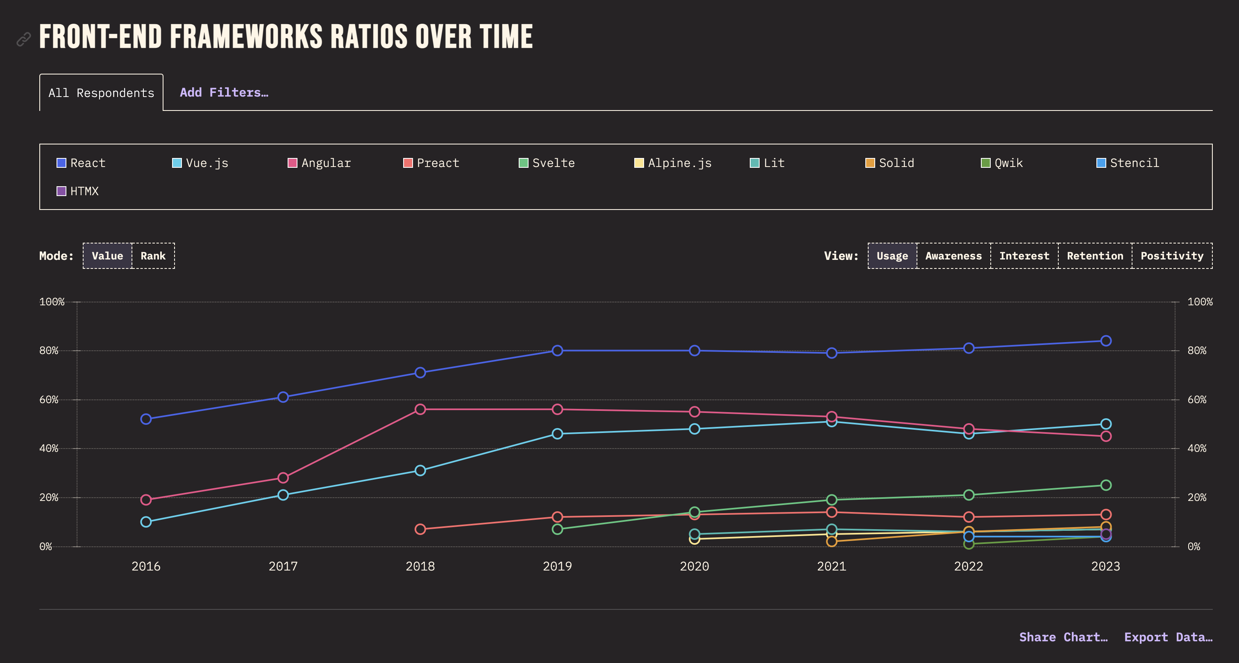
https://2023.stateofjs.com/en-US/libraries/front-end-frameworks/

Slide 4
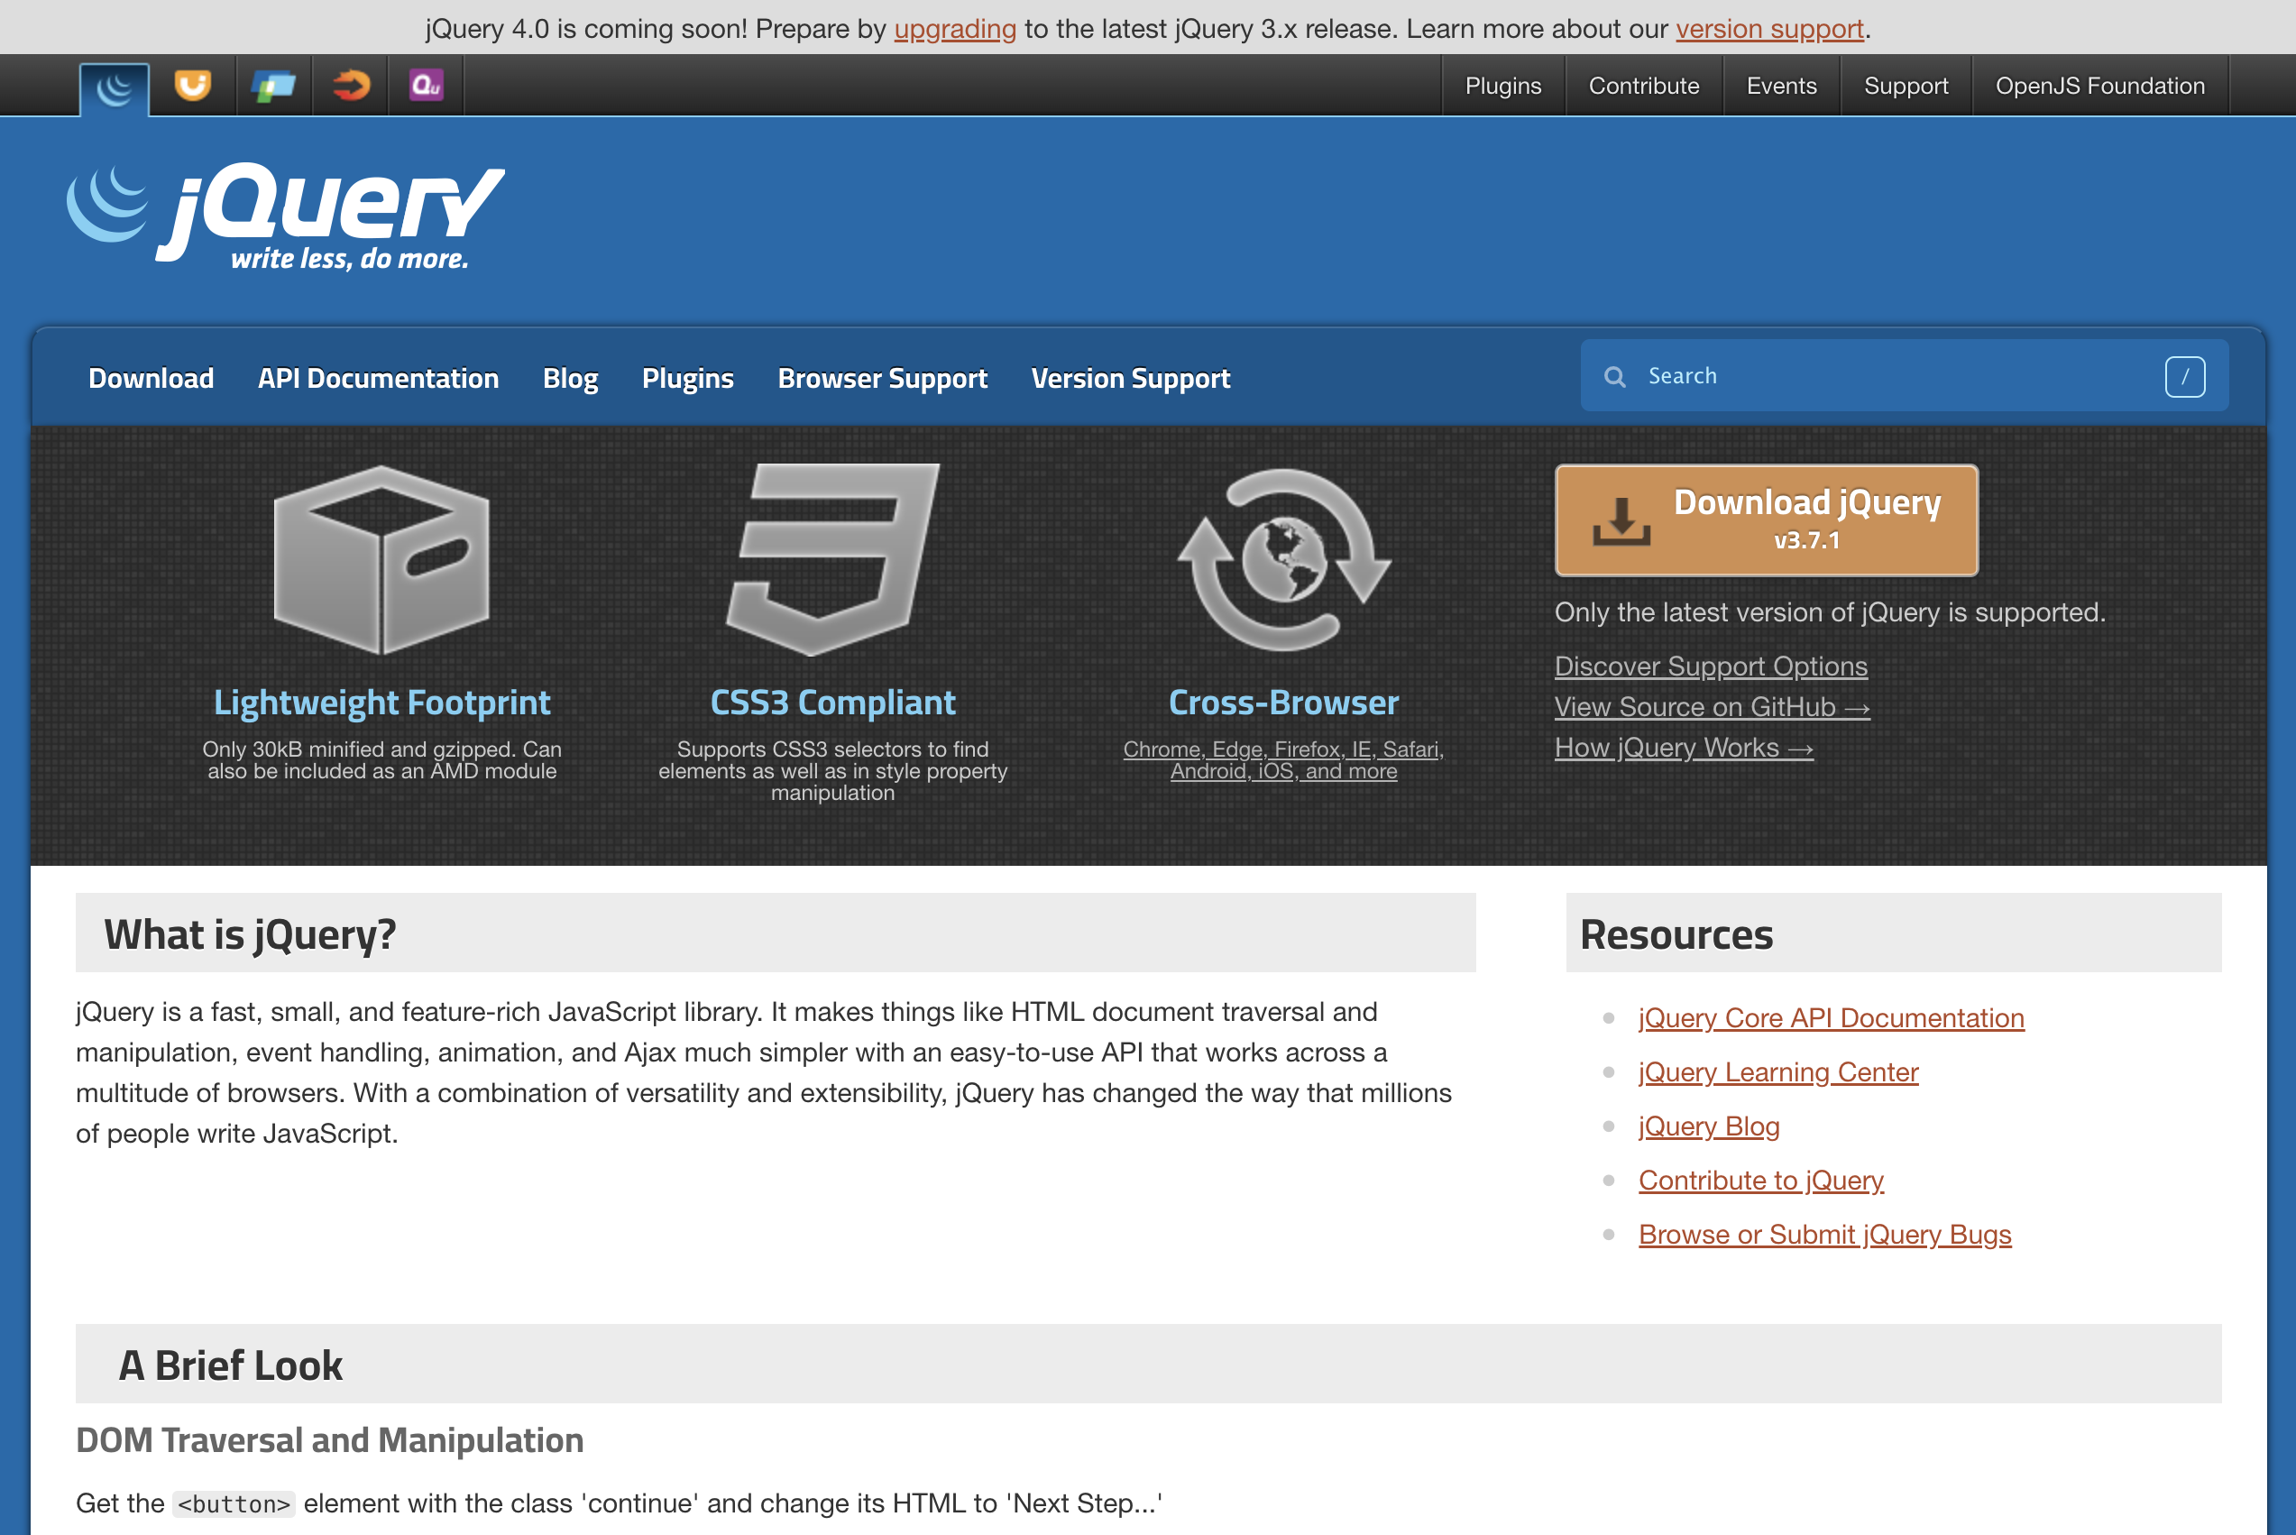
jQuery (2006) Still used in over 70% of websites
https://en.wikipedia.org/wiki/JQuery

Slide 5
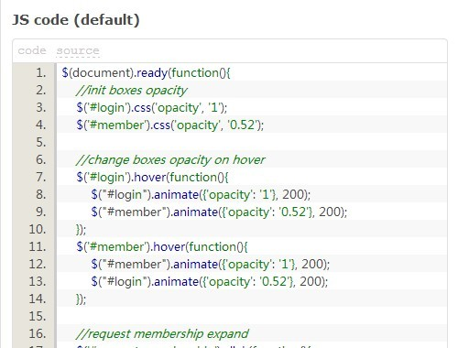
jQuery (2006) Syntax: Imperative, property-chaining

Slide 6
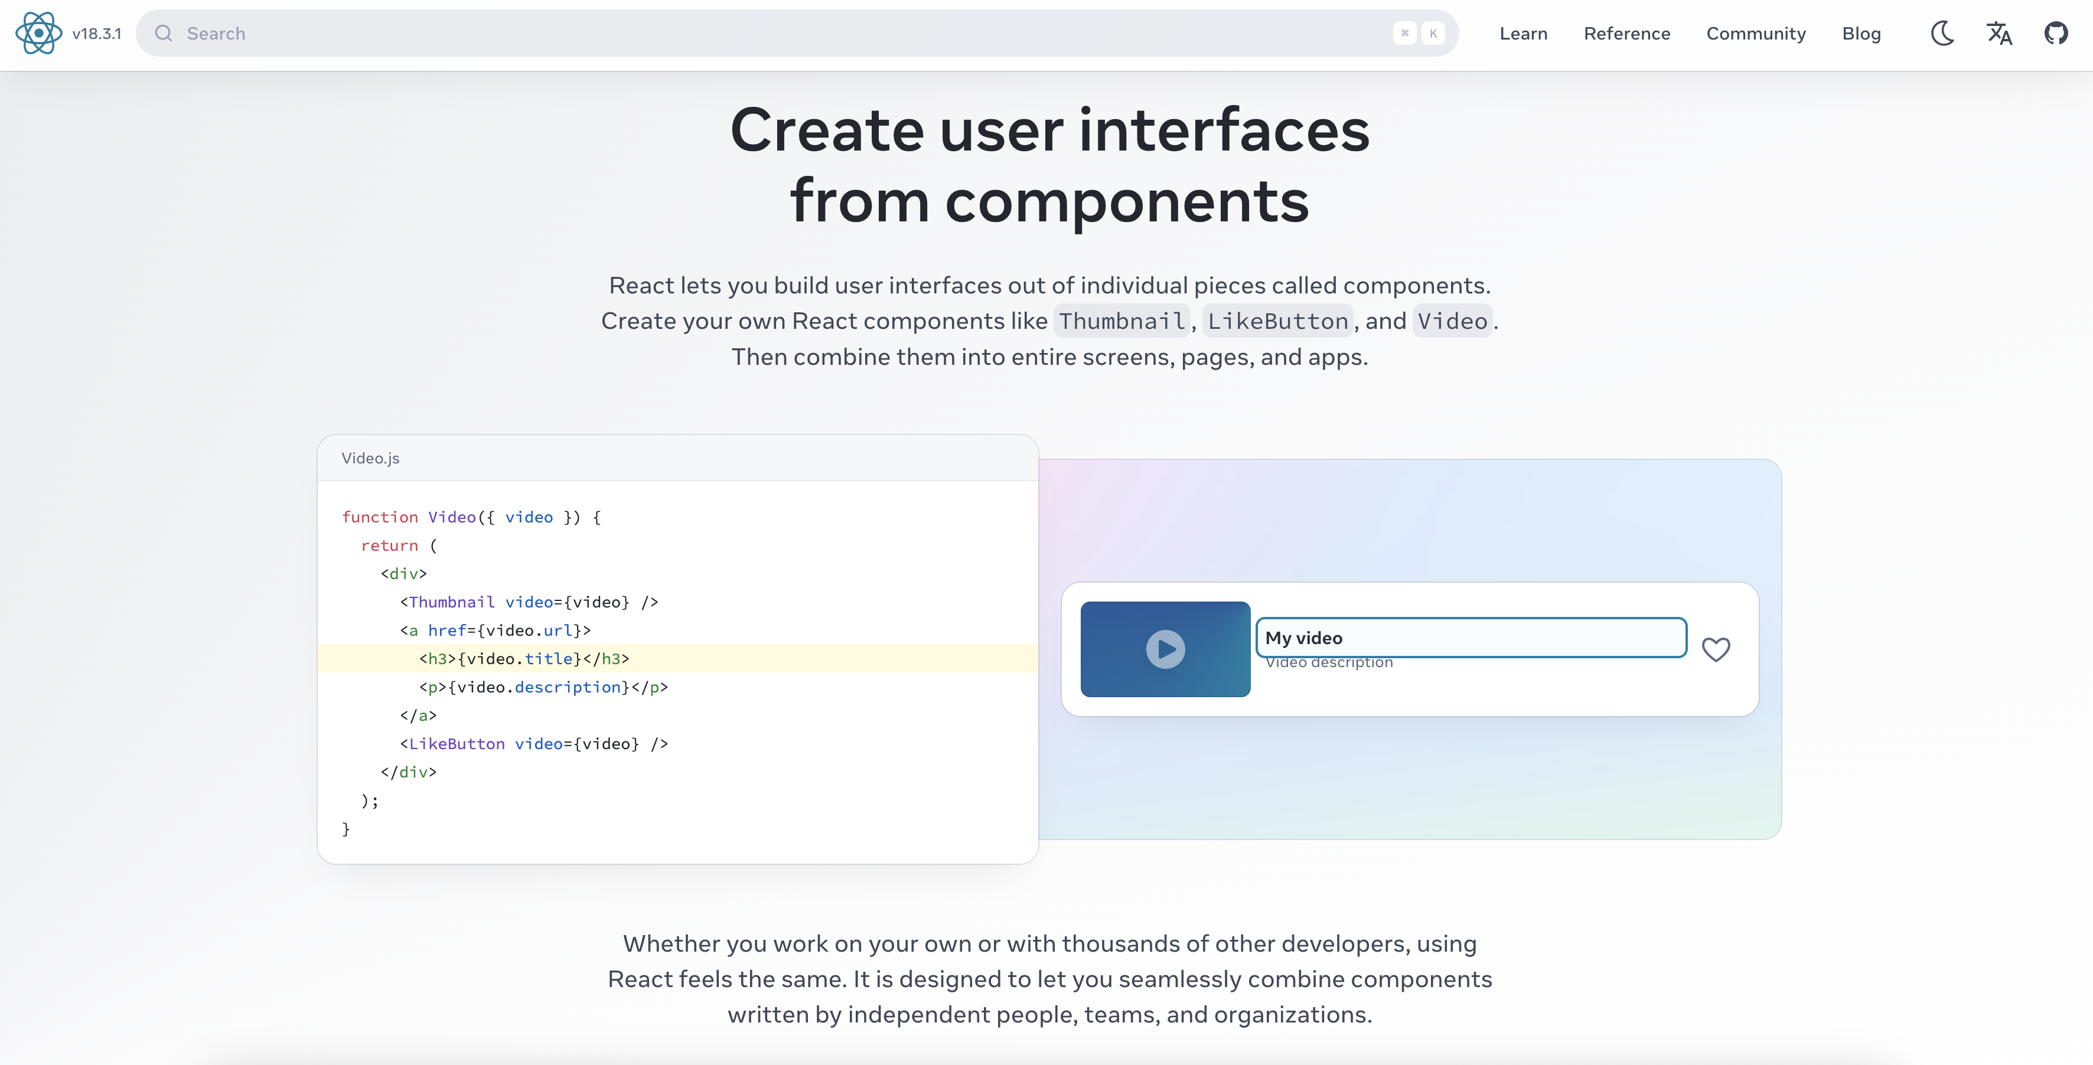
React (2013) Current major web “framework”

Slide 7
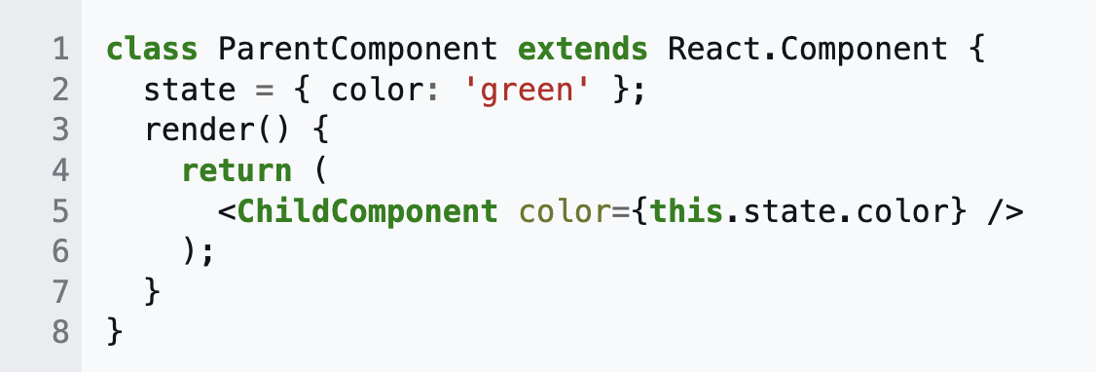
React (2013) Declarative, jsx/tsx, component-based, virtual dom

Slide 8
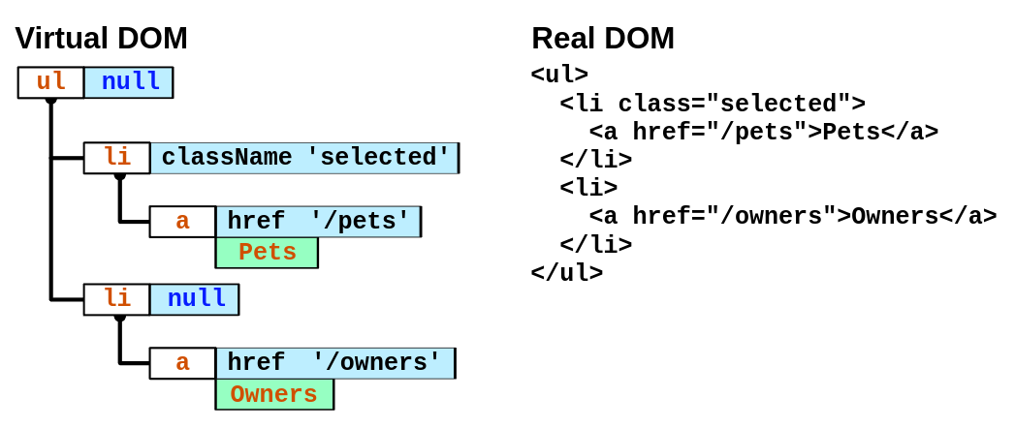
React (2006) Declarative, jsx/tsx, component-based, virtual dom

Slide 9
Declarative vs Imperative

Slide 10
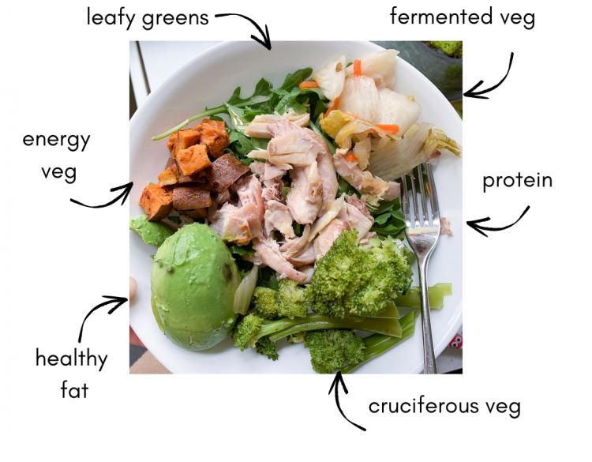
Declarative: what do you want? (rather than how)

Slide 11
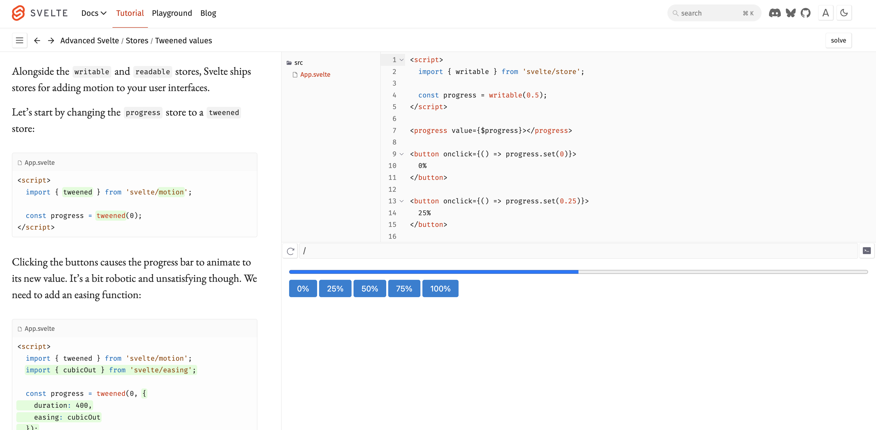
Svelte (2016) (The one everyone tells me I should try)

Slide 12
Our working repo from today (using React)
https://github.com/frankelavsky/intro-to-web-frameworks-bar-chart

