Slide 1
Effective Visual Encodings
Interactive Data Science
Frank Elavsky’s lecture(s) using Adam Perer’s materials based on some materials by Dominik Moritz, for John Stamper’s IDS course
dig.cmu.edu

Slide 2
Choosing Visual Encodings
Assume k visual encodings and n data attributes. We would like to pick the “best” encoding among a combinatorial set of possibilities of size (n+1)^{k}
Principle of Consistency
The properties of the image (visual variables) should match the properties of the data.
Principle of Importance Ordering
Encode the most important information in the most eﬀective way.

Slide 3
Design Criteria
[Mackinlay 1986]
Expressiveness
A set of facts is expressible in a visual language if the sentences (i.e. the visualizations) in the language express all the facts in the set of data, and only the facts in the data.
Effectiveness
A visualization is more eﬀective than another visualization if the information conveyed by one visualization is more readily perceived than the information in the other visualization.

Slide 4
Frank’s (bonus) Design Criteria:
¹[Borkin 2013, 2015]
²[Haroz 2015, Padilla 2018]
Memorability, recognition, recall¹
(Lasting Effectiveness)
A visualization’s lasting effectiveness on a viewer can often be determined by aesthetics, engaging titles and text annotations, and even embellishment.
Engagement²
(Attention, interaction, and effortful decision-making)
A visualization can’t even be minimally effective (see previous slide) if it doesn’t capture the audience’s attention for long enough to understand it and make meaningful decisions.

Slide 5
Design Criteria Translated
[Heer]
Expressiveness:
Tell the truth and nothing but the truth
(don’t lie, and don’t lie by omission)
Eﬀectiveness:
Use encodings that people decode better
(where better = faster and/or more accurate)

Slide 6
Design Criteria Translated
[Elavsky]
Lasting effectiveness:
Make it interesting without costing clarity
(live a little, make your design distinct)
Engagement:
Get your audience’s attention and keep it
(some decisions are painfully hard and require endurance, nuance, and thoughtfulness)

Slide 7
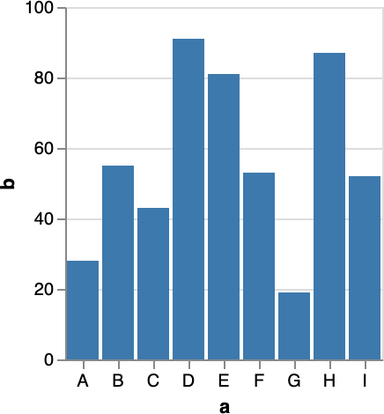
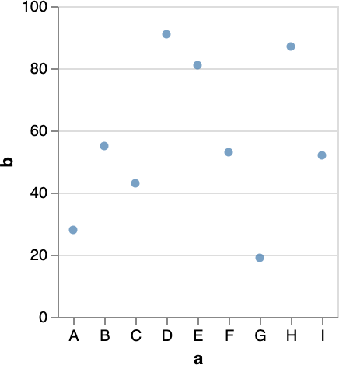
Visual Encoding: 1 Nominal, 1 Quantitative
Mark: Bar dnominal → x dquantitative → y
Mark: Point dnominal → x dquantitative → y

Slide 8
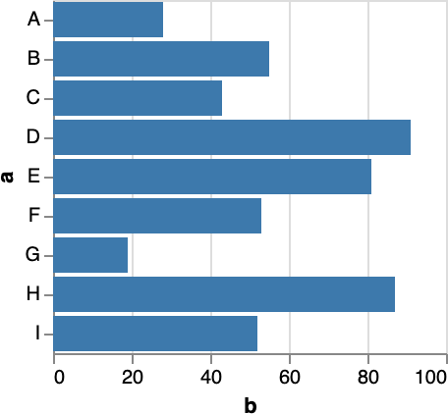
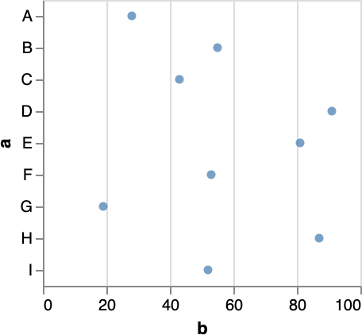
Visual Encoding: 1 Nominal, 1 Quantitative
Mark: Bar dnominal → x dquantitative → y
Mark: Bar dnominal → y dquantitative → x
Mark: Point dnominal → x dquantitative → y
Mark: Point dnominal → y dquantitative → x

Slide 9
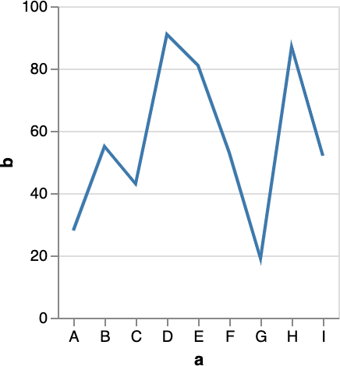
Visual Encoding: 1 Nominal, 1 Quantitative
Mark: Bar dnominal → x dquantitative → y
Mark: Point dnominal → x dquantitative → y
Mark: Line dnominal → x dquantitative → y
Violates expressiveness: the line mark implies a trend across the categories.

Slide 10
Visual Encoding: 1 Nominal, 1 Quantitative
Mark: Bar dnominal → x dquantitative → y
Mark: Point dnominal → x dquantitative → y
Mark: Line dnominal → x dquantitative → y
Violates lasting effectiveness: there is no title, text annotations, or distinct or strong visual aesthetics. These look like the same default vega-lite charts everyone uses.

Slide 11
Visual Encoding: 1 Nominal, 1 Quantitative
Mark: Bar dnominal → x dquantitative → y
Mark: Point dnominal → x dquantitative → y
Mark: Line dnominal → x dquantitative → y
Violates engagement: Boring!! Who wants to look at bar, scatter, and line charts all day?

Slide 12
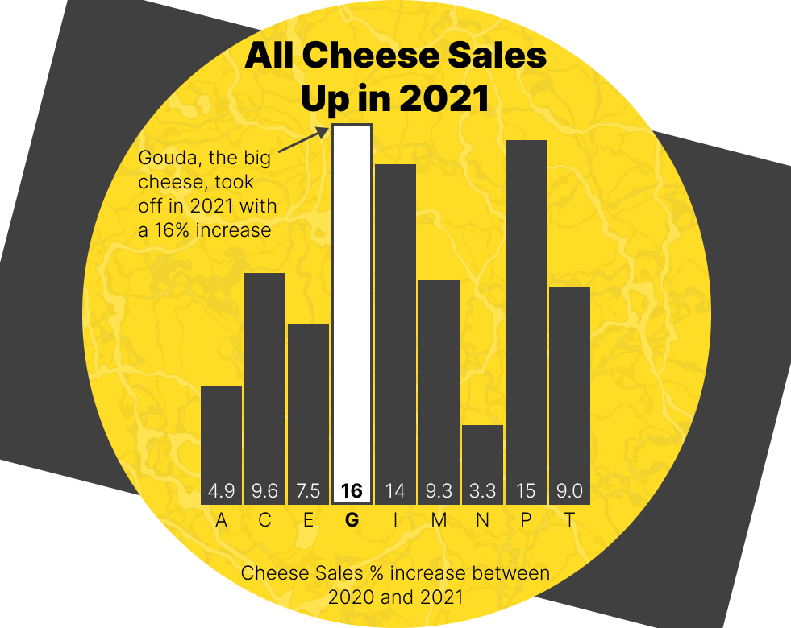
Most design depends on your audience. What kind of audiences might this chart be effective, memorable, and engaging for?
[Elavsky]

Slide 13
Discuss and compare these two designs in chat. What design elements has the right chart added? What did it remove? Would these ever be justifiable decisions? Why or why not?
[Elavsky]

Slide 14
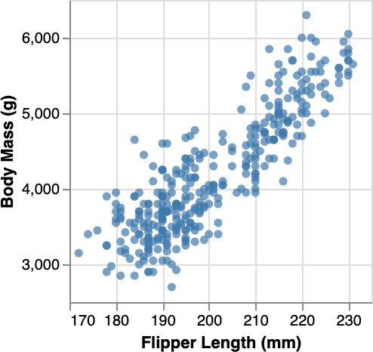
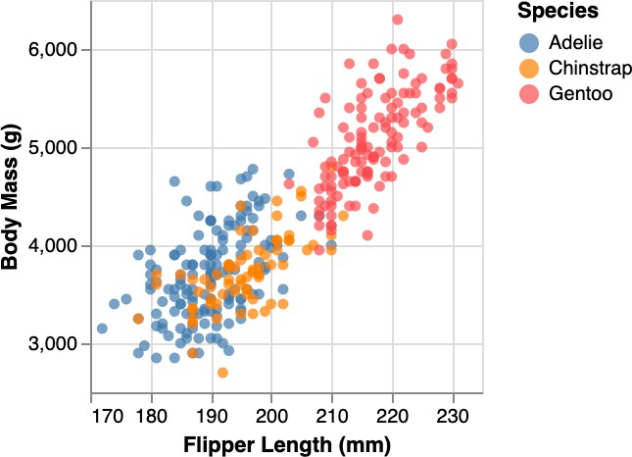
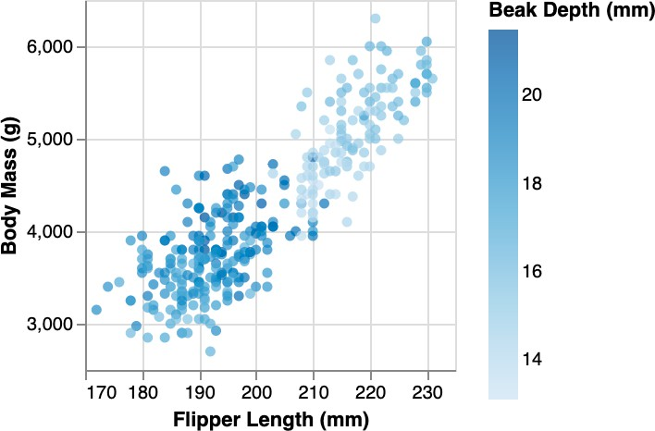
Visual Encoding
Mark: Point dquantitative → x dquantitative → y
Mark: Point dquantitative → x
dquantitative → y dnominal → color
Mark: Point dnominal → x dquantitative → y dquantitative → color

Slide 15
Practice summarizing: What is a good title?
Mark: Point dquantitative → x dquantitative → y
Mark: Point dquantitative → x
dquantitative → y dnominal → color
Mark: Point dnominal → x dquantitative → y dquantitative → color
[Elavsky]

Slide 16
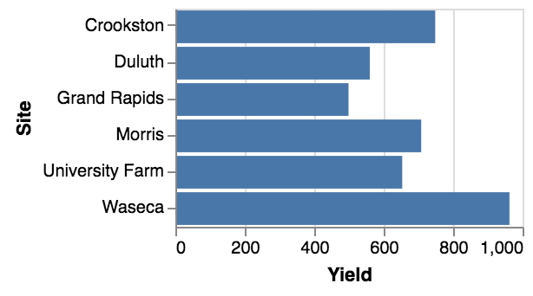
Visual Encoding

Slide 17
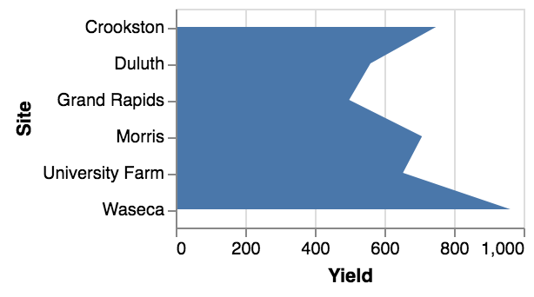
Visual Encoding
Violates expressiveness: the area mark implies a trend across the sites.

Slide 18
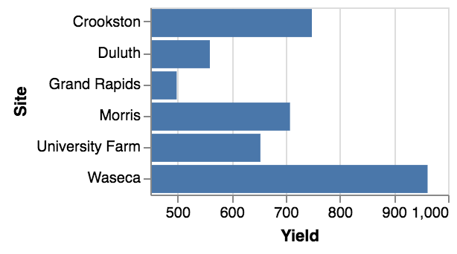
Visual Encoding
Violates expressiveness: the bar length encodes data but the baseline is not 0.

Slide 19
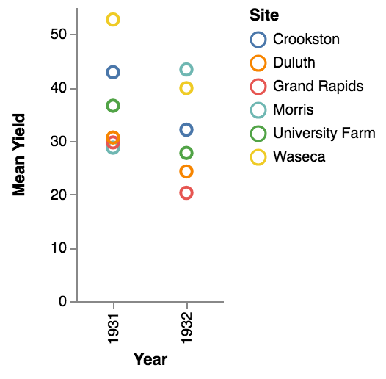
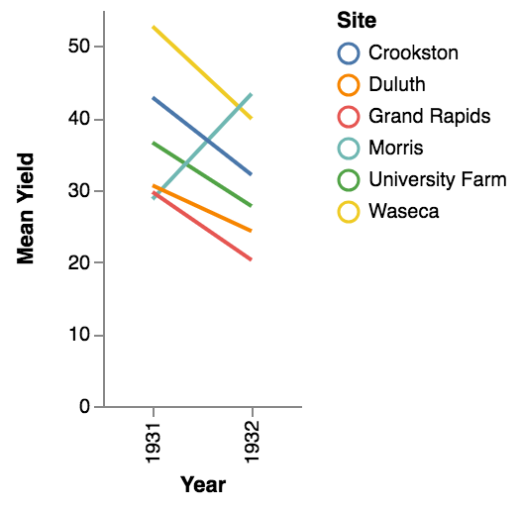
Visual Encoding
<
The line chart eﬀectively highlights the outlier.

Slide 20
Visual Encoding
<
But WHY?
The line chart eﬀectively highlights the outlier.
[Elavsky]

Slide 21
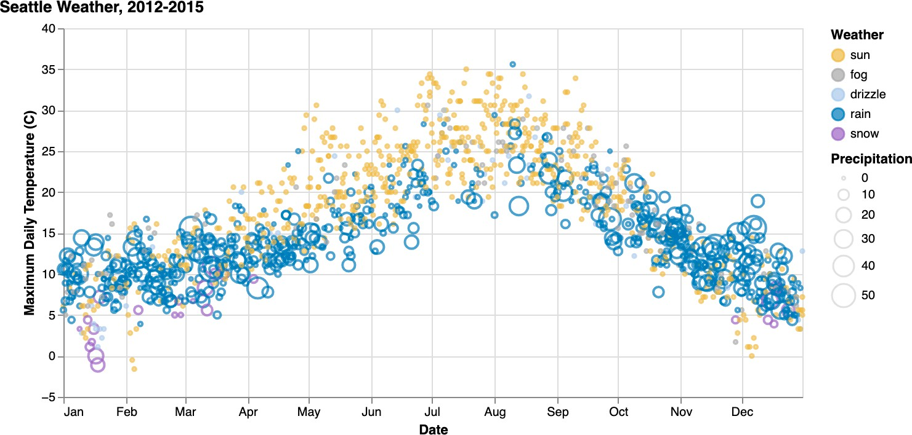
Visual Encoding
Mark: Point dnominal → x dquantitative → y dquantitative → size dnominal → color

Slide 22
Semantic Encoding: what do the colors mean?
[Elavsky]

Slide 23
Redundant Encoding
[Nothelfer 2017]
Length, Position and Value
[Elavsky]

Slide 24
Types of Channels
Magnitude Channels
How much? Position Length Saturation …
Ordinal & Quantitative Data
Identity Channels
What? Where? Shape
Color (hue) Spatial region …
Categorical Data

Slide 25
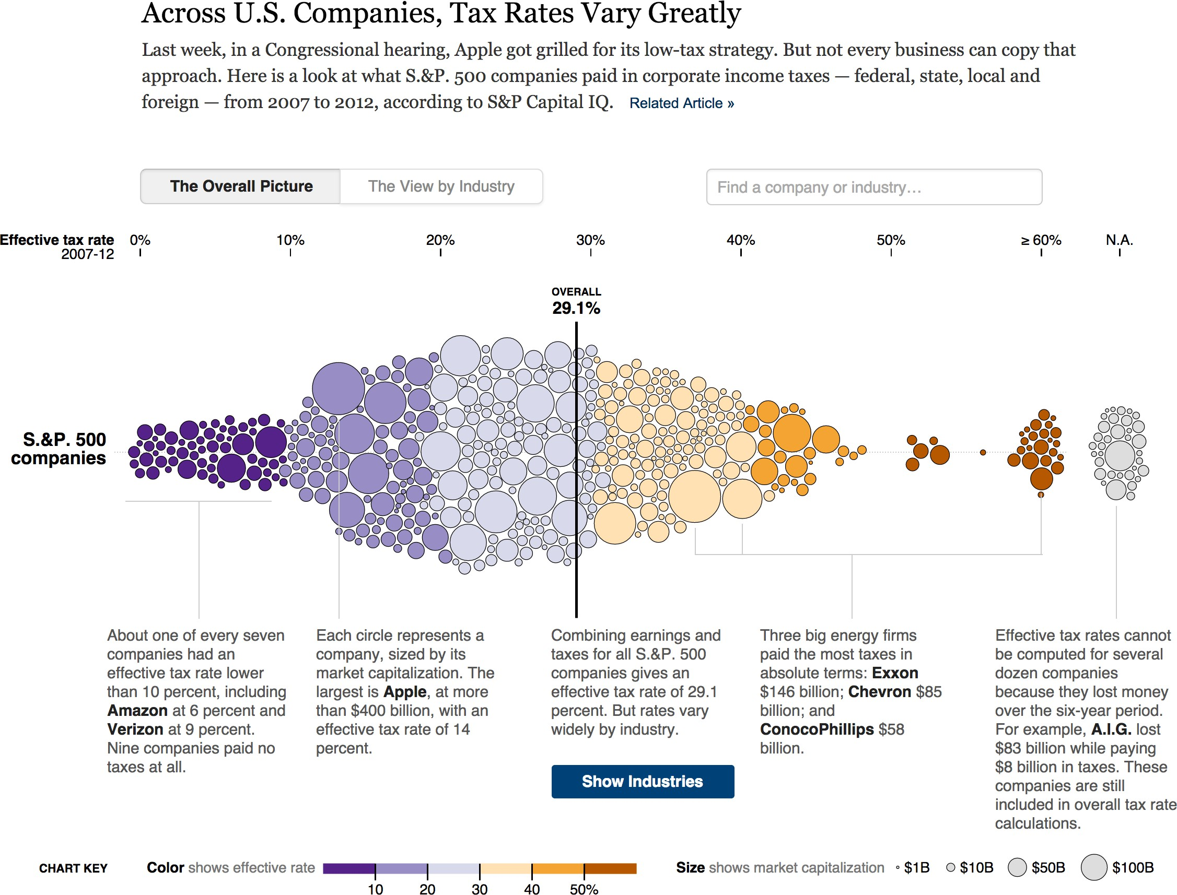
Which visual variables are used?
http://www.nytimes.com/interactive/2013/05/25/sunday-review/corporate-taxes.html

Slide 26
What features do you think made this visualization have lasting effectiveness and engagement?
[Elavsky]
http://www.nytimes.com/interactive/2013/05/25/sunday-review/corporate-taxes.html

Slide 27
Effective Visual Encodings
in Three Lessons
Using space (in)eﬀectively
(De-)Obfuscating Data (Mis)leading the Witness

Slide 28
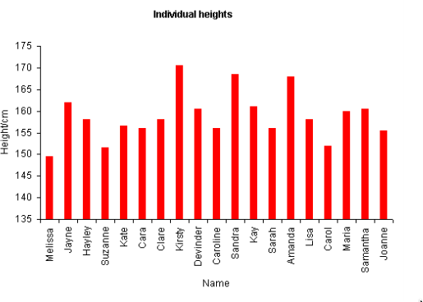
Why might this visualization be inexpressive?

Slide 29
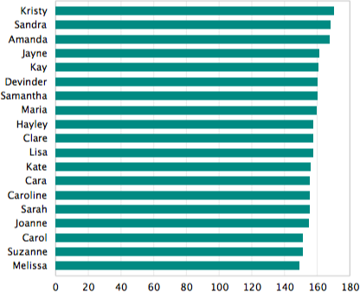

Slide 30
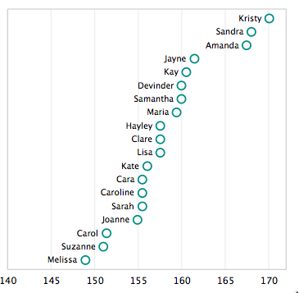
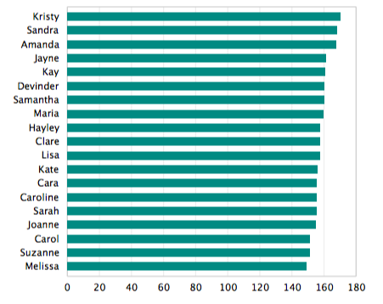

Slide 31
All Charts Should Start at Zero
Myth or Truth?

Slide 32
Average world life expectancy at birth (years)
75
50
25
0
1960
1970
1980
1990
2000
2010 2016
(Source: World Bank Data)
Alberto Cairo. How Charts Lie (2019).

Slide 33
Average world life expectancy at birth (years)
75
50
25
0
1960
1970
1980
1990
2000
2010 2016
(Source: World Bank Data)
Average world life expectancy at birth (years)
70
60
50
1960
1970
1980
1990
2000
2010
2016
Alberto Cairo. How Charts Lie (2019).

Slide 34
Average world life expectancy at birth (years)
70
60
50
1960
1970
Too narrow and tall
70
1980
1990
2000
2010
2016
Too wide and short
75
50
60
1960
1970
1980
1990
2000
2010 2016
50
1960
2016
Alberto Cairo. How Charts Lie (2019).

Slide 35
Aspect Ratio
Average world life expectancy at birth (years)
75
Approximate the proportion of the chart to match the depicted trend
70
35% increase ≈ 1/3rd
≈ 3:1aspect ratio
60
50
1960
1970
1980
1990
2000
2010
2016

Slide 36
Tufte’s Integrity Principles
Show data variation, not design variation
Clear, detailed, and thorough labeling and appropriate scales
Size of the graphic eﬀect should be directly proportional to the numerical quantities (“lie factor”)

Slide 37
Tufte’s “The Lie Factor”
Size of effect shown in graphic Size of effect in data

Slide 38
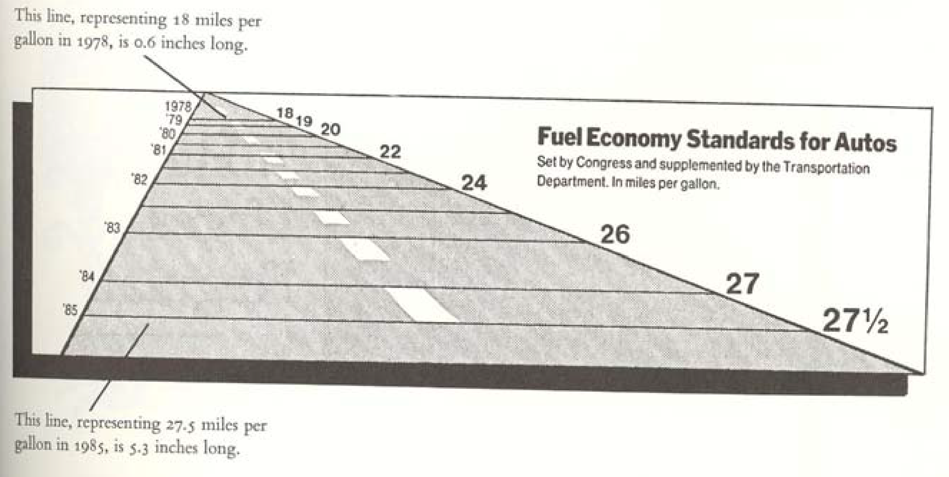
The Lie Factor
Size of effect shown in graphic Size of effect in data
Tufte, VDQI

Slide 39
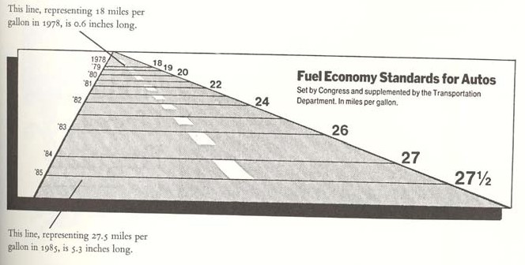
The Lie Factor
5.3 - 0.6 27.5 - 18
/ = 14.8
0.6 18
(Size of eﬀect in graphic)/(size of eﬀect in data)
Tufte, VDQI

Slide 40
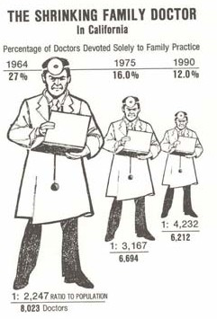
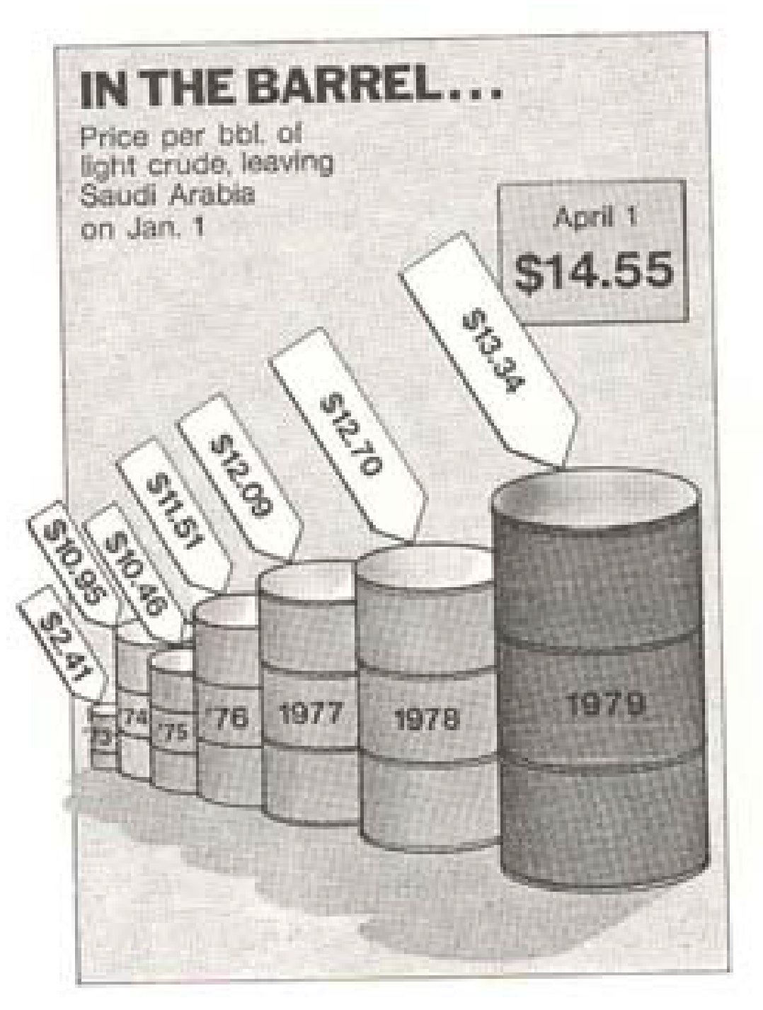
The Lie Factor
Tufte, VDQI

Slide 41
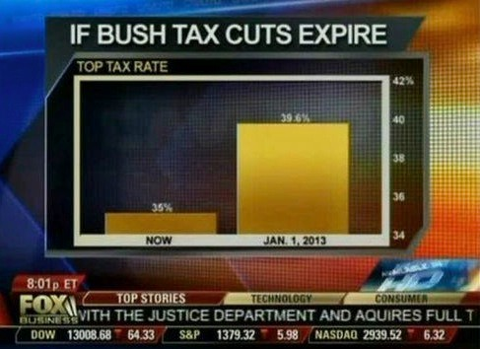
Lie Factor - Graphical Integrity
Magnitude in data must correspond to magnitude of mark
Effect in Data: factor 1.14 Effect in Graphic: factor 5 Lie Factor: 5/1.14 = 4.38
Flowing Data

Slide 42
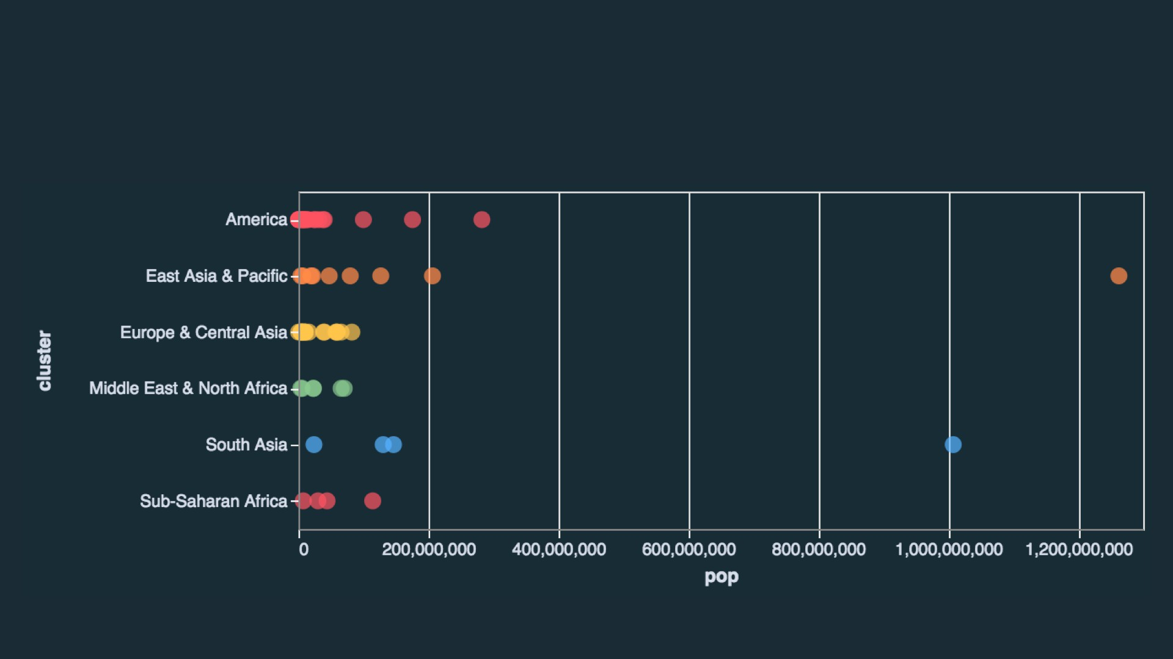
Scaling Axes: Outliers & Skew

Slide 43
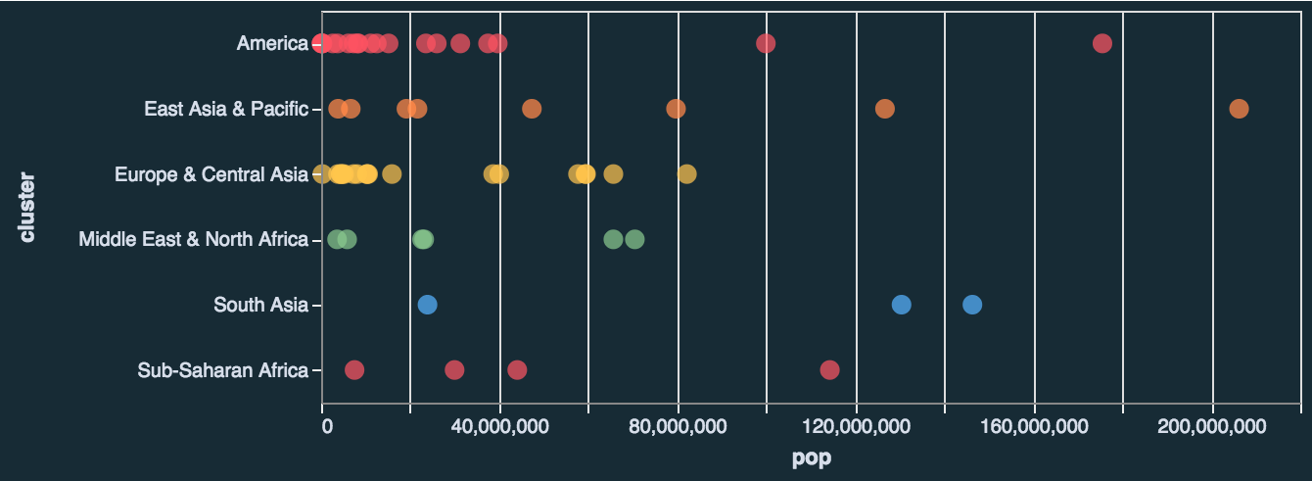
Scaling Axes: Outliers & Skew
Option 1: Clip them out

Slide 44
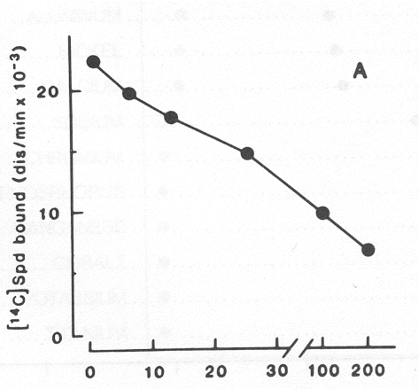
Scaling Axes: Outliers & Skew
Option 2: Scale Breaks
Violates Expressiveness Principle
Trend does not
exist in data
Cleveland (1985)

Slide 45
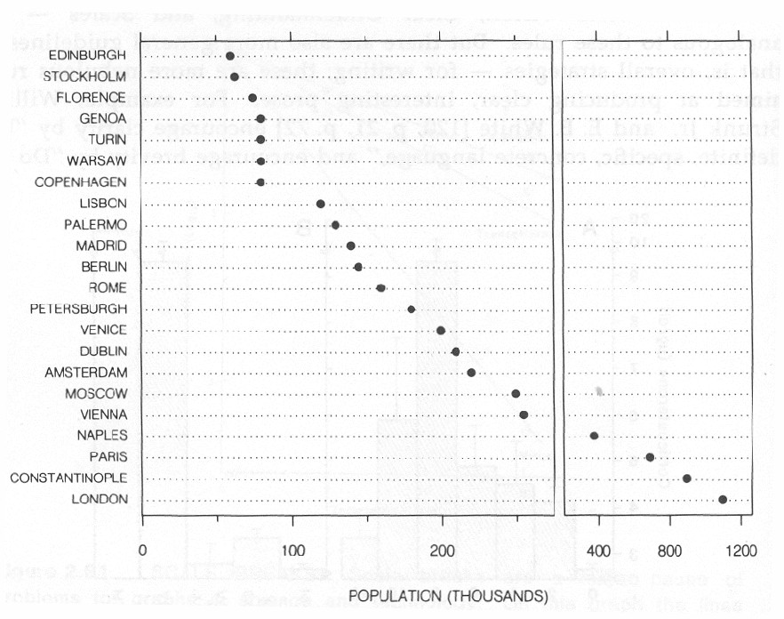
Scaling Axes: Outliers & Skew
Option 2: Scale Breaks
Prevents direct visual comparison of values
Violates Expressiveness Principle

Slide 46
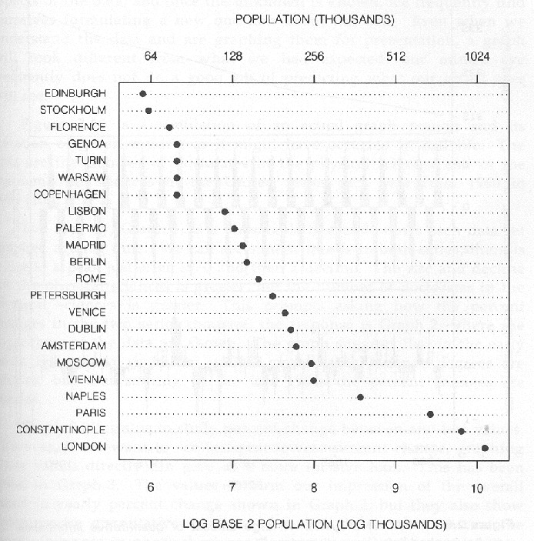
Scaling Axes: Outliers & Skew
Option 3: Log Scales
Prevents direct visual comparison of values
Enables direct visual comparison of values

Slide 47
Scaling Axes: Outliers & Skew

Slide 48
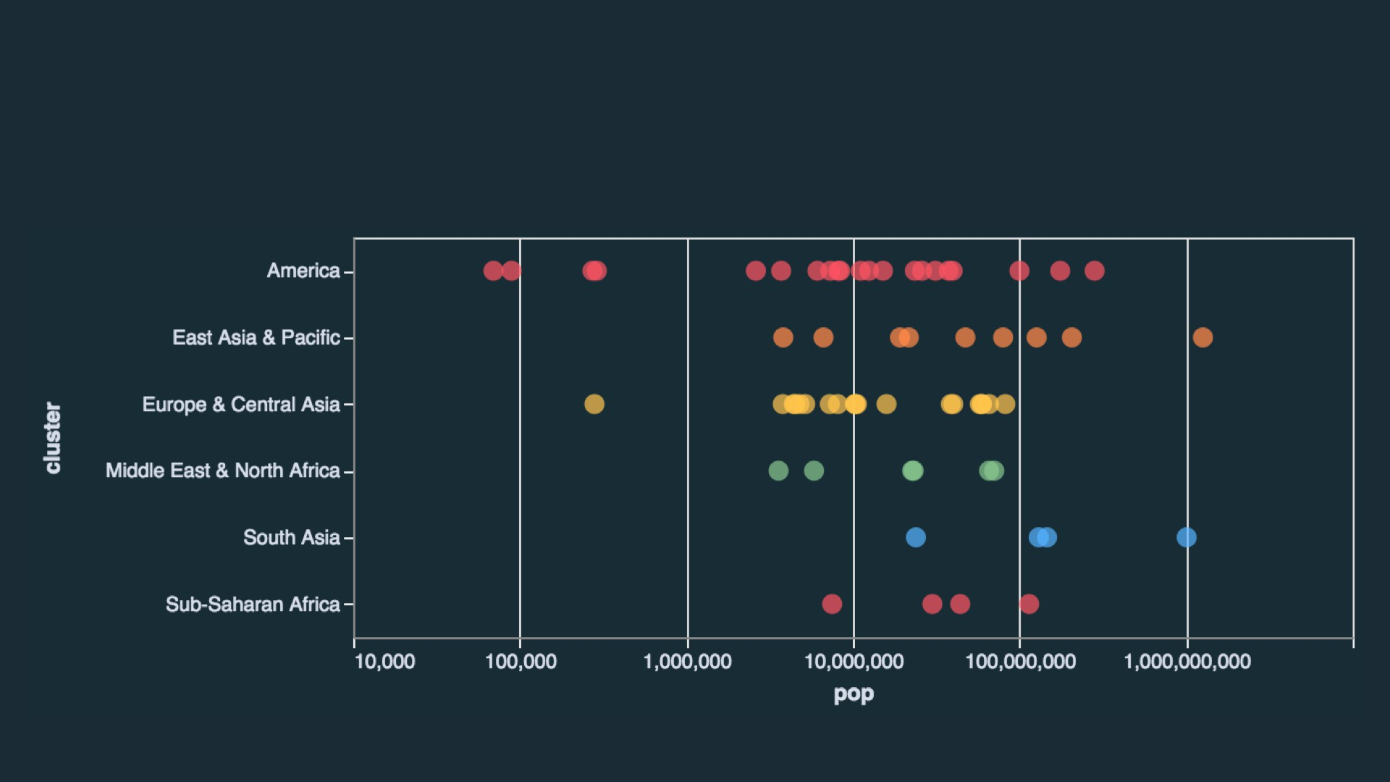
Scaling Axes: Outliers & Skew
Option 3: Log Scales
Direct visual comparison of values with no clipping required

Slide 49
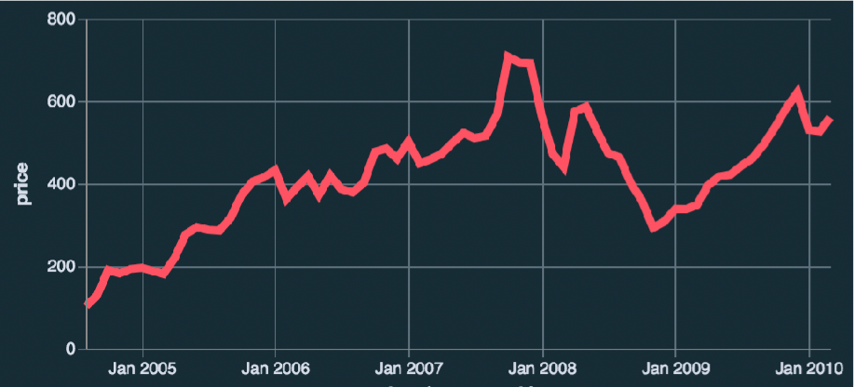
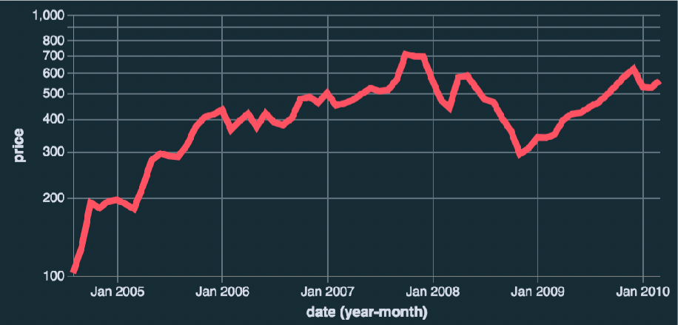
Scaling Axes: Linear vs Log
Linear Scale
Absolute change
Log Scale
Percentage change
Limitations
Positive, non-zero values Audience familiarity?

Slide 50
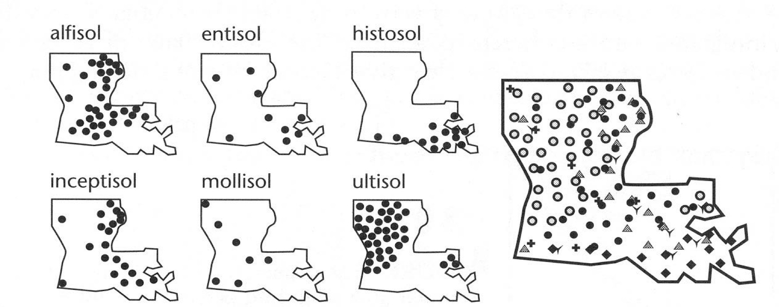
Small Multiples
MacEachren (1995)

Slide 51
Small Multiples
MacEachren (1995)

Slide 52
Effective Visual Encodings Part 2
Interactive Data Science
dig.cmu.edu
[Elavsky]

Slide 53
Visual Channels

Slide 54
Characteristics of Channels
Selective
Is a mark distinct from other marks?
Can we make out the difference between two marks?
Associative
Does it support grouping?
Quantitative (Magnitude vs Identity Channels)
Can we quantify the difference between two marks?

Slide 55
Characteristics of Channels
Order (Magnitude vs Identity)
Can we see a change in order?
Length
How many unique marks can we make?

Slide 56
Position
Strongest visual variable Suitable for all data types Problems:
Sometimes not available (spatial data)
Cluttering
Selective: yes Associative: yes Quantitative: yes Order: yes Length: fairly big

Slide 57
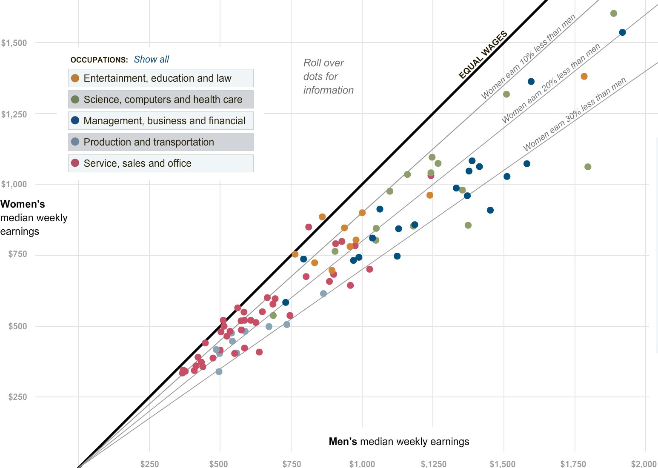
Example: Scatterplot

Slide 58
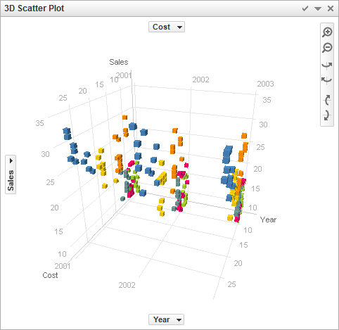
Position in 3D?
[Spotfire]

Slide 59
Length & Size
Good for 1D, OK for 2D, Bad for 3D Easy to see whether one is bigger Aligned bars use position redundantly
For 1D length: Selective: yes Associative: yes Quantitative: yes Order: yes Length: high

Slide 60
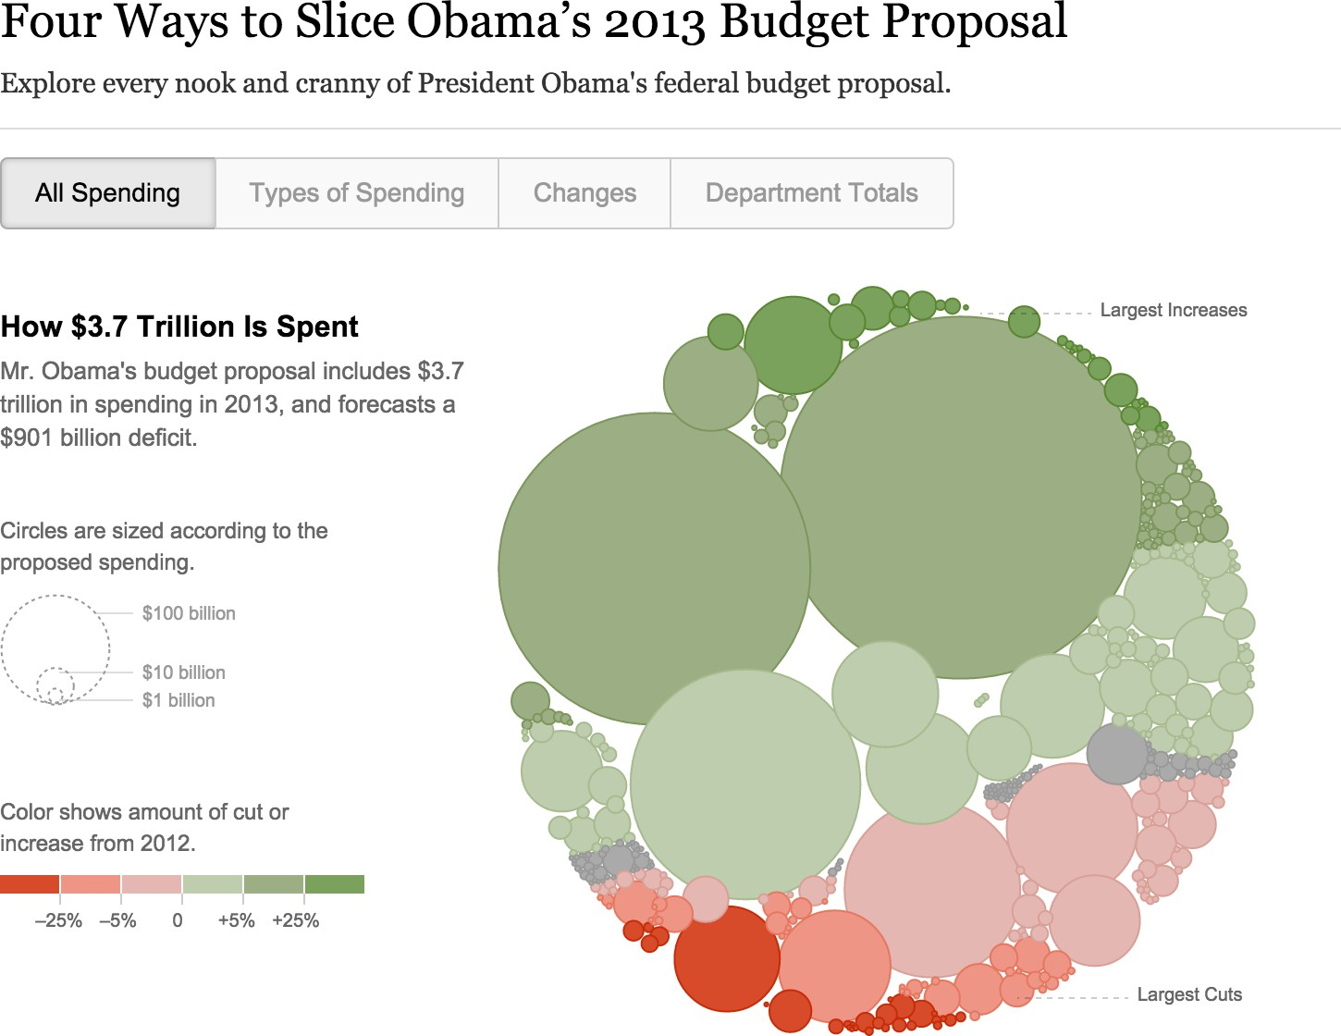
Example 2D Size: Bubbles

Slide 61
Value/Luminance & Saturation
OK for quantitative data when length & size are already used.
Not very many shades recognizable
Selective: yes
Associative: yes
Quantitative: somewhat (with problems) Order: yes
Length: limited
[Elavsky]

Slide 62
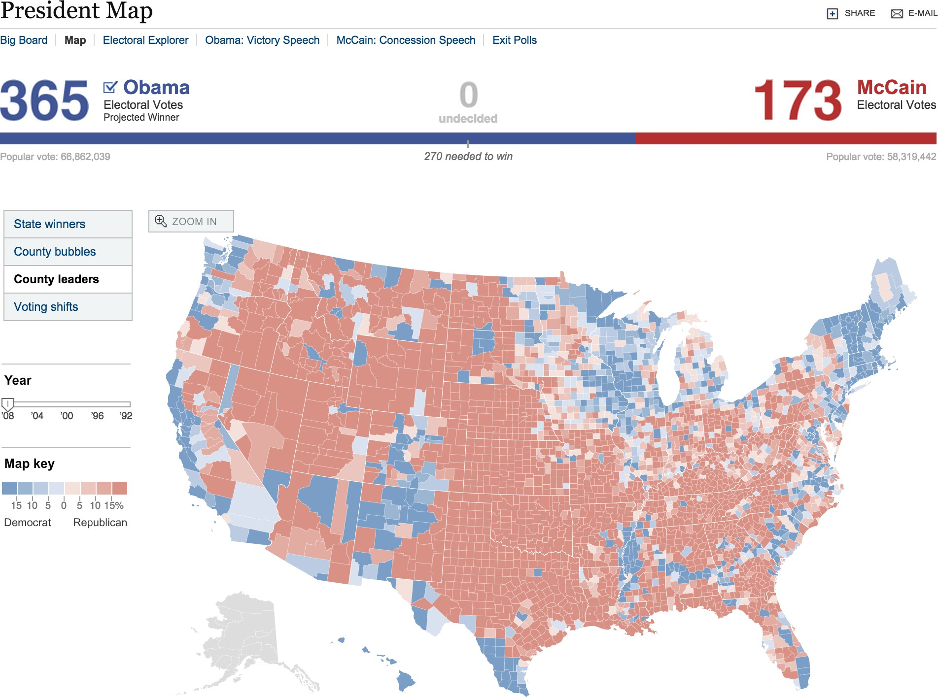
Example: Diverging Value-Scale

Slide 63
?????
Color (Hue)
<
<
Good for qualitative data (identity channel) Limited number of classes/length (~7-10!) Does not work for quantitative data!
Lots of pitfalls! Be careful!
A common rule among vis designers:
minimize color use for encoding data
Selective: yes Associative: yes Quantitative: no Order: no Length: limited
use for brushing

Slide 64
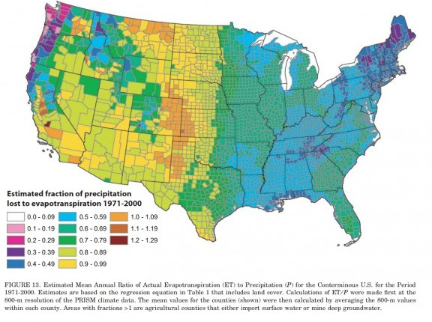
Color: Bad Example
Cliff Mass

Slide 65
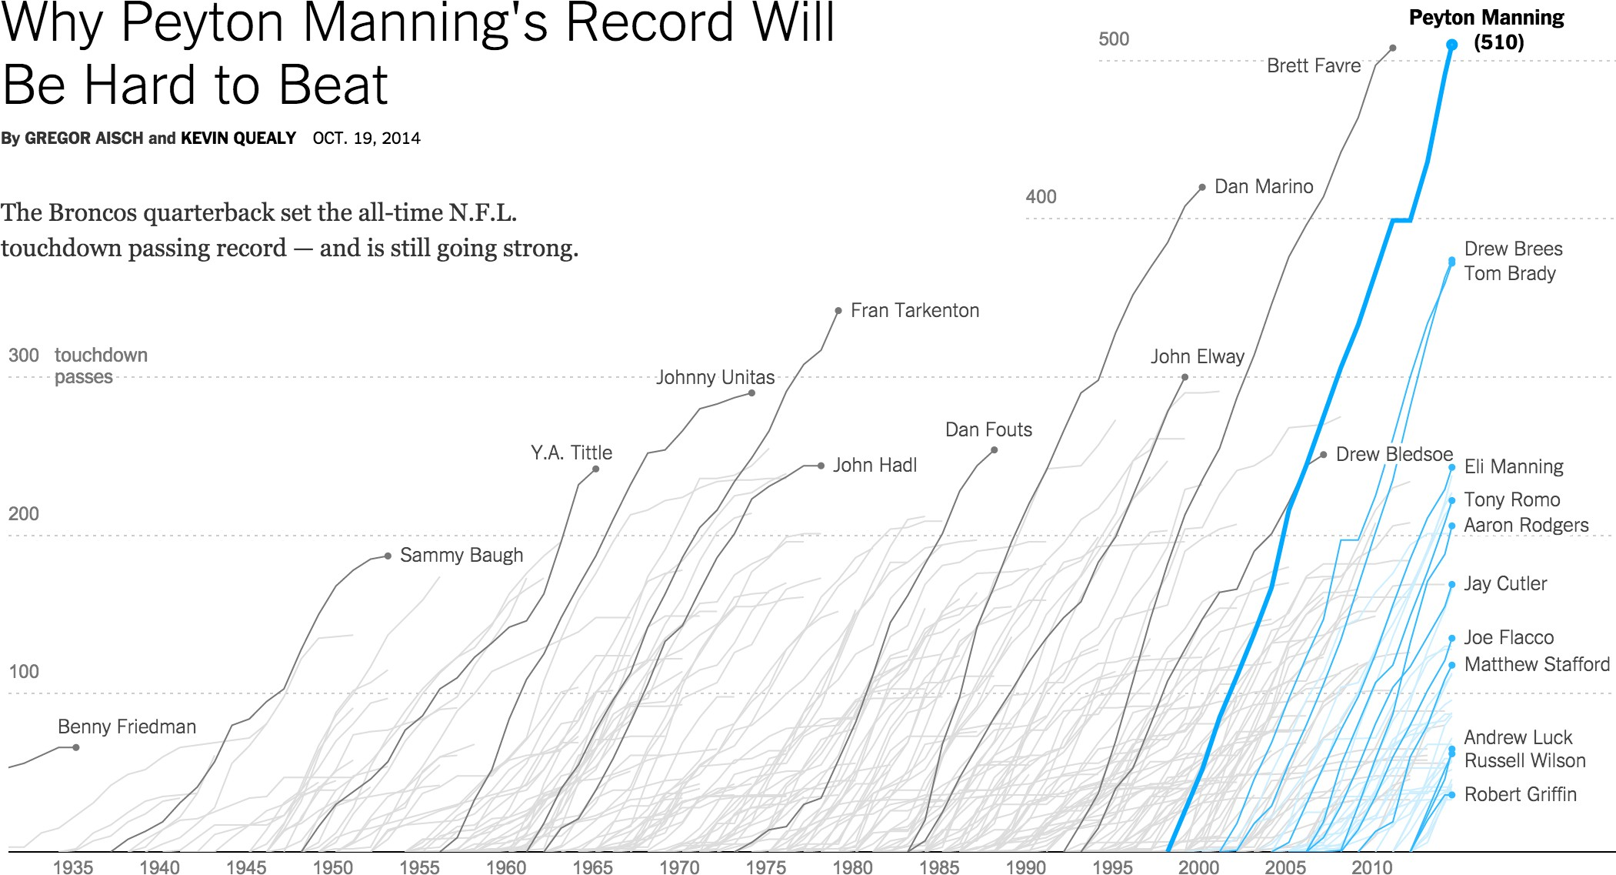
Color: Good Example

Slide 66
Accessibility and Perceivability (see additional slide deck)
https://www.frank.computer/talks/2023-visualization-accessibility-NACIS.key
[Elavsky]

Slide 67
Shape
?????
<
<
Great to recognize many classes. No grouping, ordering.
Selective: yes Associative: limited Quantitative: no Order: no
Length: vast

Slide 68
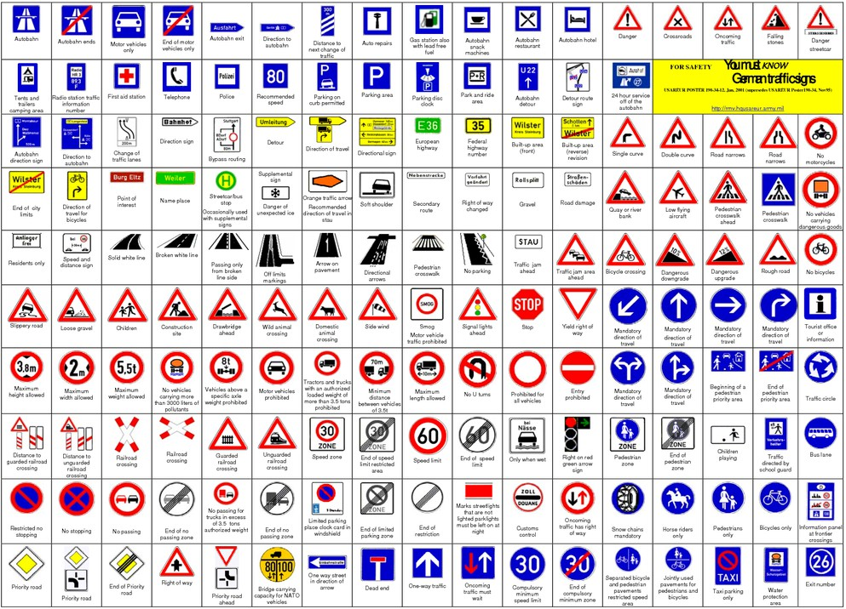

Slide 69
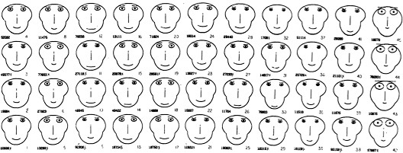
Chernoff Faces
Idea: use facial parameters to map quantitative data
Critique: https://eagereyes.org/criticism/chernoff-faces

Slide 70
Can we quantify channel effectiveness?

Slide 71
Why are quantitative channels different?
S = sensation I = intensity

Slide 72
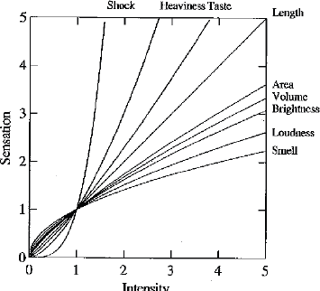
Steven’s Power Law, 1961
Electric
From Wilkinson 99, based on Stevens 61

Slide 73
How much longer?
A
2x
B

Slide 74
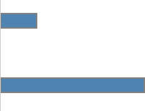
How much longer?
A
4x
B

Slide 75
How much steeper?
~4x
A
B

Slide 76
How much larger?
2x diameter 4x area
area is proportional to diameter squared
A
B

Slide 77
How much larger (area)?
3x
A
B

Slide 78
How much darker?
2x
A
B

Slide 79
How much darker?
3x
A
B

Slide 80
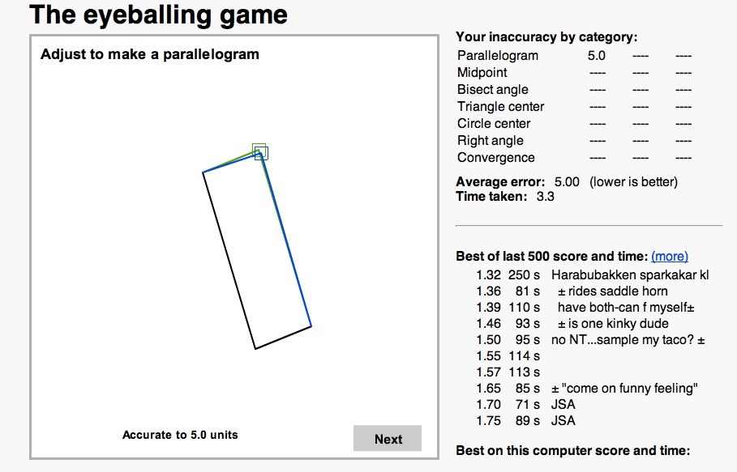
Position, Length & Angle
http://woodgears.ca/eyeball/index.html

Slide 81
Effectiveness Rankings
[Mackinlay 1986]
Quantitative
Position Length Angle Slope Area (Size) Volume
Density (Value) Color Saturation Color Hue Texture Connection Containment Shape
Ordinal
Position Density (Value)
Color Saturation Color Hue Texture Connection Containment Length
Angle Slope Area (Size) Volume Shape
Nominal
Position Color Hue Texture Connection Containment
Density (Value) Color Saturation Shape
Length Angle Slope Area Volume

Slide 82
Effectiveness Rankings
[Mackinlay 1986]
Quantitative Ordinal
Nominal
Position Color Hue Texture Connection Containment Density (Value)
Color Saturation Shape
Length Angle Slope Area Volume
Position Length Angle Slope
Position
Density (Value) Color Saturation Color Hue Texture Connection Containment Length
Angle Slope Area (Size) Volume Shape
Area (Size) Volume Density (Value)
Color Saturation Color Hue Texture Connection Containment Shape

Slide 83
Effectiveness Rankings
[Mackinlay 1986]
Quantitative
Position Length Angle Slope Area (Size) Volume
Density (Value) Color Saturation
Color Hue
Texture Connection Containment Shape
Ordinal
Position Density (Value)
Color Saturation
Color Hue Texture Connection Containment Length Angle
Slope Area (Size) Volume Shape
Nominal
Position
Color Hue Texture Connection Containment Density (Value) Color Saturation Shape
Length Angle Slope Area Volume

Slide 84
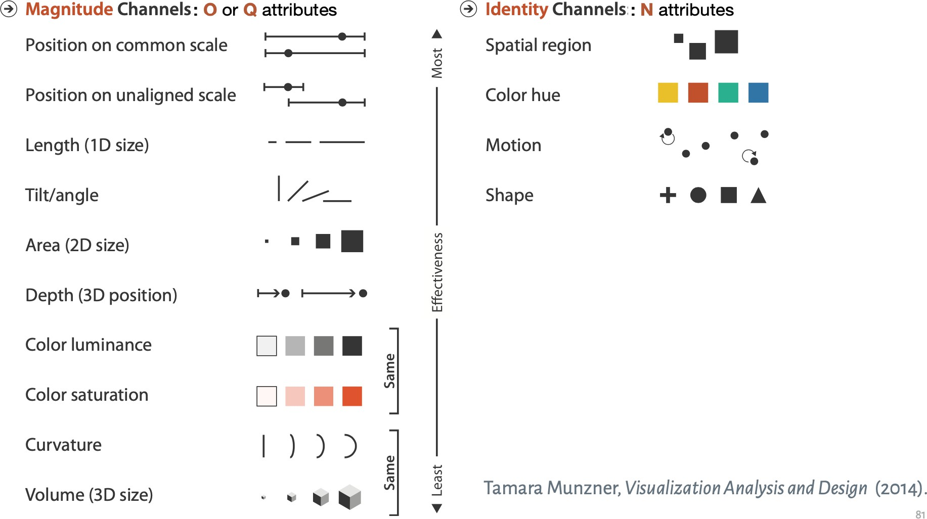
Modernization of Visual Channels

Slide 85
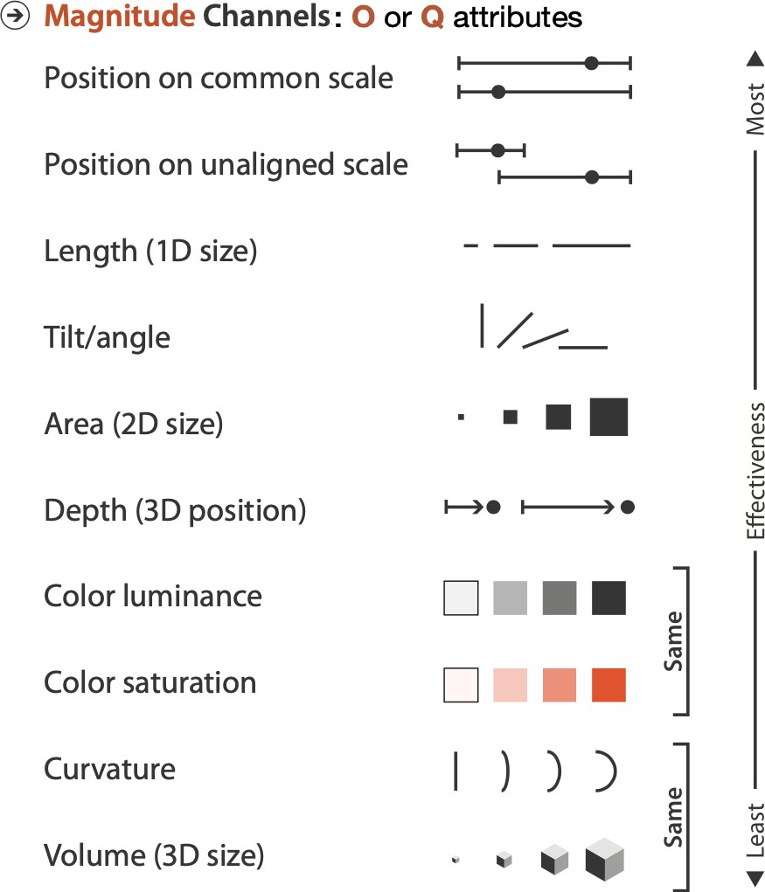
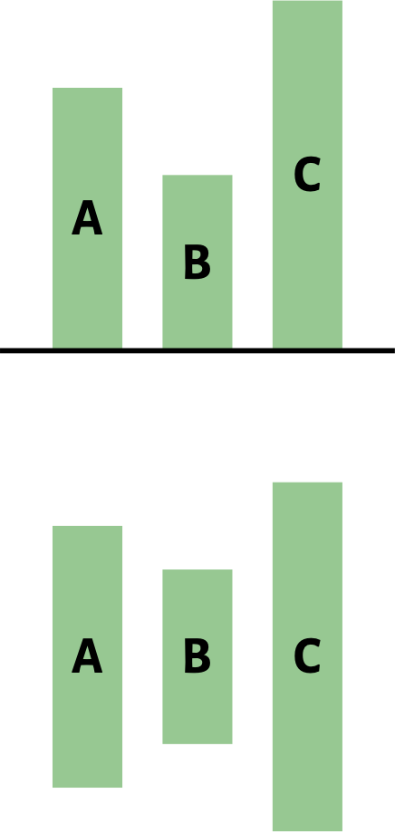
Choose Effective Encodings

Slide 86
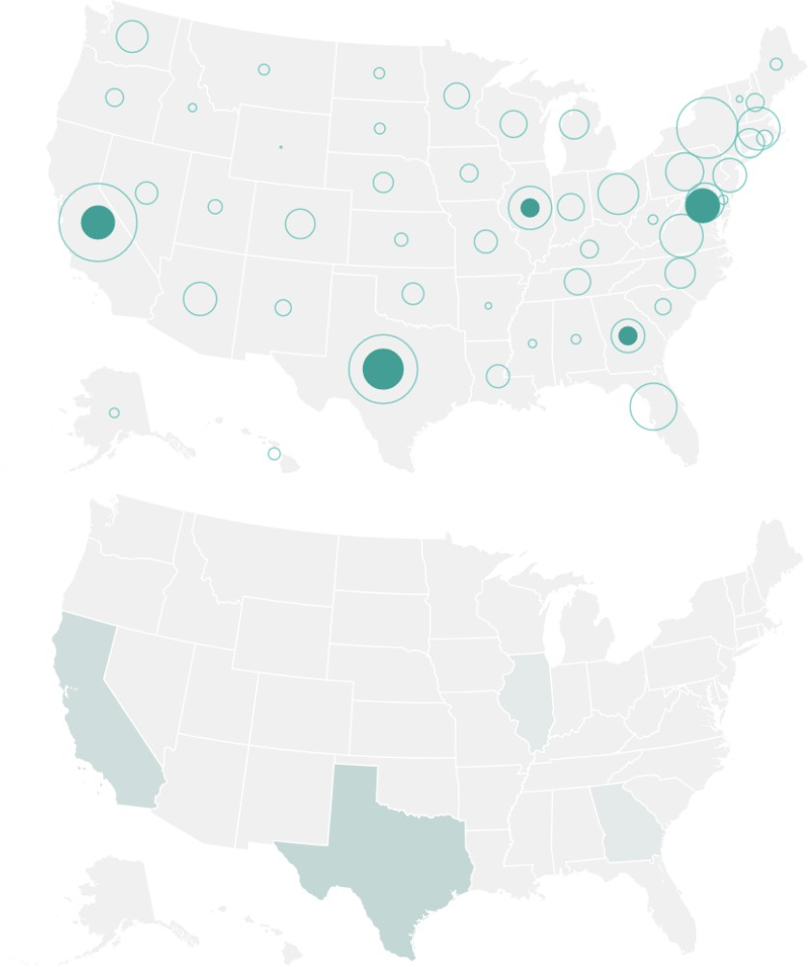
Choose Effective Encodings

Slide 87
Modernization of Visual Channels

Slide 89
Standard first, custom second

Slide 90
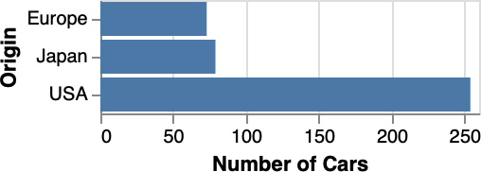
Discrete categories
Bars are most eﬀective
Use points/ticks when measure is not a count

Slide 91
Sideways layout means readable labels

Slide 92
Histograms for distributions

Slide 93
Distributions with multiple categories

Slide 94
Line charts for time series

Slide 95
Compare values with aligned charts

Slide 96
Make bar charts, not word clouds
Longer words get more visual weight, which is not good.

Slide 97
Guiding Principles
Make the important visible
Three simple, flexible tools
Color, Facets, Order

Slide 98
Make the important visible

Slide 99
Texas in Feb 2021. Winter storm.
Rolling blackouts initiated to save the grid.
https://www.texastribune.org/series/winter-storm-power-outage/?page=8

Slide 100
Common task: compare forecast vs actuals.
What do you notice?
What do you care about?

Slide 101
Differences!

Slide 102
Just the difference

Slide 103
Is the perceived difference the actual difference?

Slide 104
Make the important visible (and noticeable)
We intentionally dropped information to focus on what’s most important to us.

Slide 105
Make the important visible
Write down what is important.
Look at your chart. Is it visible? Literally.
Sketch (on paper) the chart the you want.

Slide 106
Three simple, flexible tools
Color, Small Multiples, Order.

Slide 107
Use descriptive titles and annotations
[Elavsky]

Slide 108
Your job: explain the squiggle
https://observablehq.com/@observablehq/twosimpleflexibletoolswhatcausedthis
96

Slide 109
Start with the standard line chart: one line per fuel type

Slide 110
Make Color Meaningful

Slide 111
Make Color Meaningful

Slide 112
Make Color Meaningful: to focus our attention

Slide 113
Why aren't we just stacking it?
Very sensitive to order!

Slide 114
Order matters

Slide 115
Faceting

Slide 116
Faceting

Slide 117
Three* simple, flexible tools
Make color meaningful.
Create facets.
Order matters
*(bonus) Use text to guide attention and retention
[Elavsky]

Slide 118
Color
Semantic for categories
Color to provide context or focus attention on category
Color to encode continuous data
or period of interest

Slide 119
Faceting

Slide 120
Order matters
Letters of the Alphabet,
ordered by alphabetical order
Letters of the Alphabet,
ordered by frequency

Slide 121
Order matters
https://observablehq.com/@observablehq/twosimpleflexibletoolswhatcausedthis

Slide 122
Beyond Encoding Choices
"Chart Junk”
Charts as messages: know your audience! Eﬀective color mappings
Correct use of scales Aspect ratio
Provide context

Slide 123
Design Choices Make a Difference
Borkin et al. Artery Visualization, 2011
Rainbow Diverging
62% 91%
39%
71%
[Elavsky]

Slide 124
“Chart Junk” and embellishments
[Bateman et al., CHI 2010 and Akbaba, 2021]
[Elavsky]

Slide 125
Is this a data visualization? Why or why not?
Federica Fragapane, Scientific American 2019
[Elavsky]

Slide 126
Is this a data visualization? Why or why not?
Federica Fragapane, Scientific American 2019
[Elavsky]

Slide 127
Are these?
Mona Chalabi, 2018 and 2019
[Elavsky]

Slide 128
Design Critique

Slide 129
A Record Year for Auto Recalls
NY Times: http://bit.ly/auto-recall

Slide 130
A Record Year for Auto Recalls
In your discussion group please answer the following questions:
What audience is this designed for?
What is the data shown in this visualization?
What are the marks, what are the channels?
What questions does this visualization answer?
What do you think about the use of animation?
Is the visualization easy to understand?
Is it memorable?
Engaging?
Can you read the data from the visualization?
Why do you like / dislike this visualization?
Can you suggest any improvements? How would you redesign it?
[Elavsky]

