Slide 1
Data Visualization Accessibility
Invited Talk, Northwestern MSiA, Jan 2023
axle-lab.com
Thinking about data visualization for people with disabilities.
Frank Elavsky, PhD student at Carnegie Mellon University

Slide 2
Who am I? A data visualization + accessibility researcher and engineer
Research: Carnegie Mellon and Apple.
Organize: DataVizA11y.
Contribute: W3C’s ARIA Working Group as an invited expert.
Create: Tools for designers and engineers who want to make accessible visualizations.

Slide 3
Creators
3

Slide 4
Creators
Tools
4

Slide 5
Creators
Tools
Things
5

Slide 6
Creators
Tools
Things
Future Things
6

Slide 7
But how much of this is inaccessible?
Creators
Tools
Things
Future Things
7

Slide 8
97-99.9%
Creators
Tools
Things
Future Things
Source: World Wide Web Consortium. “The WebAIM Million.”
8

Slide 9
Dreaming of ideals
Creators
Tools
Things
Future Things
9
Notes:
Common, the way most people do this work

Slide 10
The knowledgeable “specialist” intervenes
Creators
Tools
Things
Future Things
10
Notes:
Common, the way most people do this work

Slide 11
We change our systems, laws, and environments
Creators
Tools
Things
Future Things
11

Slide 12
We give creators better tools
Creators
Tools
Things
Future Things
12

Slide 13
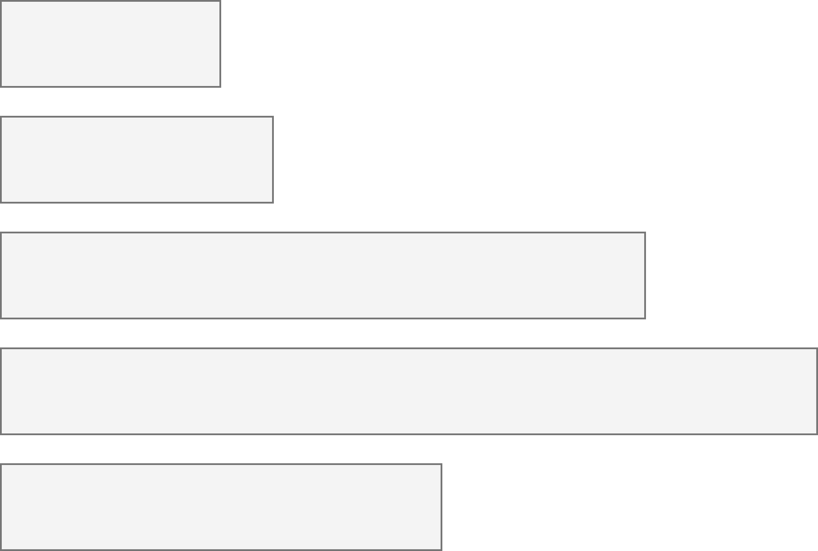
26% of people living in the United States self-report living with a disability that affects their daily life.
4.1%
Color Vision Deficiency
4.5%
Blindness, Low Vision
10.8%
Cognitive, Neurological
13.7%
Motor, Dexterity
7.4%
Vestibular, Motion
Source: Okoro et al. “Prevalence of Disabilities and Health Care Access by Disability Status and Type Among Adults”
Introduction - Example - Design - Evaluation - Results - Future Work
Notes:
But how do designers, developers, and creators of visualizations know whether something they’ve made is accessible or not for people with disabilities?

Slide 14
Every area of disability affects data visualization work.
Color Vision Deficiency
Visual design
4.1%
Non-visual design
4.5%
Blindness, Low Vision
Narrative design, statistics, storytelling
10.8%
Cognitive, Neurological
13.7%
Motor, Dexterity
Interaction design, device considerations, performance
7.4%
Vestibular, Motion
Animation, transitions
Introduction - Example - Design - Evaluation - Results - Future Work
Notes:
But how do designers, developers, and creators of visualizations know whether something they’ve made is accessible or not for people with disabilities?

Slide 15
What you will learn today
What is accessibility?
What are the social and medical models of disability?
What are “ability assumptions”?
What is “situational” disability or impairment?
What are some ways to think about accessibility in your own work?

Slide 16
Discuss: What is accessibility?
Bonus discussion:
What is “Inclusive Design” and how is it different from accessibility?

Slide 17
Accessibility (some working definitions):
1. The qualities that make an experience open or usable to all.
2. The qualities that make an experience open or usable specifically for people with disabilities.

Slide 18
26% are disabled. Now what?
4.1%
Color Vision Deficiency
4.5%
Blindness, Low Vision
10.8%
Cognitive, Neurological
13.7%
Motor, Dexterity
7.4%
Vestibular, Motion
Source: Okoro et al. “Prevalence of Disabilities and Health Care Access by Disability Status and Type Among Adults”
Introduction - Example - Design - Evaluation - Results - Future Work
Notes:
But how do designers, developers, and creators of visualizations know whether something they’ve made is accessible or not for people with disabilities?

Slide 19
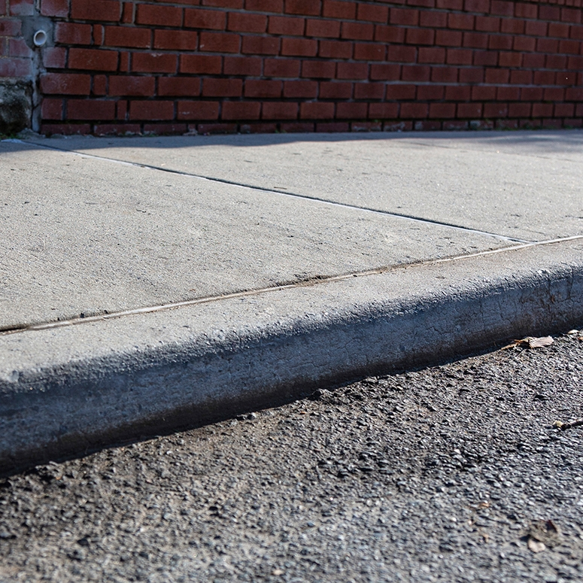
Concept: social vs medical models of disability
a “curb”

Slide 20
What do we do about curbs in our cities?

Slide 21
Medical model: the body is the cause of disability (according to normative standards).

Slide 22
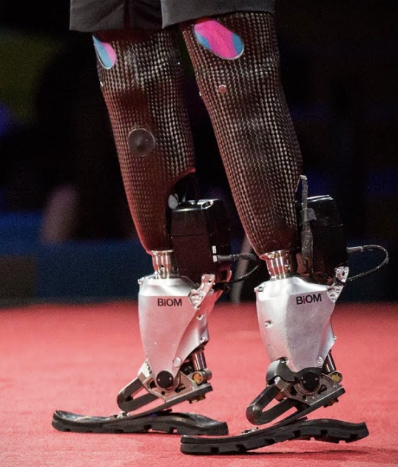
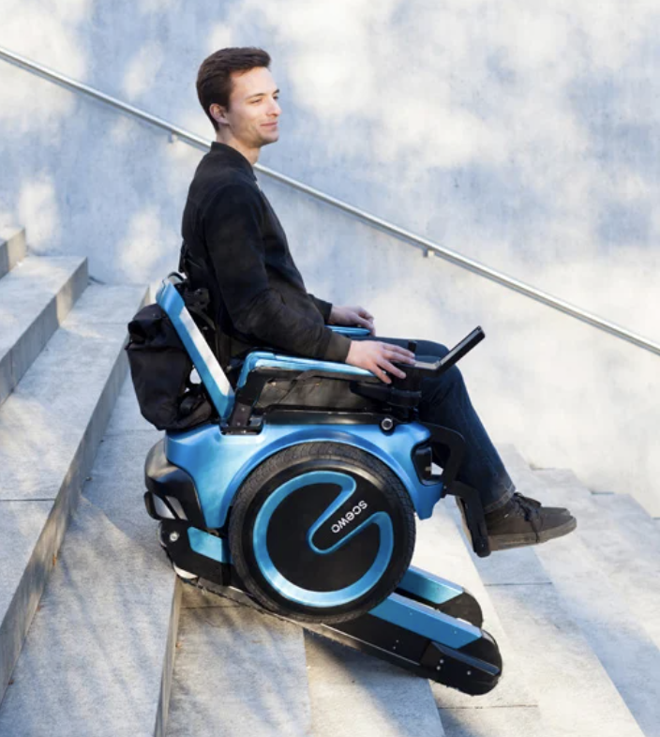
Medical model: augment or “cure” the body.

Slide 23
Social model: The curb is the source of disability (a “barrier” to access).

Slide 24
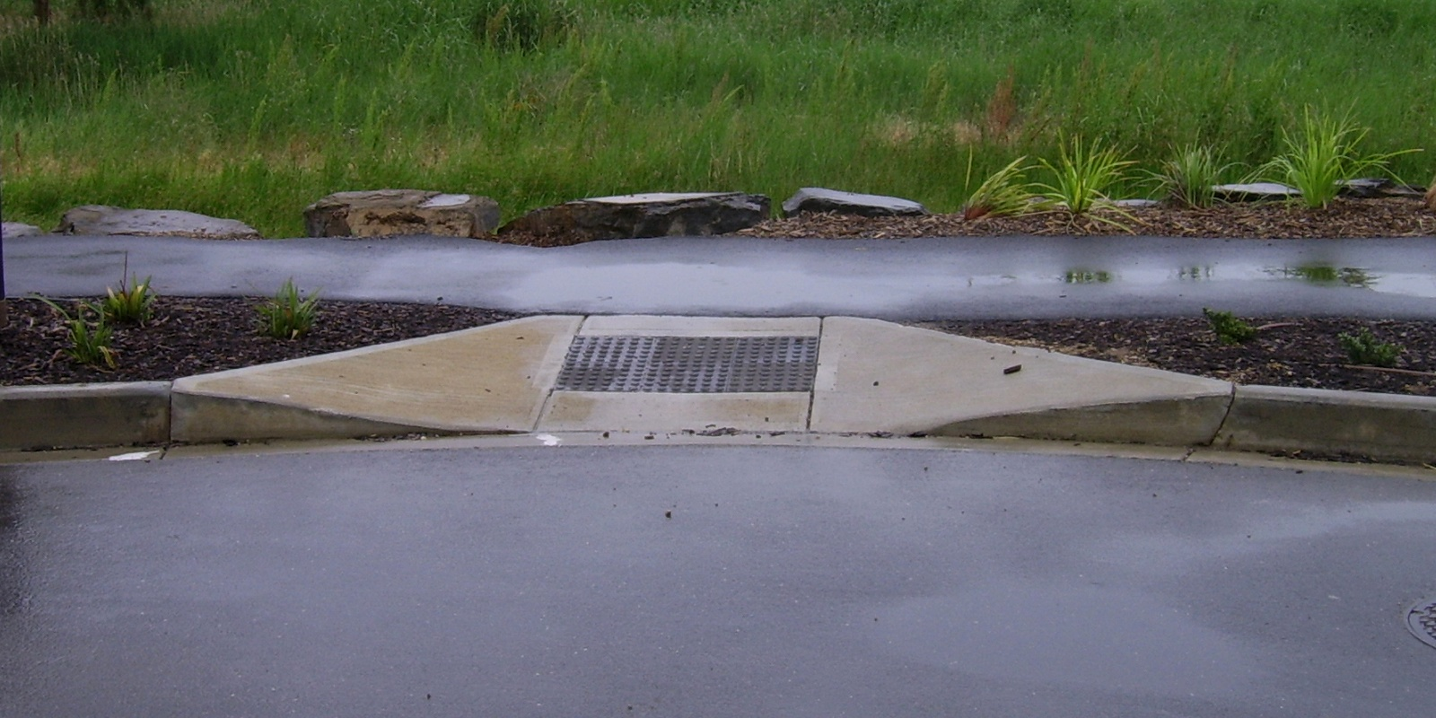
Social model: Cut the curb.

Slide 25
Discuss: Why do people do this work?

Slide 26
Access is a human right
Accessibility is an internationally recognized human right.
It is the morally and ethically correct thing to do.
https://www.un.org/development/desa/disabilities/convention-on-the-rights-of-persons-with-disabilities/article-9-accessibility.html
https://www.un.org/development/desa/disabilities/convention-on-the-rights-of-persons-with-disabilities/article-10-right-to-life.html

Slide 27
It is expensive to exclude accessibility

Slide 28
15% of time spent on accessibility…
… for 26% of all people
It is expensive to exclude accessibility

Slide 29
Fixing inaccessibility takes 1.5 – 10x more time if done after something is built.

Slide 30
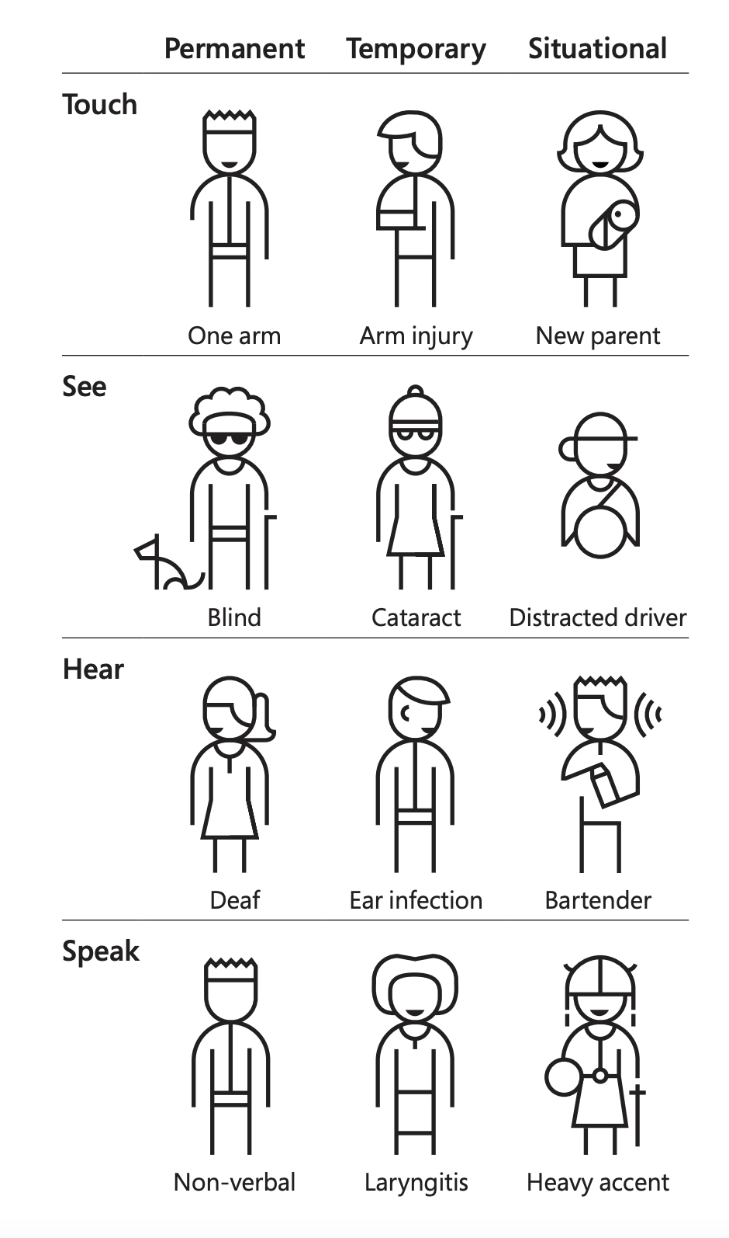
Concept: Situational Impairment “Design for One, Extend to All”
Microsoft’s Inclusive Design 101 Toolkit: https://download.microsoft.com/download/b/0/d/b0d4bf87-09ce-4417-8f28-d60703d672ed/inclusive_toolkit_manual_final.pdf

Slide 31
We all experience situational impairment in our daily lives. Accessibility benefits everyone!

Slide 32
Discuss: Share an example where you might be impaired in some way and how accessible technology or infrastructure helps you.

Slide 33
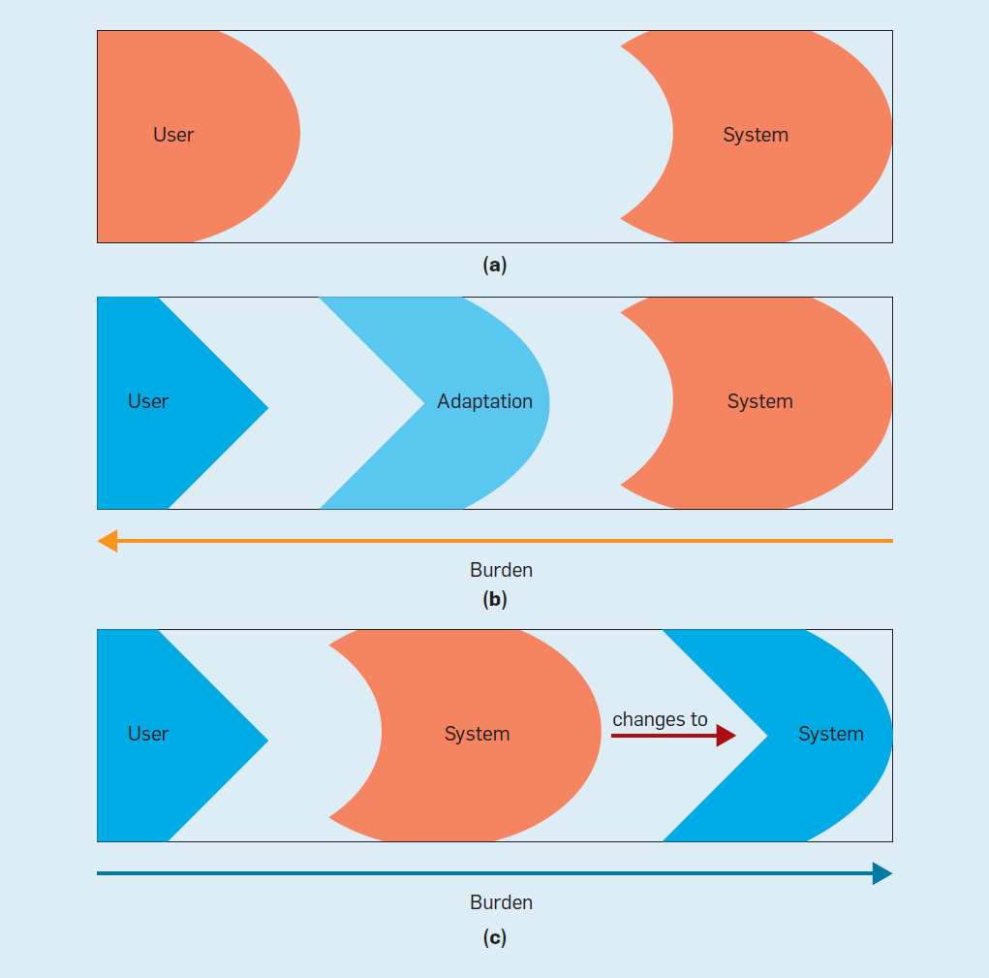
Concept: Ability Assumptions
(Wobbrock et al) https://cacm.acm.org/magazines/2018/6/228034-ability-based-design/fulltext

Slide 34
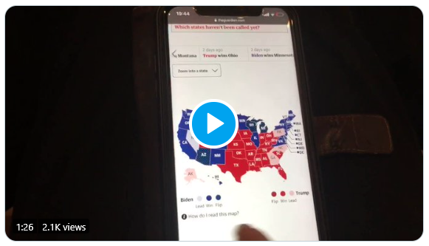
What is an inaccessible experience like?
Credit: Sarah Fossheim on twitter

Slide 35
Demo: Using a screen reader
Mac users: VoiceOver
Windows users: NVDA (requires download)

Slide 36
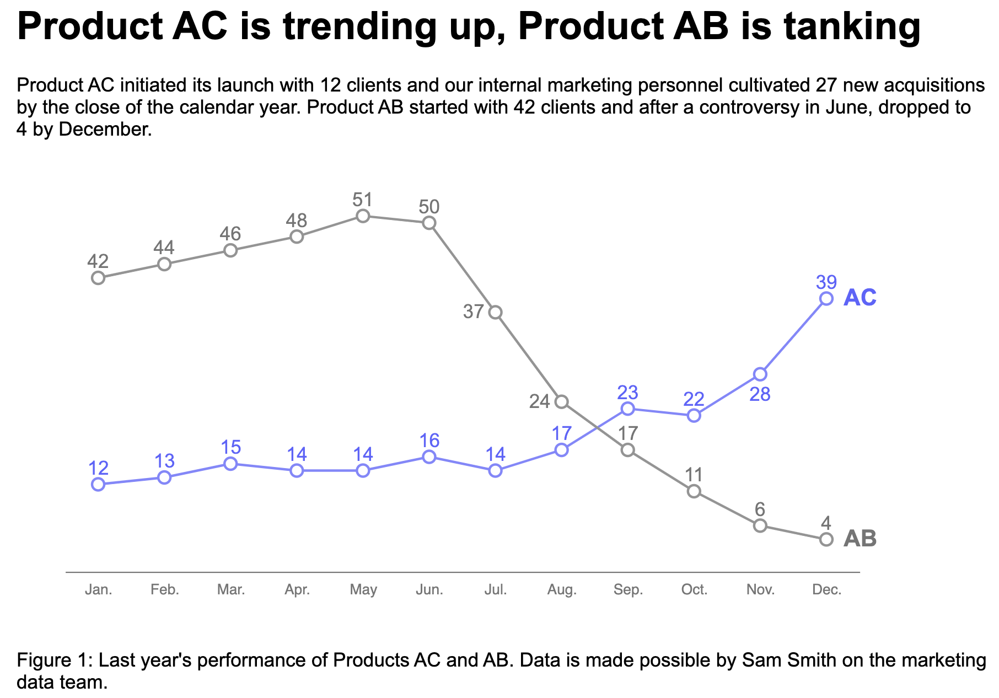
Explore: An interactive bar chart
https://frankelavsky.github.io/assessing_chart_interactivity/

Slide 37
A methods question: How do you know something is inaccessible?

Slide 38
Listen to people with disabilities.

Slide 39
There are a lot of ways to listen to PWD:
Actually ask them!
Find where they are already speaking
Find where they have already spoken:
Research
Blog posts
Accessibility standards

Slide 40
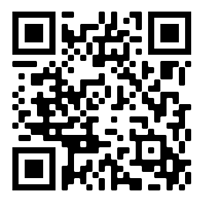
How do you make a visualization accessible?
Let’s vote on which principle we go over today!
bit.ly/viz_a11y_uc_poll
1. Perceivable: Contrast, color, alt
2. Operable: Keyboard and SR access
3. Understandable: Textual descriptions and simplicity

Slide 41
Perceivable
Can someone perceive this in multiple ways? Is each way easy?

Slide 42
Perceivable Checklist:
High Contrast
CVD-Safe + Redundant Encoding
Alt Text

Slide 43
Design with high contrast
Colorblindness Disproportionately Overrepresented in A11y Resources
Colorblindness Disproportionately Overrepresented in A11y Resources
Colorblindness: % of People
Colorblindness: % of People
4%
4%
Low Vision: % of People
Low Vision: % of People
25%
25%
Colorblindness: # of Resources
Colorblindness: # of Resources
51
51
Low Vision: # of Resources
Low Vision: # of Resources
5
5
Notes:
https://projects.susielu.com/viz-palette

Slide 44
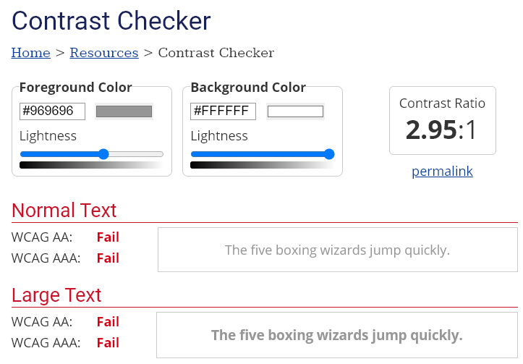
Use High Contrast Text
Text needs at least 4.5:1 contrast against its background.
Large text (bold and 16pt or larger) can be 3:1 or higher.

Slide 45
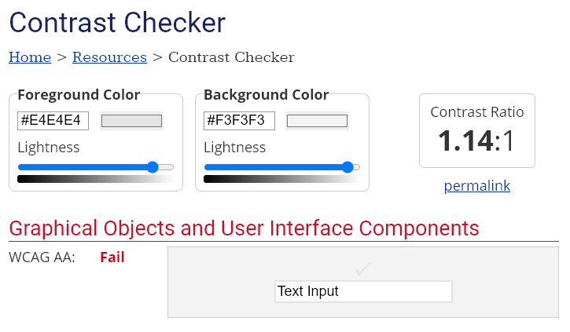
Use High Contrast Geometries
Chart elements need at least 3:1 contrast against their background.

Slide 46
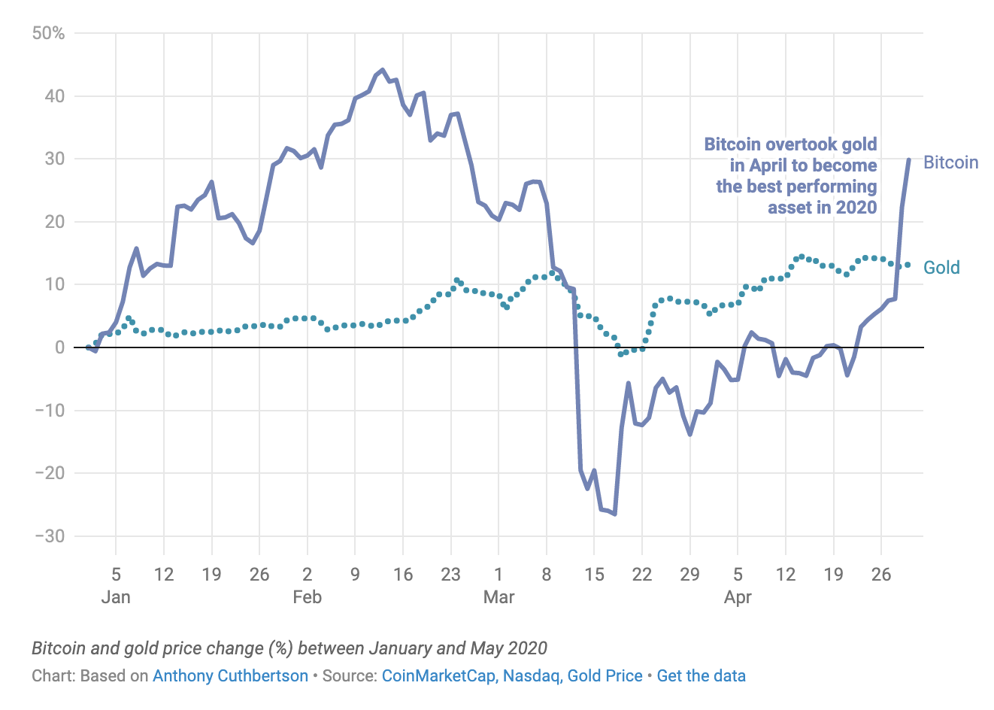
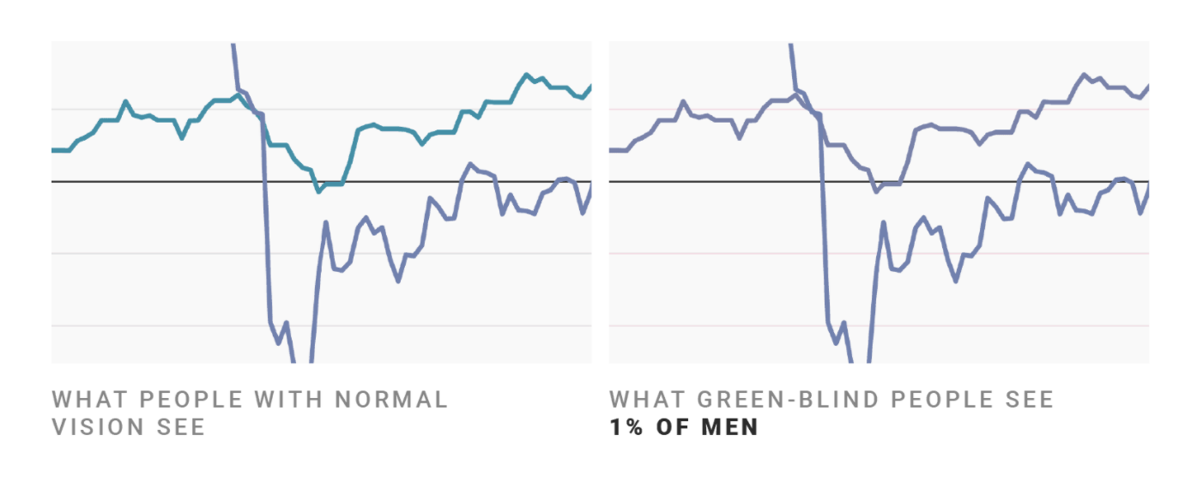
Don’t rely on color alone!
(Muth) https://blog.datawrapper.de/colorblindness-part2/

Slide 47
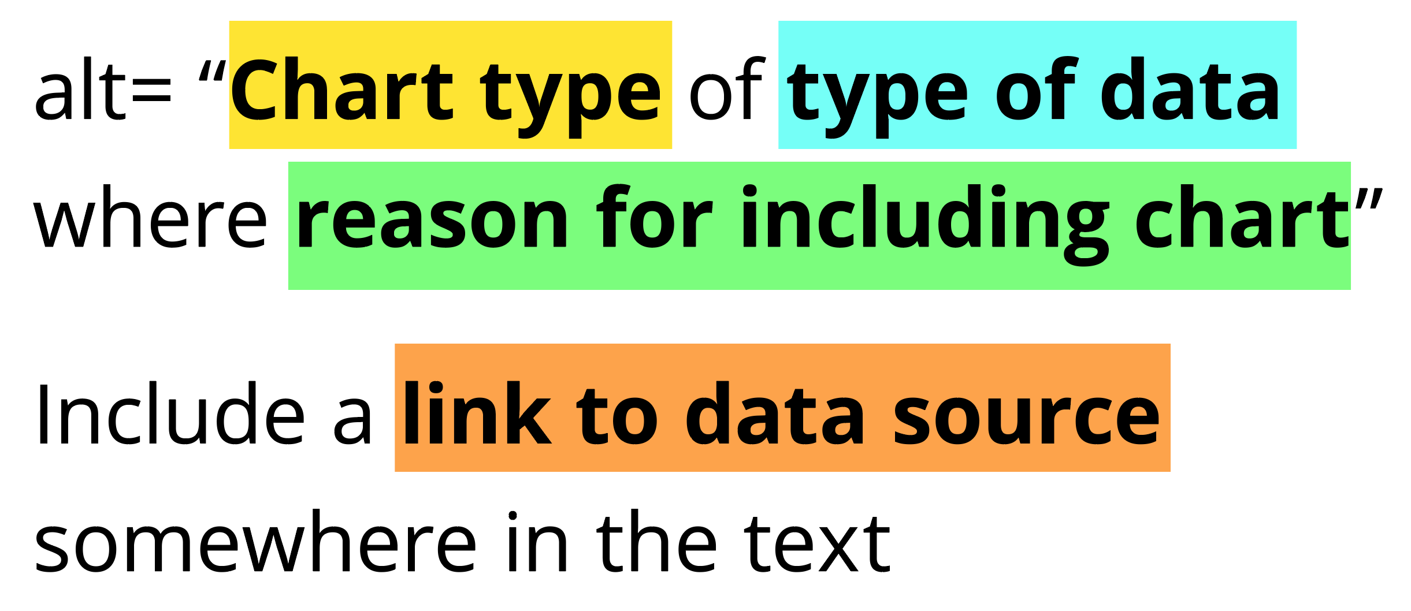
Add alt text
There is great research on alt text, but the most important thing to know is that you should add it to every image you post online (including twitter), in a document, or presentation.
Guidance: https://medium.com/nightingale/writing-alt-text-for-data-visualization-2a218ef43f81

Slide 48
Perceivable Evaluation Toolkit:
Contrast Checker
Safe color design
CVD Checker
Redundant encoding design ideas
Alt Text

Slide 49
Operable
Can someone operate this in multiple ways? Is each way easy?

Slide 50
Operable Checklist:
Mouse
Keyboard-only
Screen Reader

Slide 51
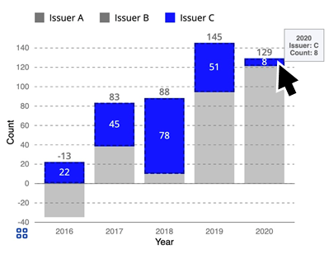
Ensure Keyboard Access (if interactive)

Slide 52
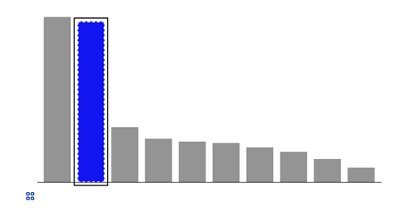
Indicate keyboard focus, use multi-modal style
This is a keyboard focus indicator (outer border) with the same styling effect applied on mouse hover (inner dashed white lines and blue fill)

Slide 53
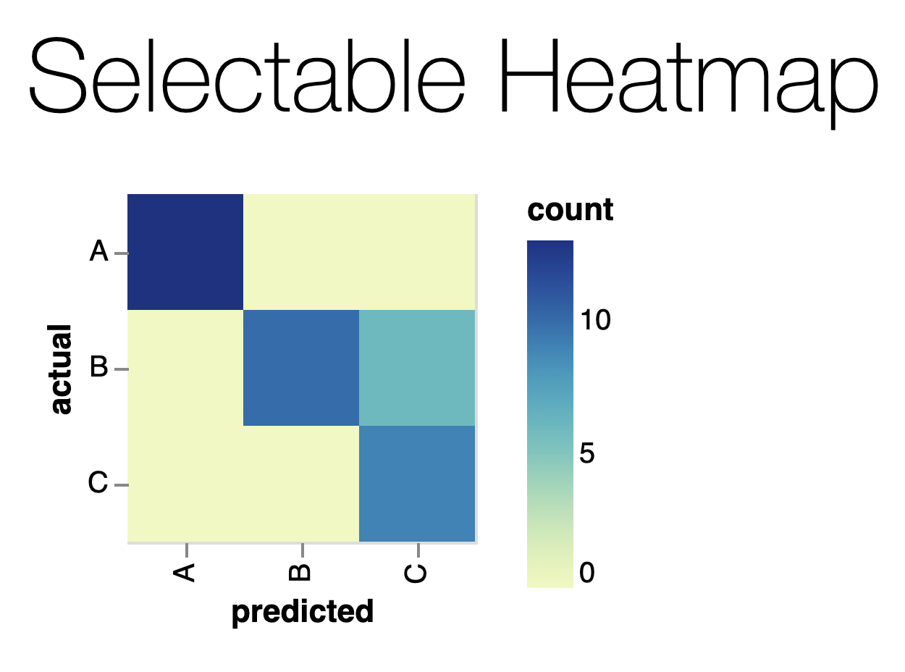
Why Keyboard-only?
Some things work for screen readers but not for keyboard-only users!
https://vega.github.io/vega-lite/examples/selection_heatmap.html

Slide 54
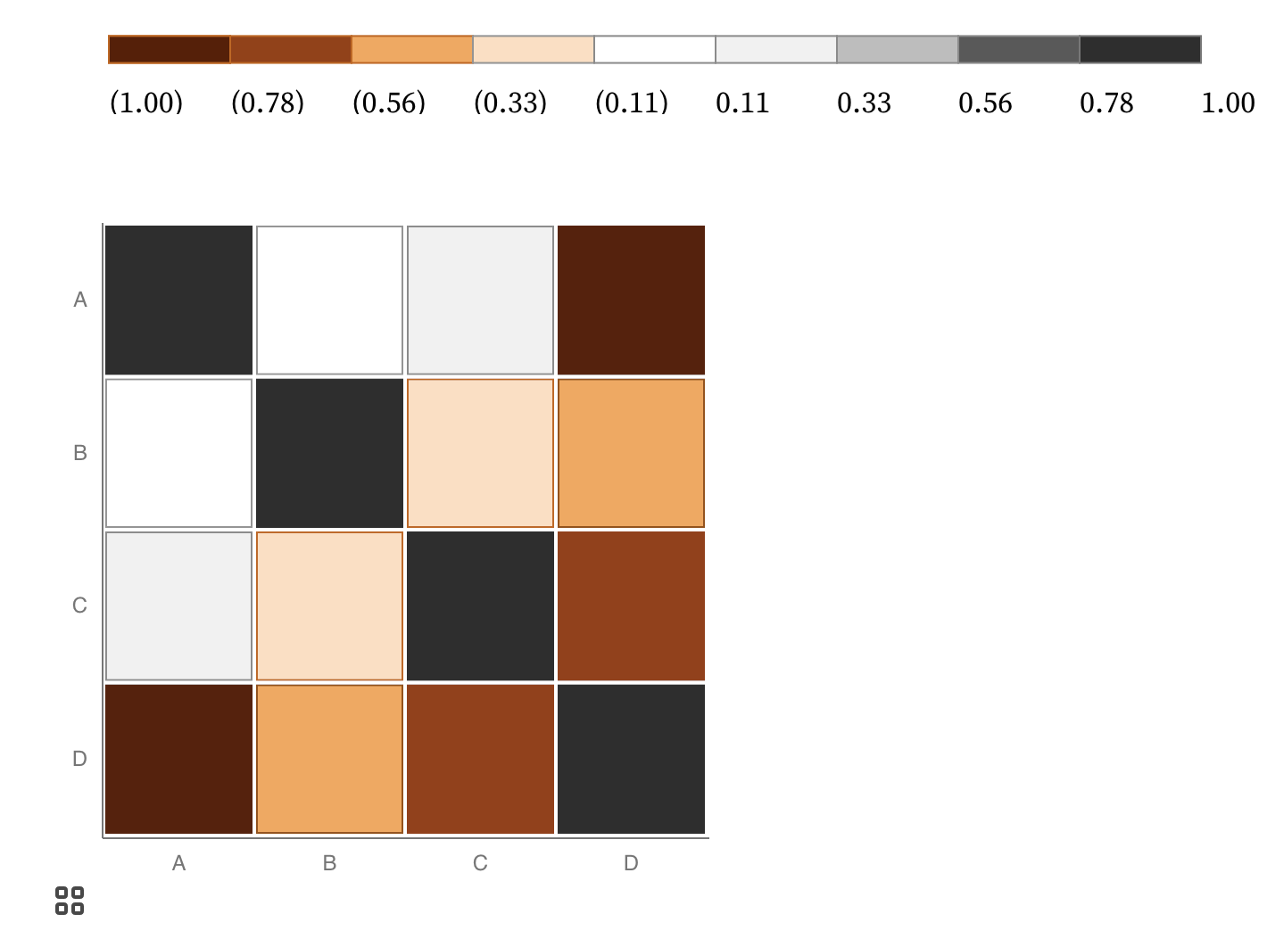
Keyboard only example:
https://observablehq.com/@frankelavsky/experimental-color-scale-textures

Slide 55
Operable Evaluation Toolkit:
Use your mouse: can it do something meaningful? (tooltip, click event, etc) If so:
Test using a keyboard-only: can you navigate and use keyboard activation (spacebar/enter) on the visualization?
Test using a screen reader: Can you use a screen reader to navigate and use keyboard activation on the visualization?

Slide 56
Understandable
Can someone understand this in multiple ways? Is each way easy?

Slide 57
Understandable Checklist:
Descriptive title, summary, or caption
Data table or data download
Reading level

Slide 58
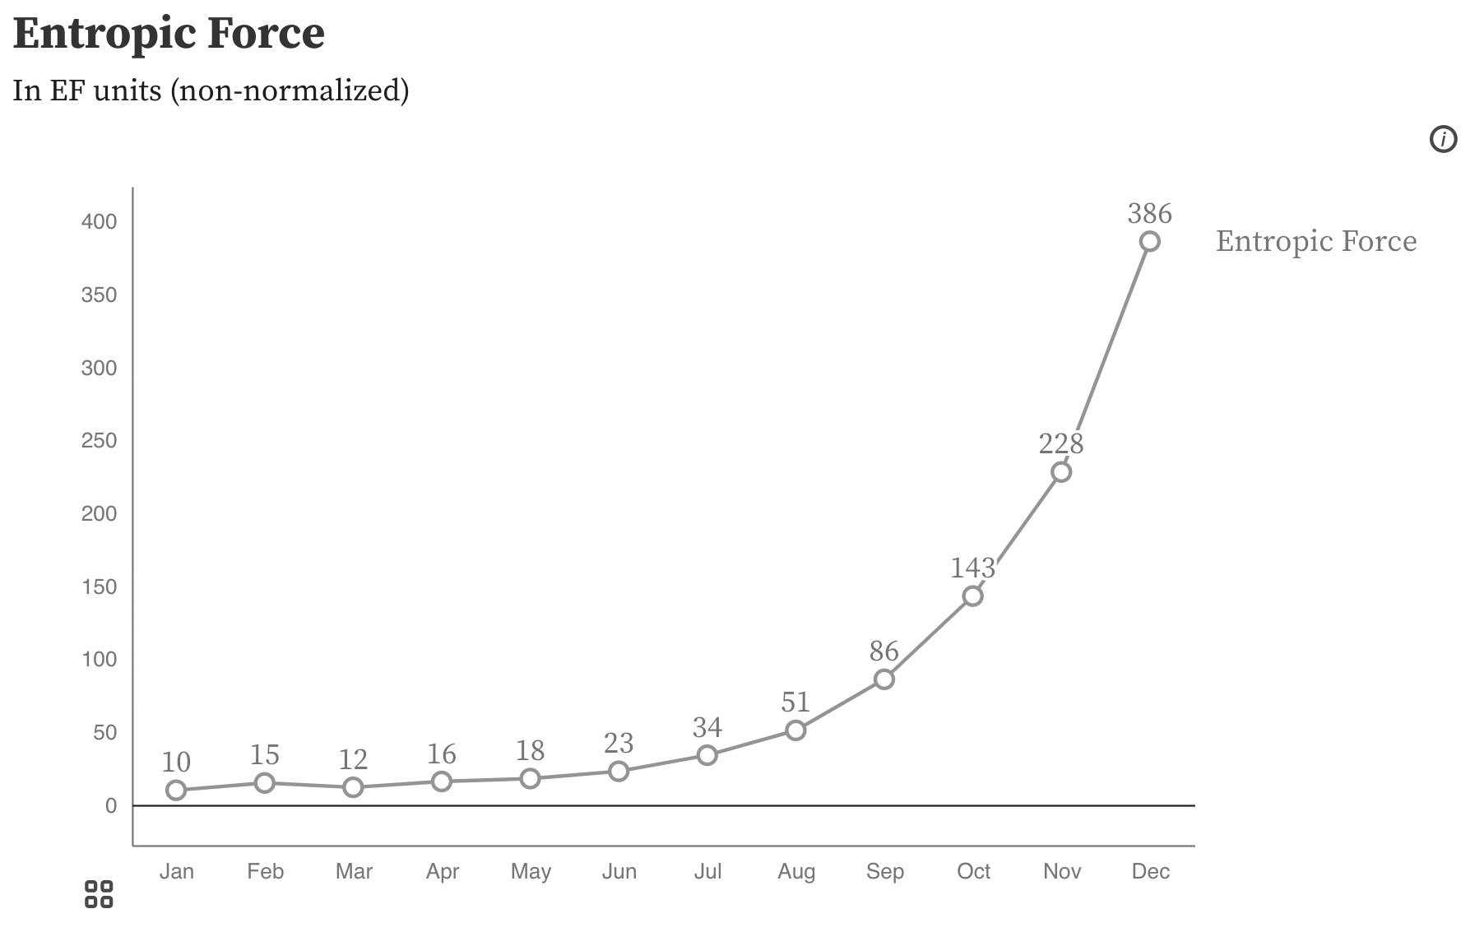
Non-descriptive titles are inaccessible

Slide 59
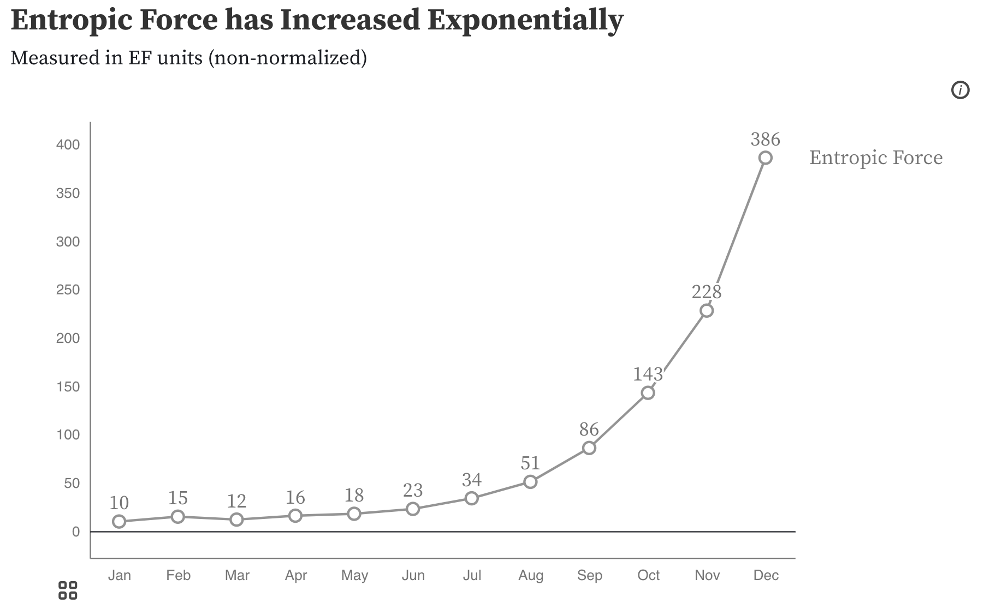
Descriptive titles have summaries/takeaways

Slide 60
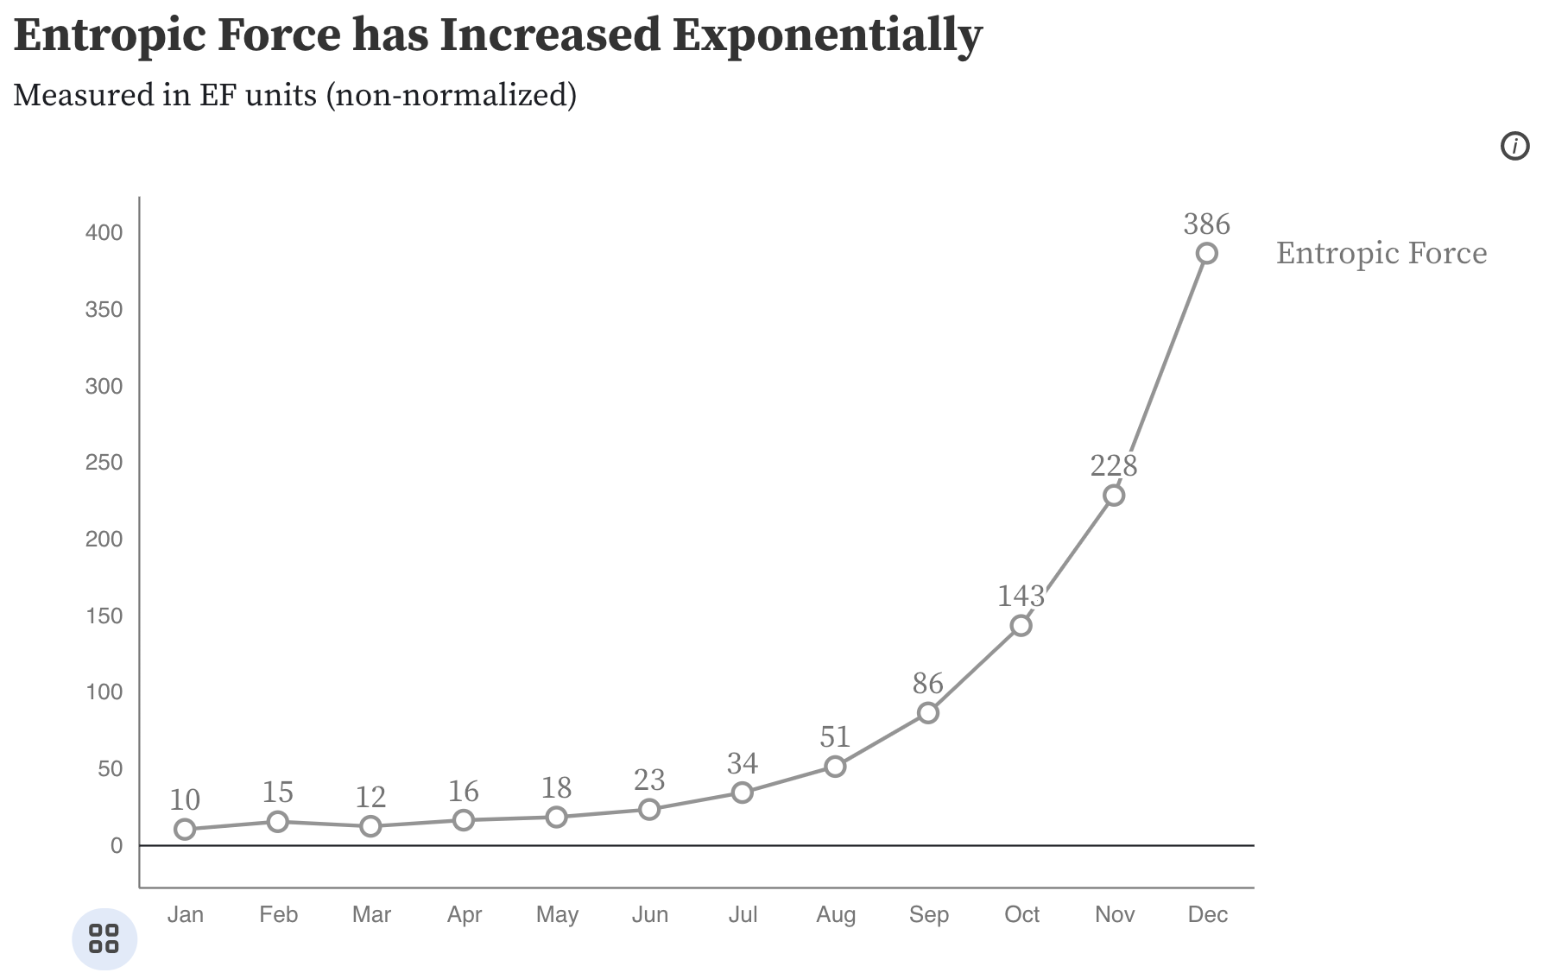
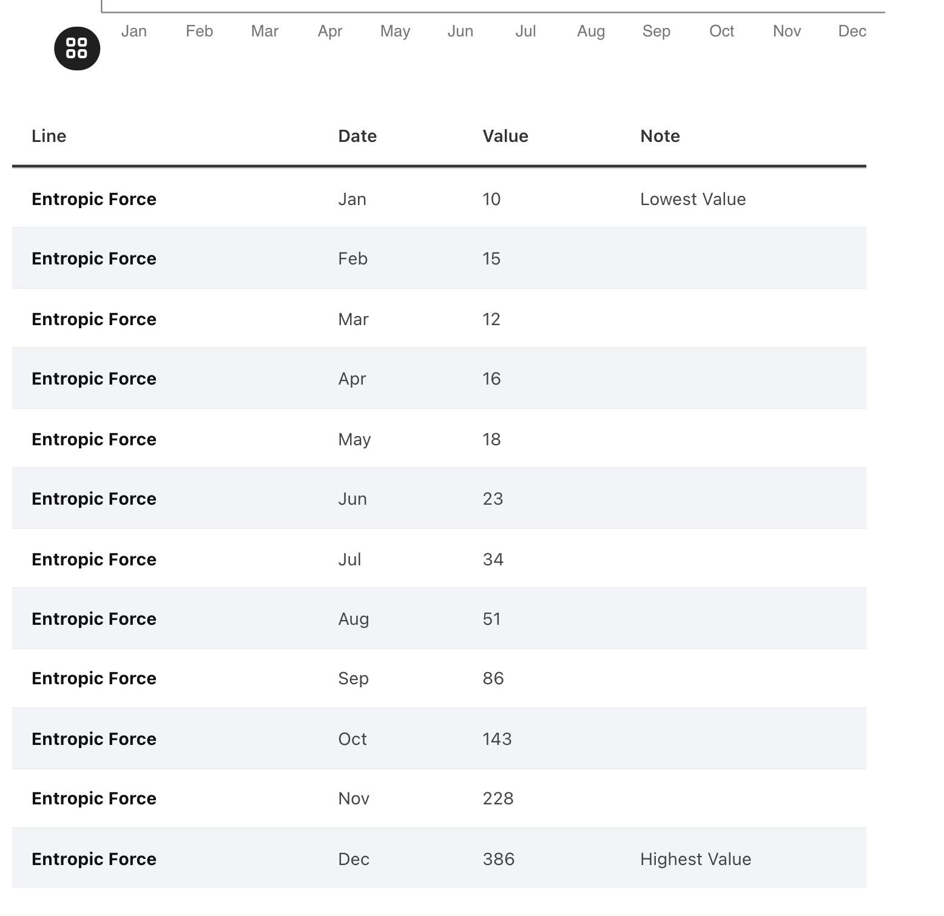
All charts should have data available!

Slide 61
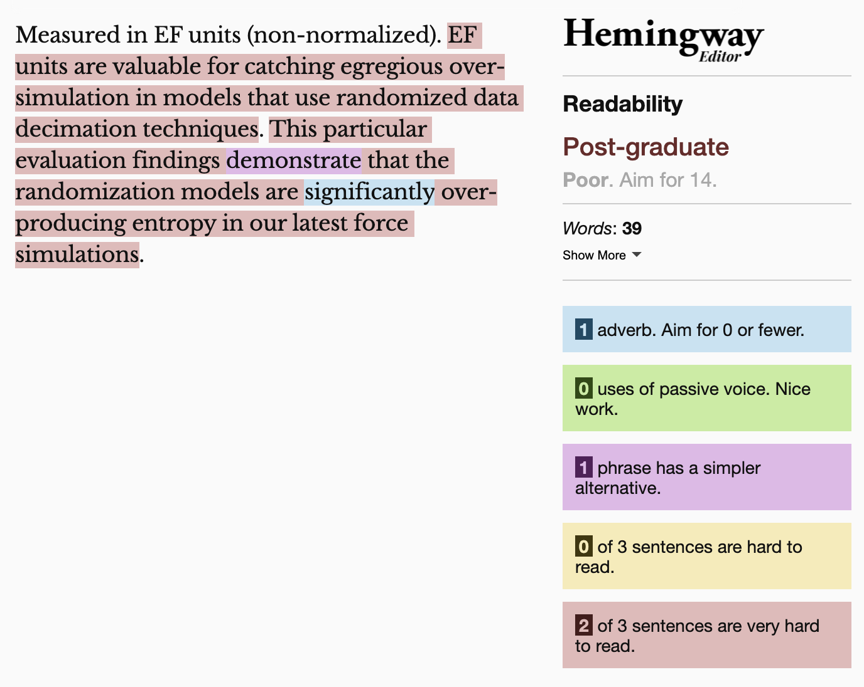
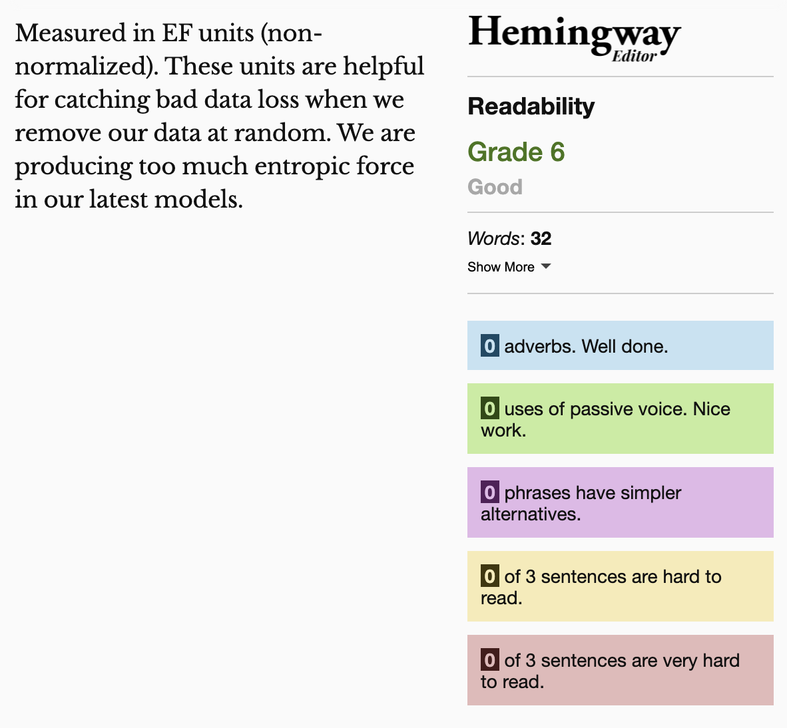
Keep summaries as non-technical as possible
If the topic is technical, provide a “plain language” summary somewhere close by that is easy to find (either in the same location or with by providing a link).

Slide 62
Understandable Evaluation Toolkit:
Is there a descriptive title, summary, or caption?
Is there an accessible table or downloadable data file provided?
Is the descriptive text supporting the visualization presented at a reading level at grade 9 or below?

Slide 63
Q/A
Happy to answer questions about how to do this work professionally (design, engineering, research, education)
as well as any questions about data visualization and accessibility more broadly (including tools, challenges, what lies in the future)

Slide 64
Resources
A resources repository!
My twitter (@FrankElavsky)
Chartability

