Slide 1
CHARTABILITY
Frank Elavsky, Comm Talk, 2022 @FrankElavsky
frank.computer/chartability
How accessible is my visualization? Evaluating visualization accessibility with Chartability.
hcii.cmu.edu
by Frank Elavsky, Cynthia Bennett, Dominik Moritz
axle-lab.com
dig.cmu.edu

Slide 2
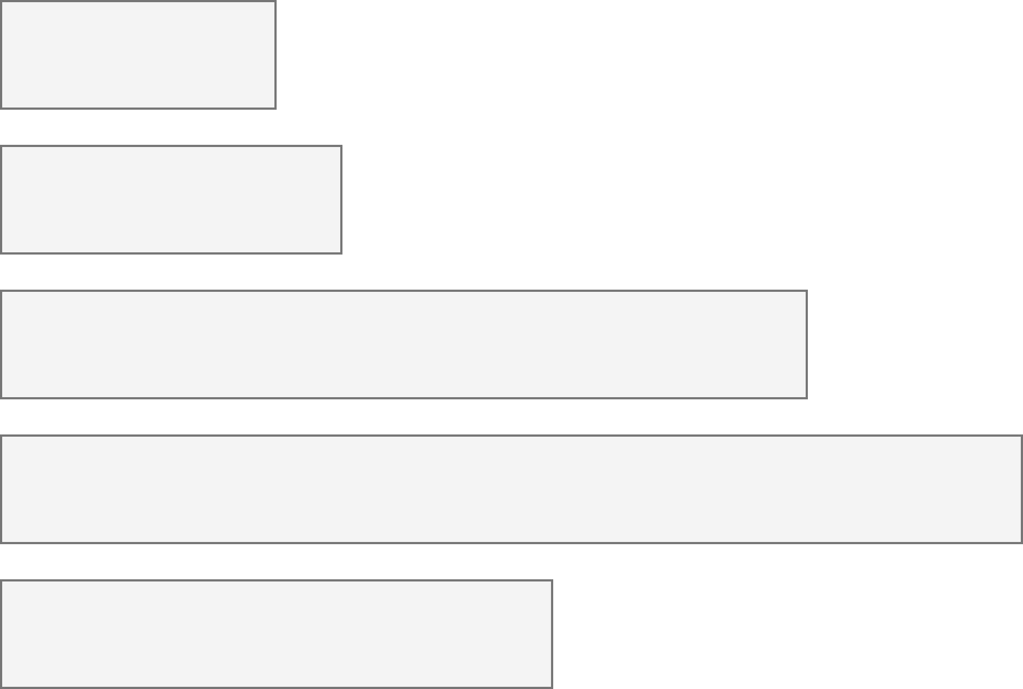
26% of people living in the United States self-report living with a disability that affects their daily life.
4.1%
Color Vision Deficiency
4.5%
Blindness, Low Vision
10.8%
Cognitive, Neurological
13.7%
Motor, Dexterity
7.4%
Vestibular, Motion
Source: Okoro et al. “Prevalence of Disabilities and Health Care Access by Disability Status and Type Among Adults”
Introduction - Example - Design - Evaluation - Results - Future Work
Notes:
But how do designers, developers, and creators of visualizations know whether something they’ve made is accessible or not for people with disabilities?

Slide 3
However, 97 – 99% of the top million websites analyzed each year have accessibility failures.
Source: Webaim Million Report, 2022
Introduction - Example - Design - Evaluation - Results - Future Work

Slide 4
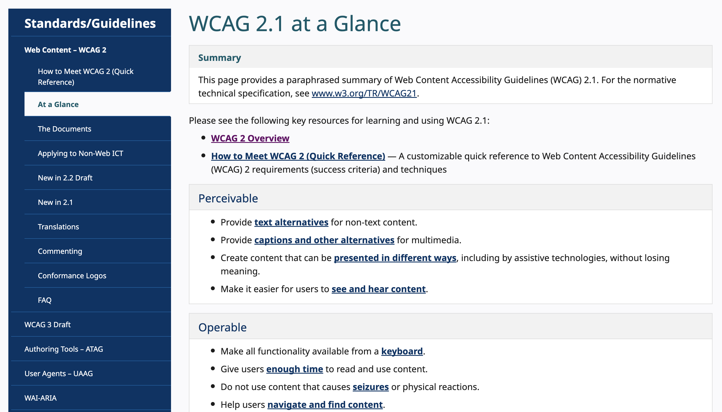
Web Content Accessibility Guidelines (WCAG), May 1999 - Present
Source: Web Content Accessibility Guidelines, 2023
Introduction - Example - Design - Evaluation - Results - Future Work
4

Slide 5
WCAG informs policy for 55% of the world’s population.
Source: WAI Laws and Policy, 2018
Introduction - Example - Design - Evaluation - Results - Future Work
5

Slide 6
Perceivable:
Different ways of perceiving.
Introduction - Example - Design - Evaluation - Results - Future Work
6
Notes:
Make more of a note!!!

Slide 7
Perceivable:
Different ways of perceiving.
Operable:
Different ways of interacting.
Introduction - Example - Design - Evaluation - Results - Future Work
7
Notes:
Make more of a note!!!

Slide 8
Perceivable:
Different ways of perceiving.
Operable:
Different ways of interacting.
Understandable:
A minimum level of comprehension.
Introduction - Example - Design - Evaluation - Results - Future Work
8
Notes:
Make more of a note!!!

Slide 9
Perceivable:
Different ways of perceiving.
Operable:
Different ways of interacting.
Understandable:
A minimum level of comprehension.
Robust:
Standards, semantics, and technological interoperability.
Introduction - Example - Design - Evaluation - Results - Future Work
9
Notes:
Make more of a note!!!

Slide 10
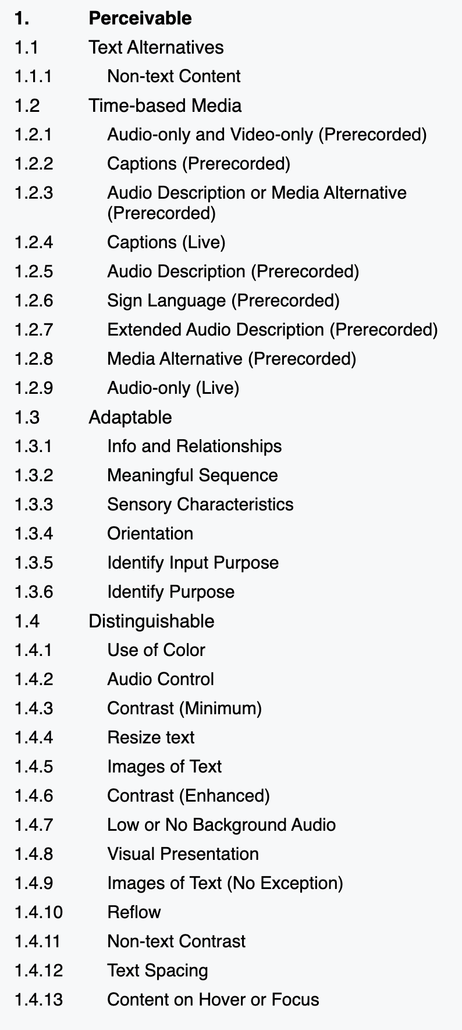
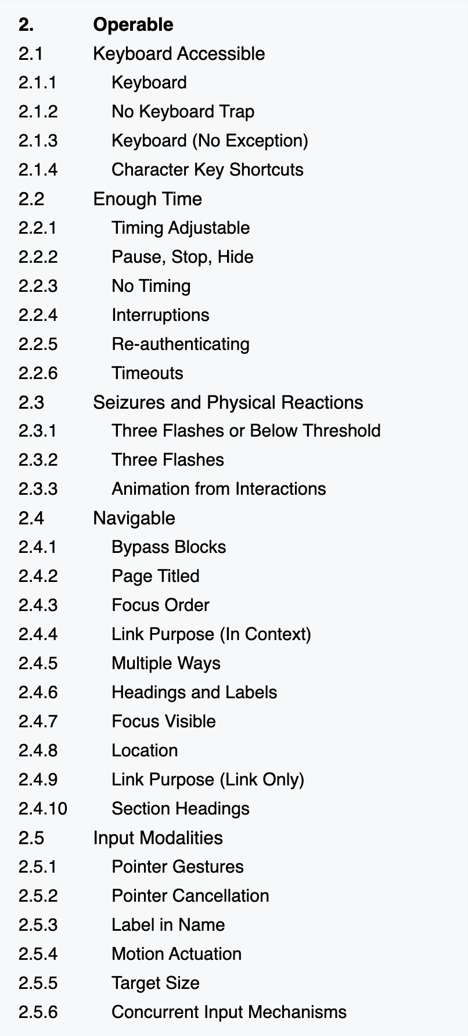
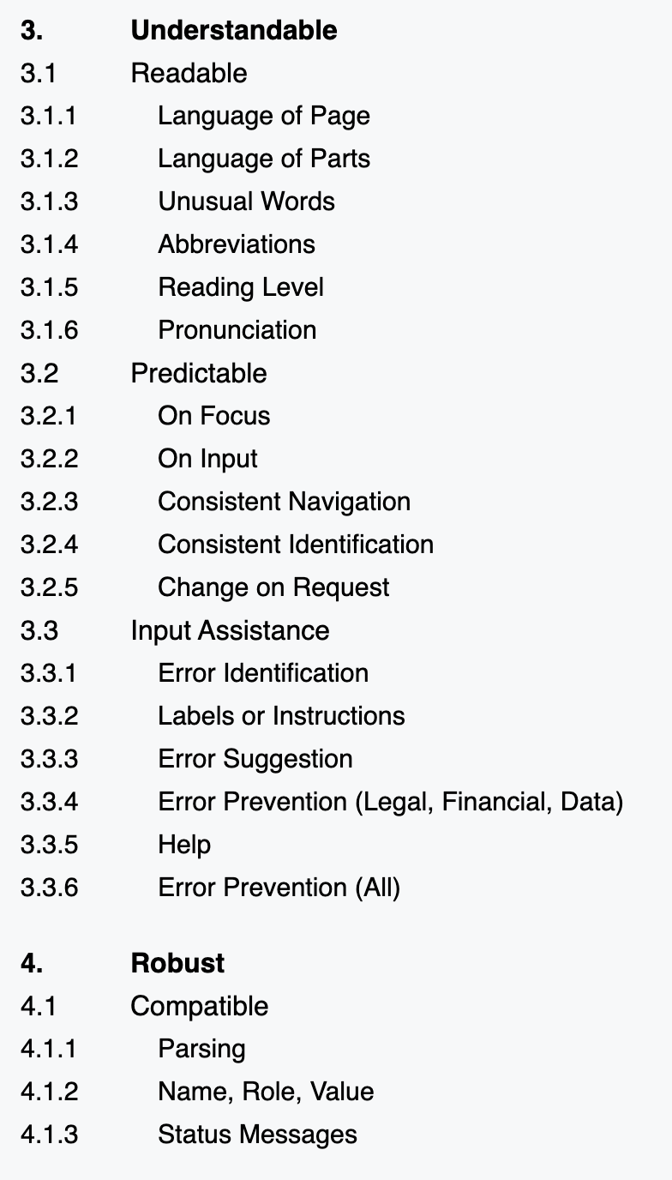
WCAG 2.1 has 78 criteria under these 4 principles
Introduction - Example - Design - Evaluation - Results - Future Work
10

Slide 11
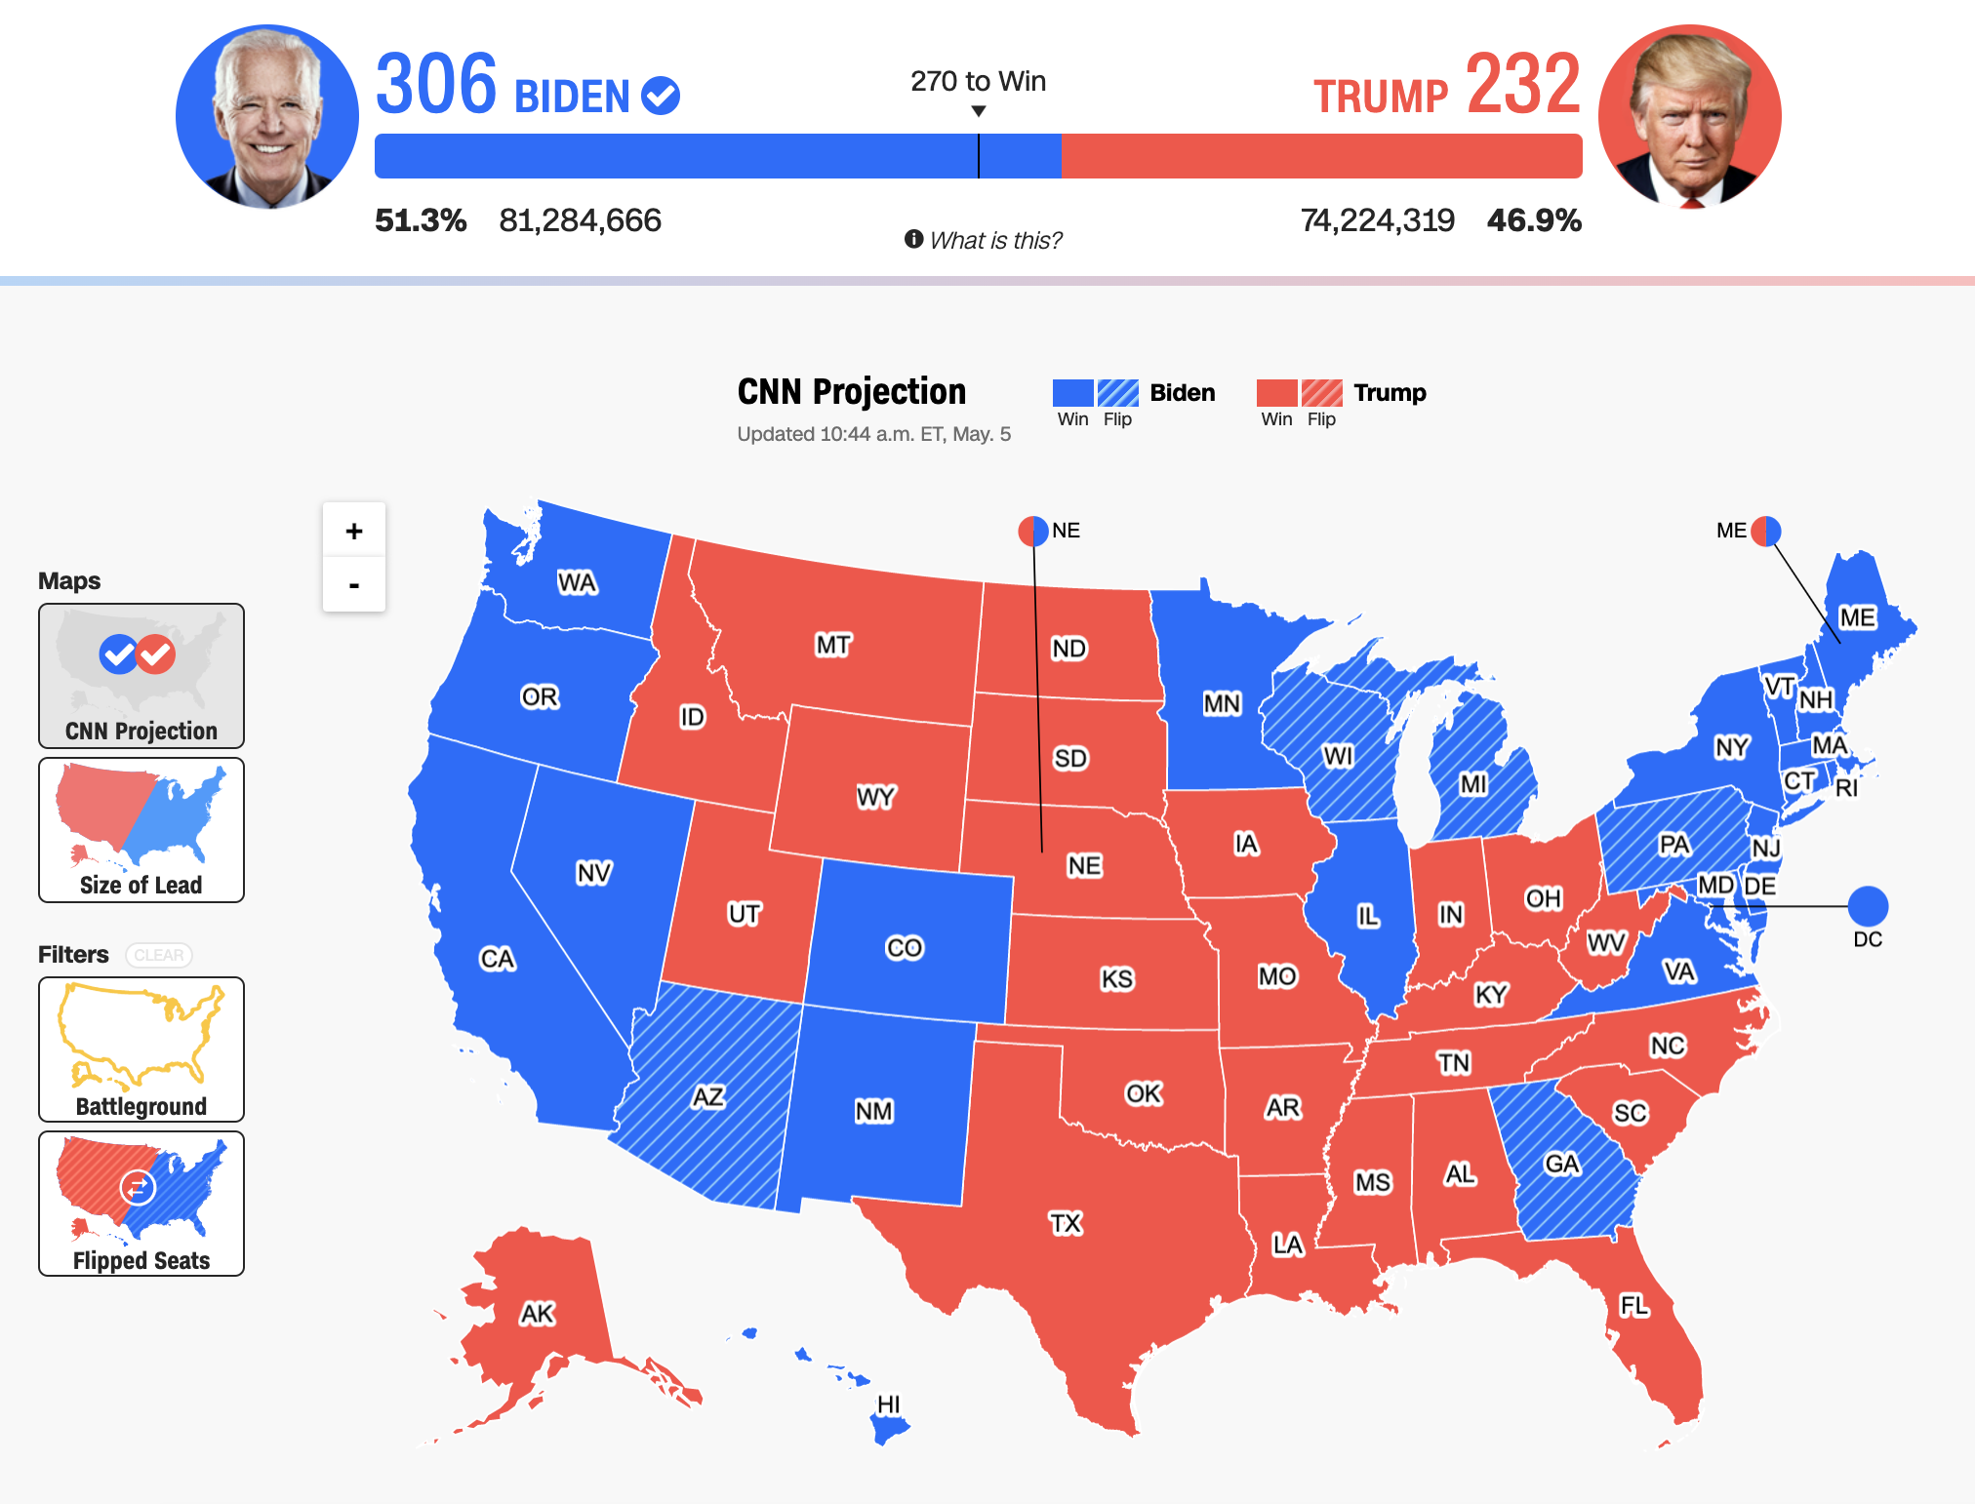
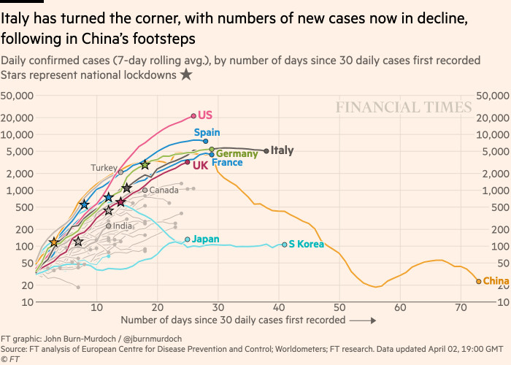
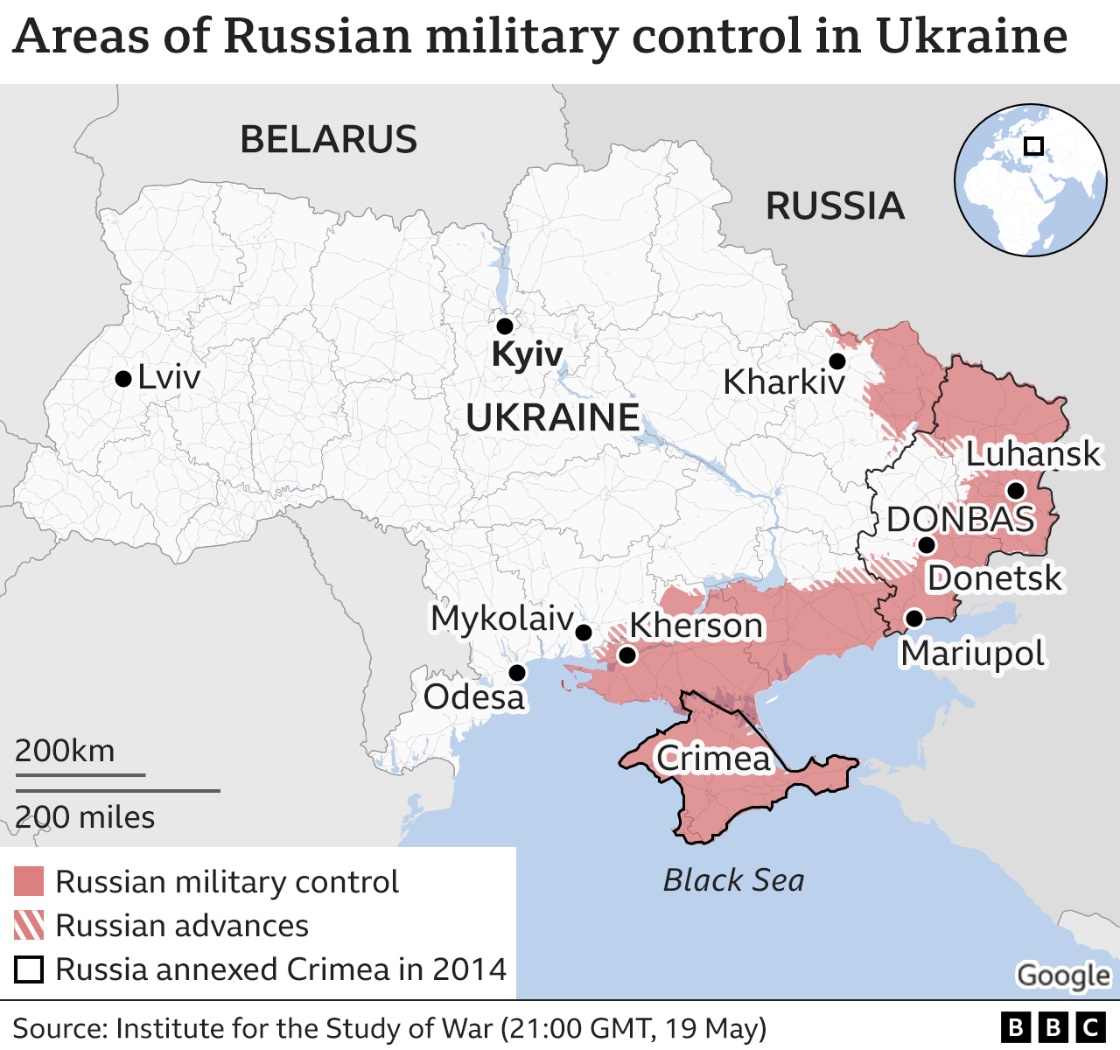
Visualizations inform the public and guide decision-making, policy, and business.
Politics
(CNN)
Health
(Financial Times)
Conflicts
(BBC)
Introduction - Example - Design - Evaluation - Results - Future Work

Slide 12
I have evidence in my own work that we need an equivalent set of guidelines for evaluating the accessibility of data visualizations.
Introduction - Example - Design - Evaluation - Results - Future Work

Slide 13
~100,000 tests ~250 visualizations mean 320 errors per visualization 0 visualizations error-free
Introduction - Example - Design - Evaluation - Results - Future Work

Slide 14
~100,000 tests ~250 visualizations mean 320 errors per visualization 0 visualizations error-free
Introduction - Example - Design - Evaluation - Results - Future Work

Slide 15
~100,000 tests ~250 visualizations mean 320 errors per visualization 0 visualizations error-free
Introduction - Example - Design - Evaluation - Results - Future Work

Slide 16
~100,000 tests ~250 visualizations mean 320 errors per visualization 0 visualizations error-free
Introduction - Example - Design - Evaluation - Results - Future Work

Slide 17
It is imperative that designers and developers learn to recognize access barriers.
Introduction - Example - Design - Evaluation - Results - Future Work

Slide 18
We need a WCAG for visualization.
Introduction - Example - Design - Evaluation - Results - Future Work

Slide 19
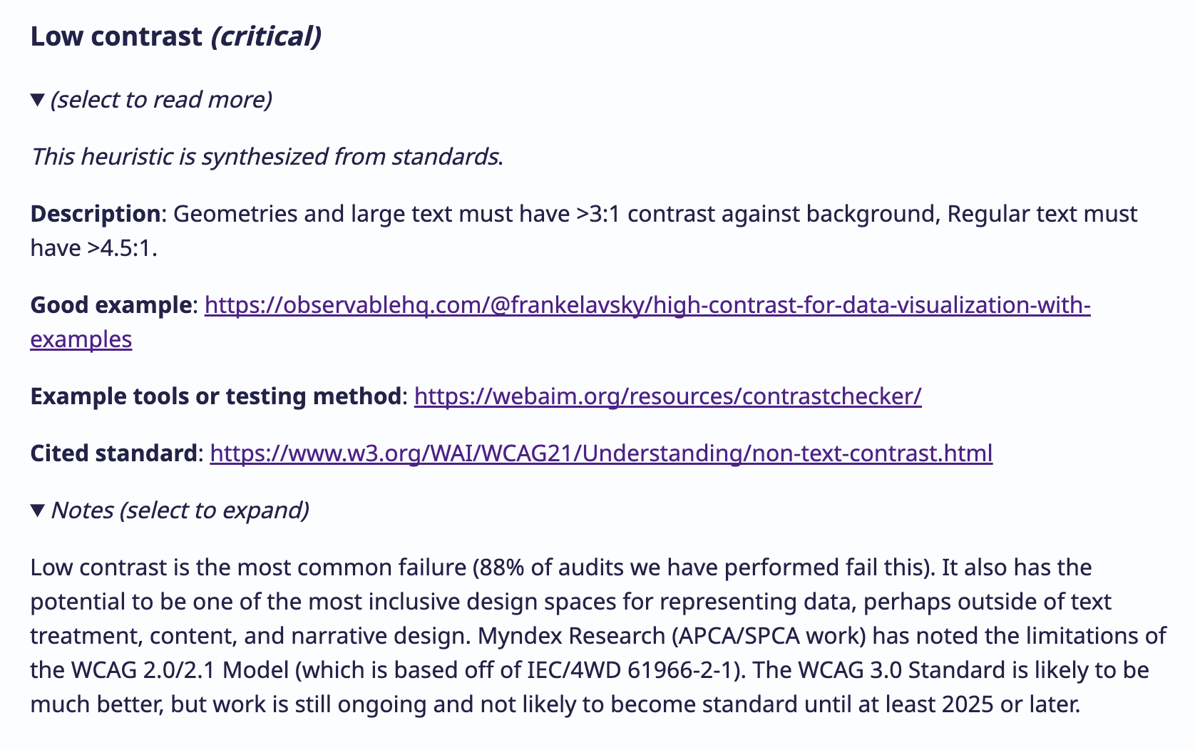
Source: Chartability Workbook
Introduction - Example - Design - Evaluation - Results - Future Work
19

Slide 20
Example: Testing the accessibility of a visualization
Introduction - Example - Design - Evaluation - Results - Future Work

Slide 21
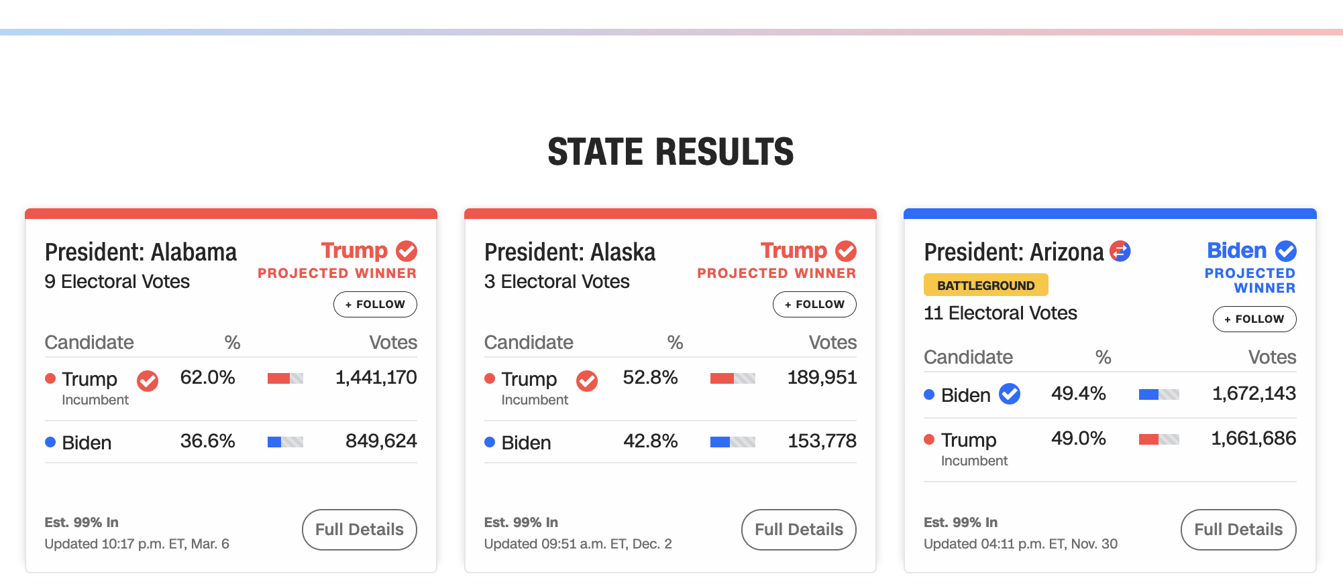
Let’s evaluate this one from CNN.
Introduction - Example - Design - Evaluation - Results - Future Work

Slide 22
978 access failures found in ~60 minutes.
Perceivable:
6 Low contrast
57 Content is only visual
50 Color alone is used
3 Meaningful elements can be distinguished
Operable:
54 Interaction modality only has one input type
58 No interaction cues or instructions
5 Low contrast on interactive elements
4 Keyboard focus indicator missing
4 Complex actions have no alternative
18 Target pointer interaction is too small
Understandable:
4 Interactive context is not clear
6 Metrics or variables are undefined
Robust:
275 Does not conform to standards
82 Semantically invalid
12 Fragile technology support
Compromising:
54 Information can only be reached through single process
61 Information cannot be navigated according to narrative or structure
Assistive:
101 Navigation and interaction is tedious
Flexible:
2 User style change not respected
121 User text adjustments are not respected
1 Scrolling experiences cannot be adjusted or opted out of
Contrast and textures cannot be adjusted
Introduction - Example - Design - Evaluation - Results - Future Work

Slide 23
Perceivable Failures
6 Low contrast
57 Content is only visual
50 Color alone is used
1 Meaningful elements can be distinguished
Introduction - Example - Design - Evaluation - Results - Future Work
23

Slide 24
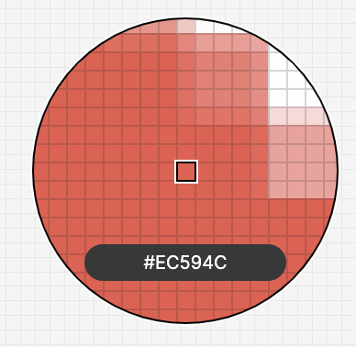
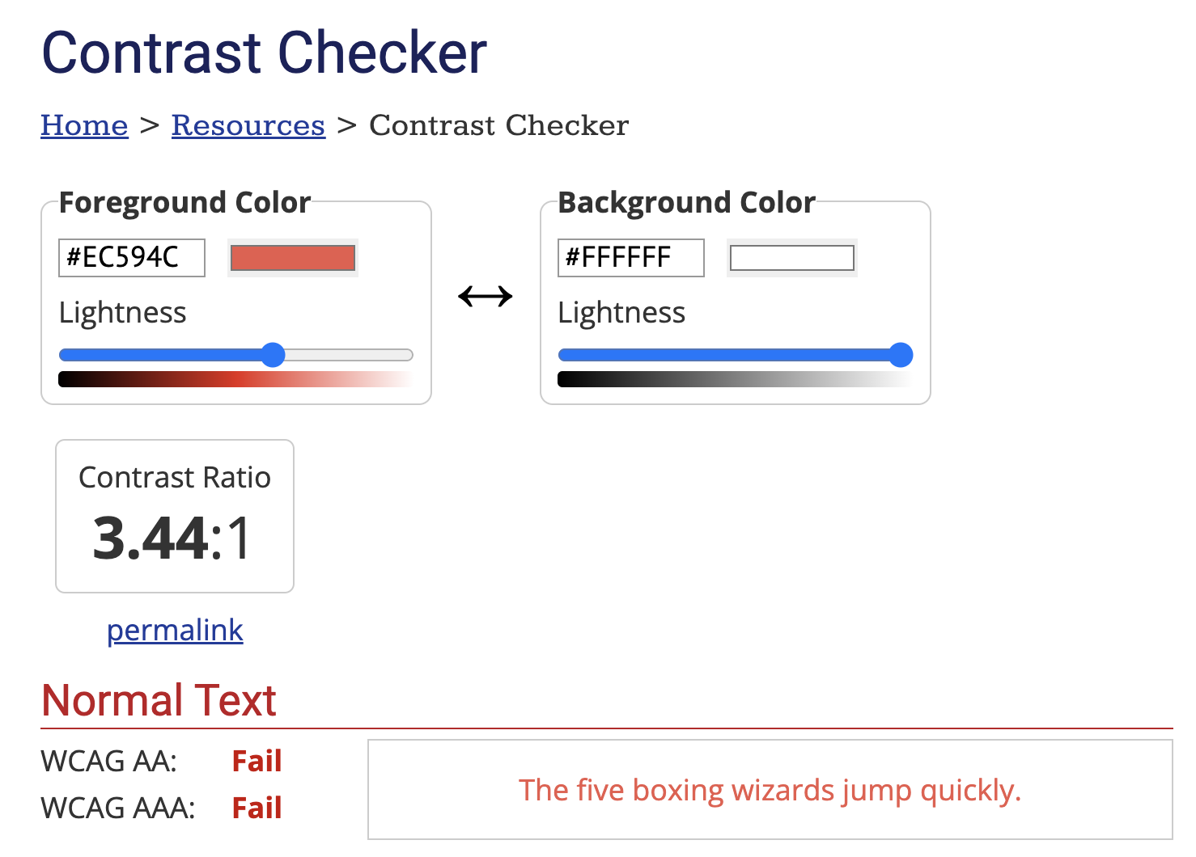
Introduction - Example - Design - Evaluation - Results - Future Work
24

Slide 25
Perceivable Failures
6 Low contrast
57 Content is only visual
50 Color alone is used
1 Meaningful elements can be distinguished
Introduction - Example - Design - Evaluation - Results - Future Work
25

Slide 26
Each state should announce to screen readers what state it is and who won it, not “image!”
Introduction - Example - Design - Evaluation - Results - Future Work
26

Slide 27
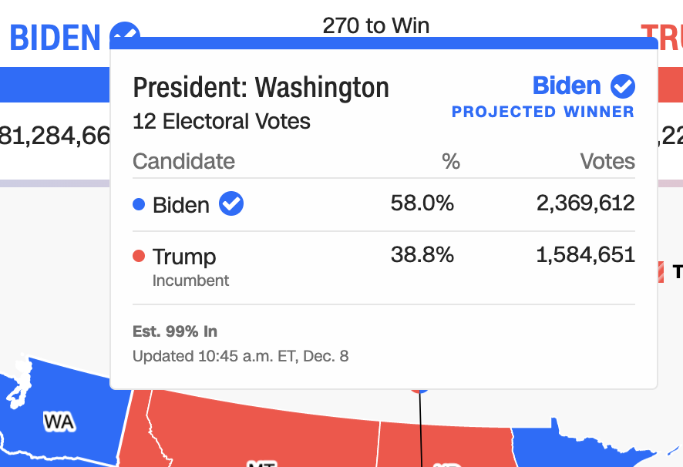
Operable Failures
54 Interaction modality only has one input type
58 No interaction cues or instructions
5 Low contrast on interactive elements
4 Keyboard focus indicator missing
4 Complex actions have no alternative
18 Target pointer interaction is too small
Introduction - Example - Design - Evaluation - Results - Future Work
27

Slide 28
If a mouse can do something (like produce a tooltip), then there must be parity at least with a keyboard.
===
Introduction - Example - Design - Evaluation - Results - Future Work
28

Slide 29
Operable Failures
54 Interaction modality only has one input type
58 No interaction cues or instructions
5 Low contrast on interactive elements
4 Keyboard focus indicator missing
4 Complex actions have no alternative
18 Target pointer interaction is too small
Introduction - Example - Design - Evaluation - Results - Future Work
29

Slide 30
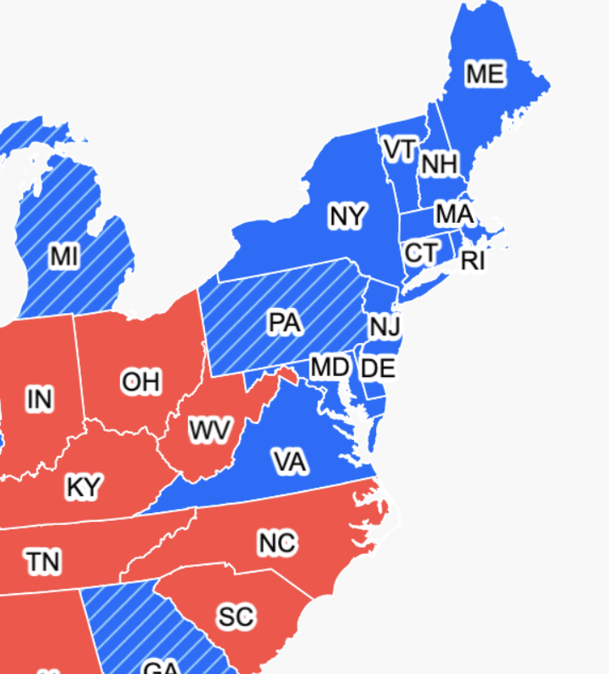
Expecting users to hover on something tiny is an accessibility design failure
Introduction - Example - Design - Evaluation - Results - Future Work
30

Slide 31
Conjecture 1: we can’t build a more accessible world if we don’t know how to recognize accessibility barriers.
Introduction - Example - Design - Evaluation - Results - Future Work
31

Slide 32
Conjecture 2: most practitioners don’t know how to recognize accessibility barriers because learning how is difficult and intimidating.
Introduction - Example - Design - Evaluation - Results - Future Work
32

Slide 33
Hypothesis: if we can collect and synthesize existing knowledge for practitioners into a usable artifact, we can improve how they do this work.
Introduction - Example - Design - Evaluation - Results - Future Work
33

Slide 34
How did we make Chartability?
Introduction - Example - Design - Evaluation - Results - Future Work
34

Slide 35
WCAG as our seed
Source: WCAG 2.1 Standards Draft, 2018
Introduction - Example - Design - Evaluation - Results - Future Work
35

Slide 36
We supplement WCAG
Web Standards
Broad
Academic Papers
Focused on vision
Practitioner Artifacts
Practical examples
Introduction - Example - Design - Evaluation - Results - Future Work
36

Slide 37
Thematic analysis of standards, research, and practitioner artifacts produced 45 heuristics.
Coded Data
Web Standards
Academic Papers
45 Heuristics
Practitioner Artifacts
Introduction - Example - Design - Evaluation - Results - Future Work
37

Slide 38
Fit into WCAG’s 4 Principles
Perceivable (7)
Operable (7)
26 Heuristics
Understandable (9)
Robust (3)
Demanded new Principles
Compromising (7)
19 Heuristics
Assistive (5)
Flexible (7)
Introduction - Example - Design - Evaluation - Results - Future Work
38

Slide 39
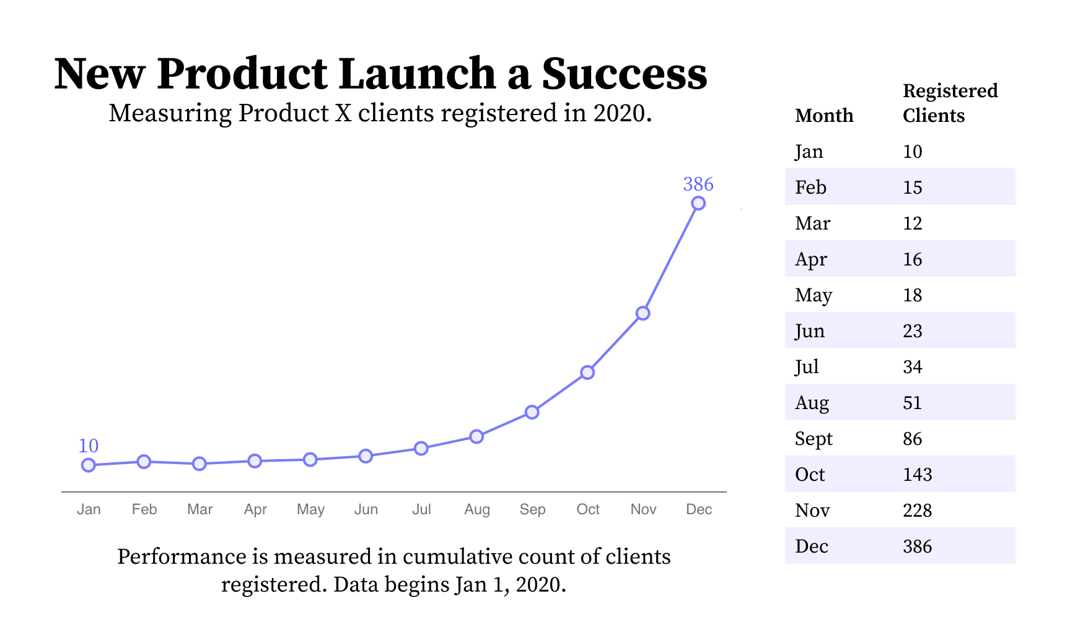
Compromising:
Heuristics that mix understandable and robust, evaluating the different ways people use and understand information during interaction.
Introduction - Example - Design - Evaluation - Results - Future Work
39

Slide 40
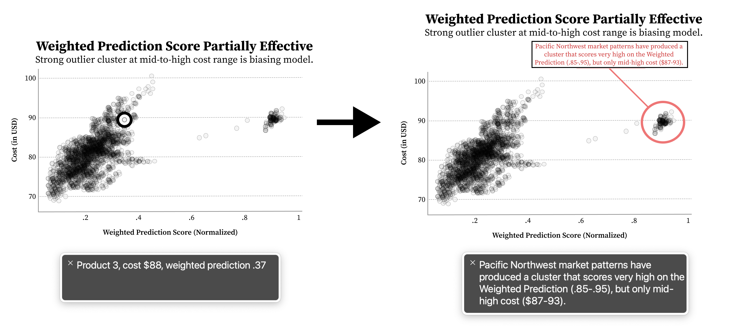
Assistive:
Heuristics that mix understandable and perceivable, focusing on the labor required for access.
Introduction - Example - Design - Evaluation - Results - Future Work
40

Slide 41
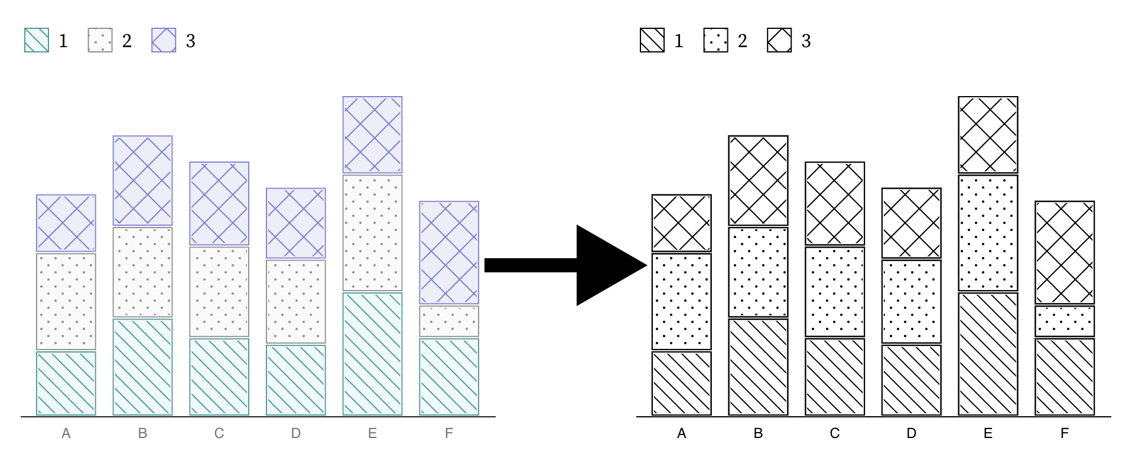
Flexible:
Heuristics that mix perceivable and robust, emphasizing the importance of adjustable and adaptive presentations.
Introduction - Example - Design - Evaluation - Results - Future Work
41

Slide 42
Evaluation
Introduction - Example - Design - Evaluation - Results - Future Work
42

Slide 43
5 stages evaluating Chartability
4 Beta Tests
Early Advice
2 Demo Sessions
Professional Workshop
Practitioner Test + Interviews
Introduction - Example - Design - Evaluation - Results - Future Work
43

Slide 44
5 stages evaluating Chartability
4 Beta Tests
Early Advice
2 Demo Sessions
Professional Workshop
Practitioner Test + Interviews
Introduction - Example - Design - Evaluation - Results - Future Work
44

Slide 45
Most research evaluating heuristics measures inter-rater reliability across evaluations [1] or the effectiveness of the outcomes [2].
[1] E. Wall et al. “A Heuristic Approach to Value-Driven Evaluation of Visualizations,” 2019.
[2] B. S. Santos, S. Silva, and P. Dias, “Heuristic Evaluation in Visualization: An Empirical Study,” 2018.
Introduction - Example - Design - Evaluation - Results - Future Work
45

Slide 46
But what are the interests, needs, and challenges that practitioners have when using heuristics to evaluate visualization accessibility?
Introduction - Example - Design - Evaluation - Results - Future Work
46

Slide 47
The practitioner evaluation
Pre-questions (5-point Likert)
Let them use Chartability while we observe (2 – 8hr sessions)
We ask post-questions (Likert and semi-structured)
Sources: L. South et al. “Effective Use of Likert Scales in Visualization Evaluations: A Systematic Review,” 2022.
J. Lazar, J. Feng and H. Hochheiser. “Research Methods In Human Computer Interaction, Chapter 8” 2017.
Introduction - Example - Design - Evaluation - Results - Future Work
47

Slide 48
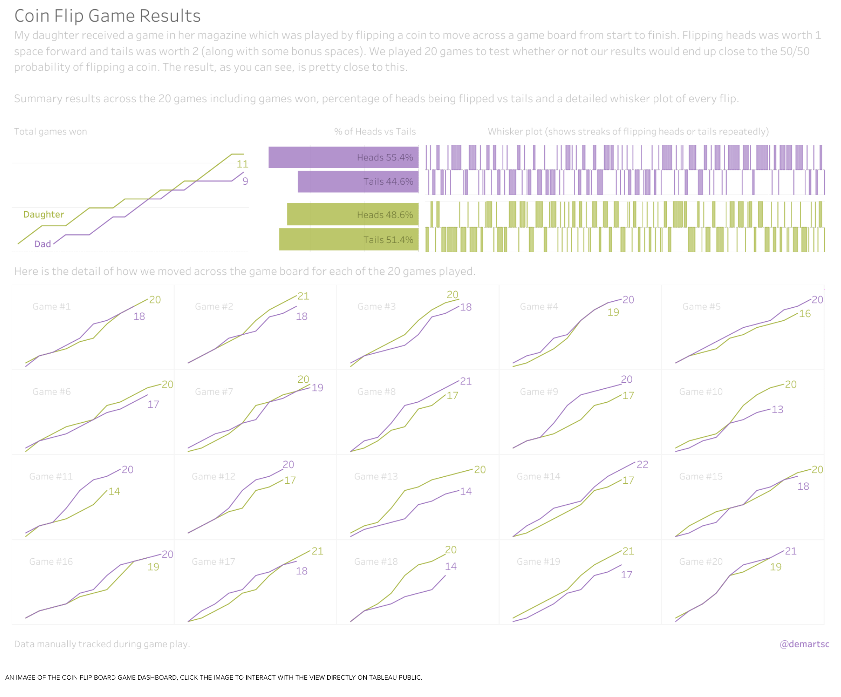
Working on people’s real projects gave us deeper interview sessions
Source: Coin Flip Game, 2017
Source: The Naked Truth, 2021
Introduction - Example - Design - Evaluation - Results - Future Work
48

Slide 49
3 accessibility novices. Each with 1 project.
Introduction - Example - Design - Evaluation - Results - Future Work
49

Slide 50
3 accessibility experts. 2 with a shared project.
Introduction - Example - Design - Evaluation - Results - Future Work
50

Slide 51
Results
Introduction - Example - Design - Evaluation - Results - Future Work
51

Slide 52
Novices: 3 / 3 felt more confident auditing visualizations for accessibility after Chartability.
Introduction - Example - Design - Evaluation - Results - Future Work
52

Slide 53
Novices: 3 / 3 felt more confident auditing visualizations for accessibility after Chartability.
Expansive
“Chartability helps me consider so much more than colorblindness”
Introduction - Example - Design - Evaluation - Results - Future Work
53

Slide 54
Novices: 3 / 3 felt more confident auditing visualizations for accessibility after Chartability.
Expansive
Clarifying
“I was overwhelmed by accessibility at first. But after trying Chartability, now I feel like I have a process.”
Introduction - Example - Design - Evaluation - Results - Future Work
54

Slide 55
Novices: 3 / 3 felt more confident auditing visualizations for accessibility after Chartability.
Expansive
Clarifying
Experts: 3 / 3 intend to keep using Chartability in their own work.
Introduction - Example - Design - Evaluation - Results - Future Work
55

Slide 56
Novices: 3 / 3 felt more confident auditing visualizations for accessibility after Chartability.
Expansive
Clarifying
Experts: 3 / 3 intend to keep using Chartability in their own work.
Grounding
“Chartability did a very good job of highlighting concerns that are often ignored or forgotten when auditing and designing/developing”
Introduction - Example - Design - Evaluation - Results - Future Work
56

Slide 57
Novices: 3 / 3 felt more confident auditing visualizations for accessibility after Chartability.
Expansive
Clarifying
Experts: 3 / 3 intend to keep using Chartability in their own work.
Grounding
Goes beyond
“Chartability goes beyond compliance. It is clearly focusing on a good experience.”
Introduction - Example - Design - Evaluation - Results - Future Work
57

Slide 58
What other results are worth noting from Chartability’s use?
Introduction - Example - Design - Evaluation - Results - Future Work
58

Slide 59
Chartability is well-travelled
Introduction - Example - Design - Evaluation - Results - Future Work
59

Slide 60
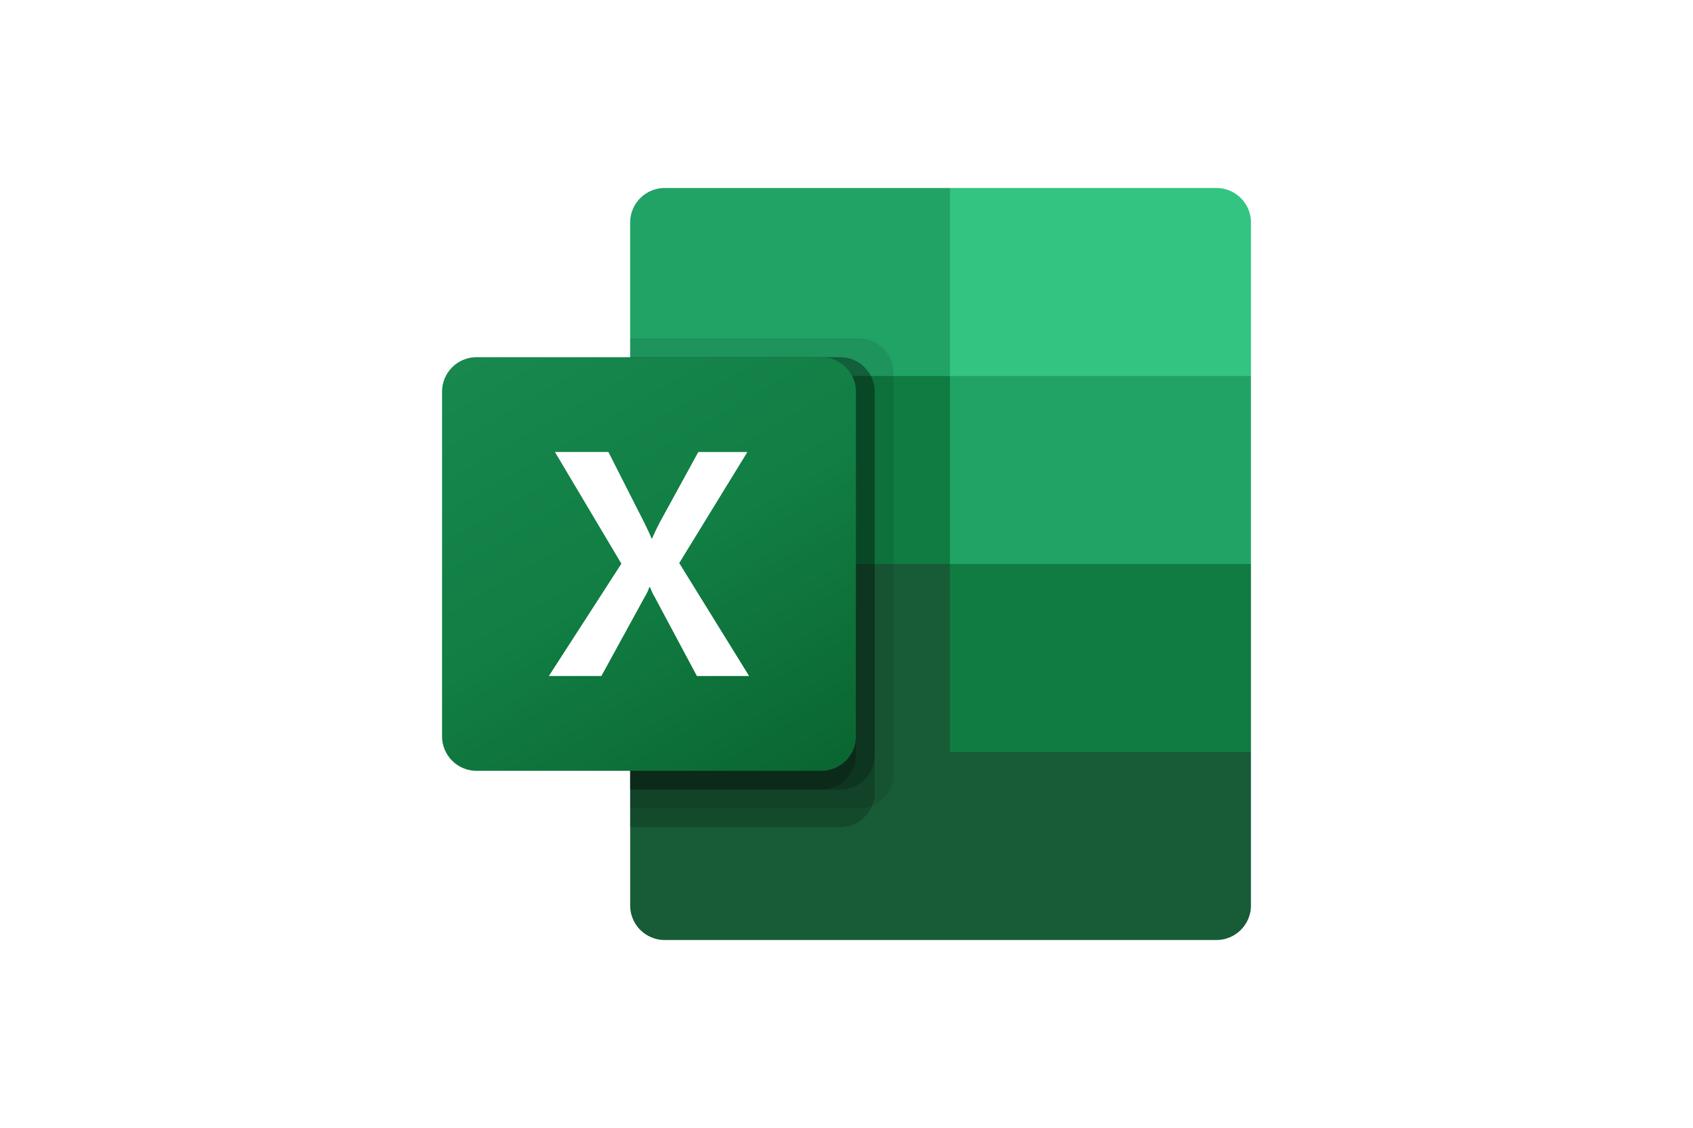
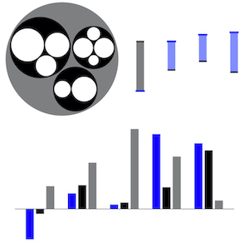
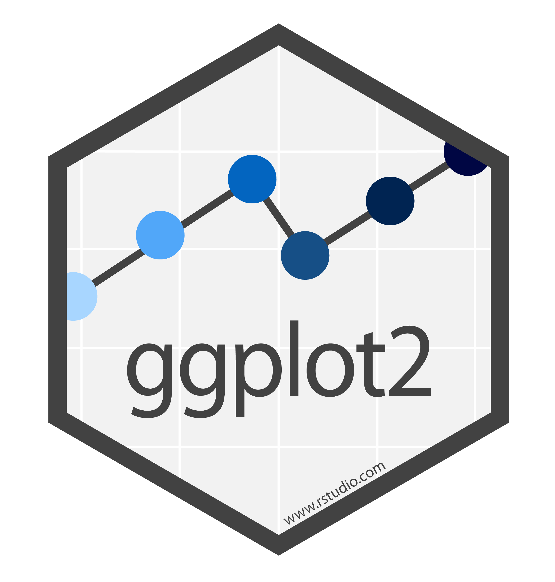
Chartability is well-travelled
Introduction - Example - Design - Evaluation - Results - Future Work
60

Slide 61
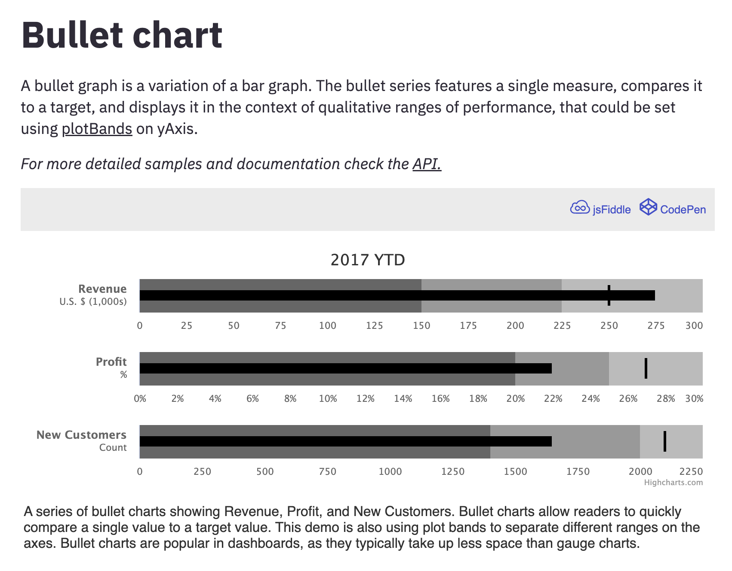
Even best-in-class tools like Highcharts benefit from Chartability
Introduction - Example - Design - Evaluation - Results - Future Work
61

Slide 62
Even best-in-class tools like Highcharts benefit from Chartability
Chart type has an explanation in the docs
Introduction - Example - Design - Evaluation - Results - Future Work
62

Slide 63
Even best-in-class tools like Highcharts benefit from Chartability
Improved keyboard and screen reader navigation
Introduction - Example - Design - Evaluation - Results - Future Work
63

Slide 64
Even best-in-class tools like Highcharts benefit from Chartability
Alt text made visible for a clear takeaway for all
Introduction - Example - Design - Evaluation - Results - Future Work
64

Slide 65
Community Involvement has Improved Chartability
Chartability is now on Version 2, with 50 total heuristics.
Introduction - Example - Design - Evaluation - Results - Future Work
65

Slide 66
Conclusion
We collected and synthesized existing knowledge for practitioners into a usable artifact and believe we know a bit more about how this improves how they do this work.
Introduction - Example - Design - Evaluation - Results - Future Work
66

Slide 67
My future work:
How do tools shape how practitioners imagine the potential of their work?
Introduction - Example - Design - Evaluation - Results - Future Work
67

Slide 68
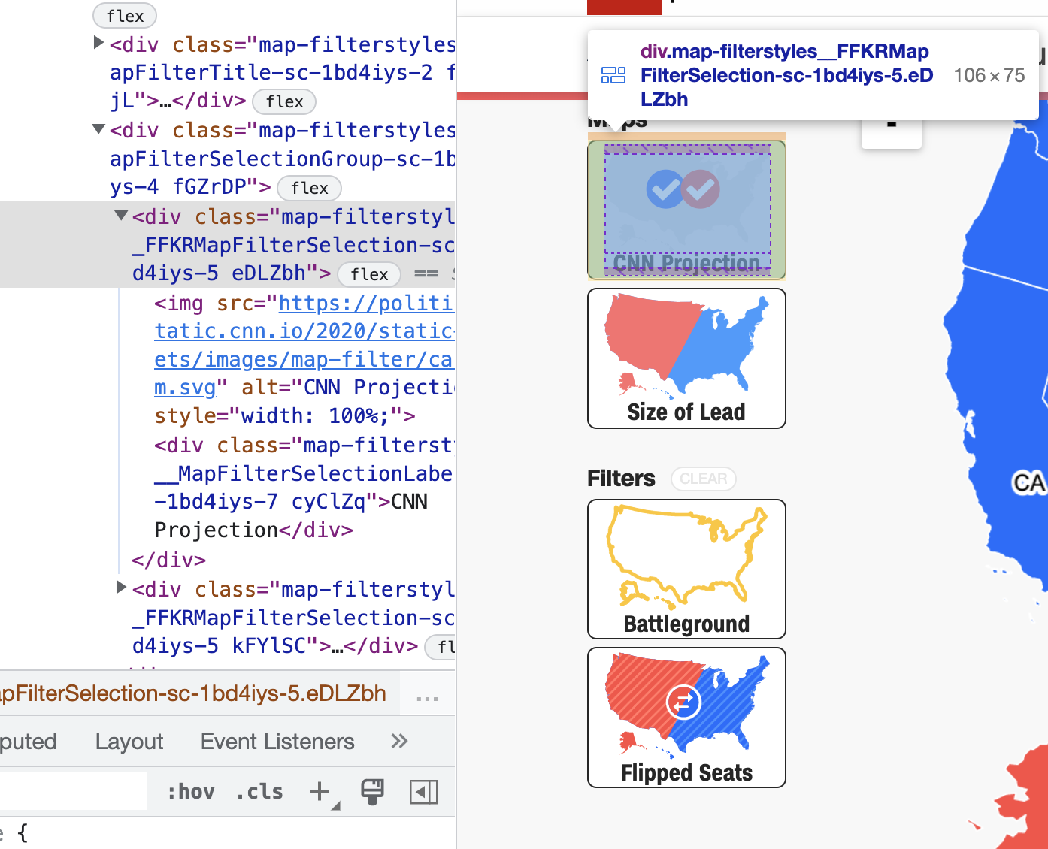
Why do practitioners use tools and materials that produce inaccessible outcomes?
Introduction - Example - Design - Evaluation - Results - Future Work
68

Slide 69
CHARTABILITY
Frank Elavsky, Comm Talk, 2022 @FrankElavsky
frank.computer/chartability
How accessible is my visualization? Evaluating visualization accessibility with Chartability.
hcii.cmu.edu
by Frank Elavsky, Cynthia Bennett, Dominik Moritz
axle-lab.com
dig.cmu.edu

