Slide 1
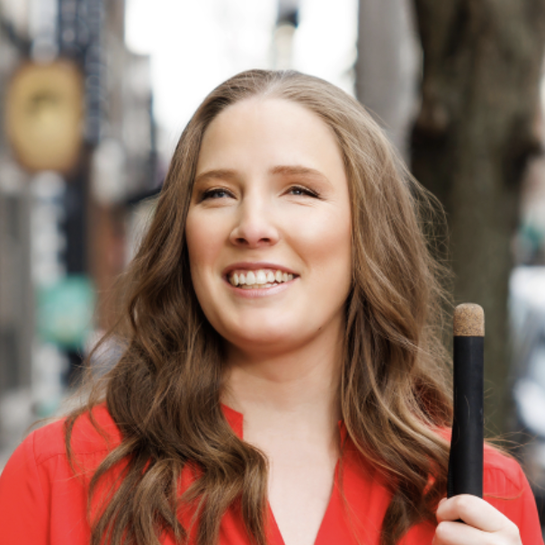
CHARTABILITY
Frank Elavsky, Comm Talk, 2022 @FrankElavsky
frank.computer/chartability
How accessible is my visualization? Evaluating visualization accessibility with Chartability.
hcii.cmu.edu
axle-lab.com
dig.cmu.edu
by Frank Elavsky, Cynthia Bennett, Dominik Moritz

Slide 2
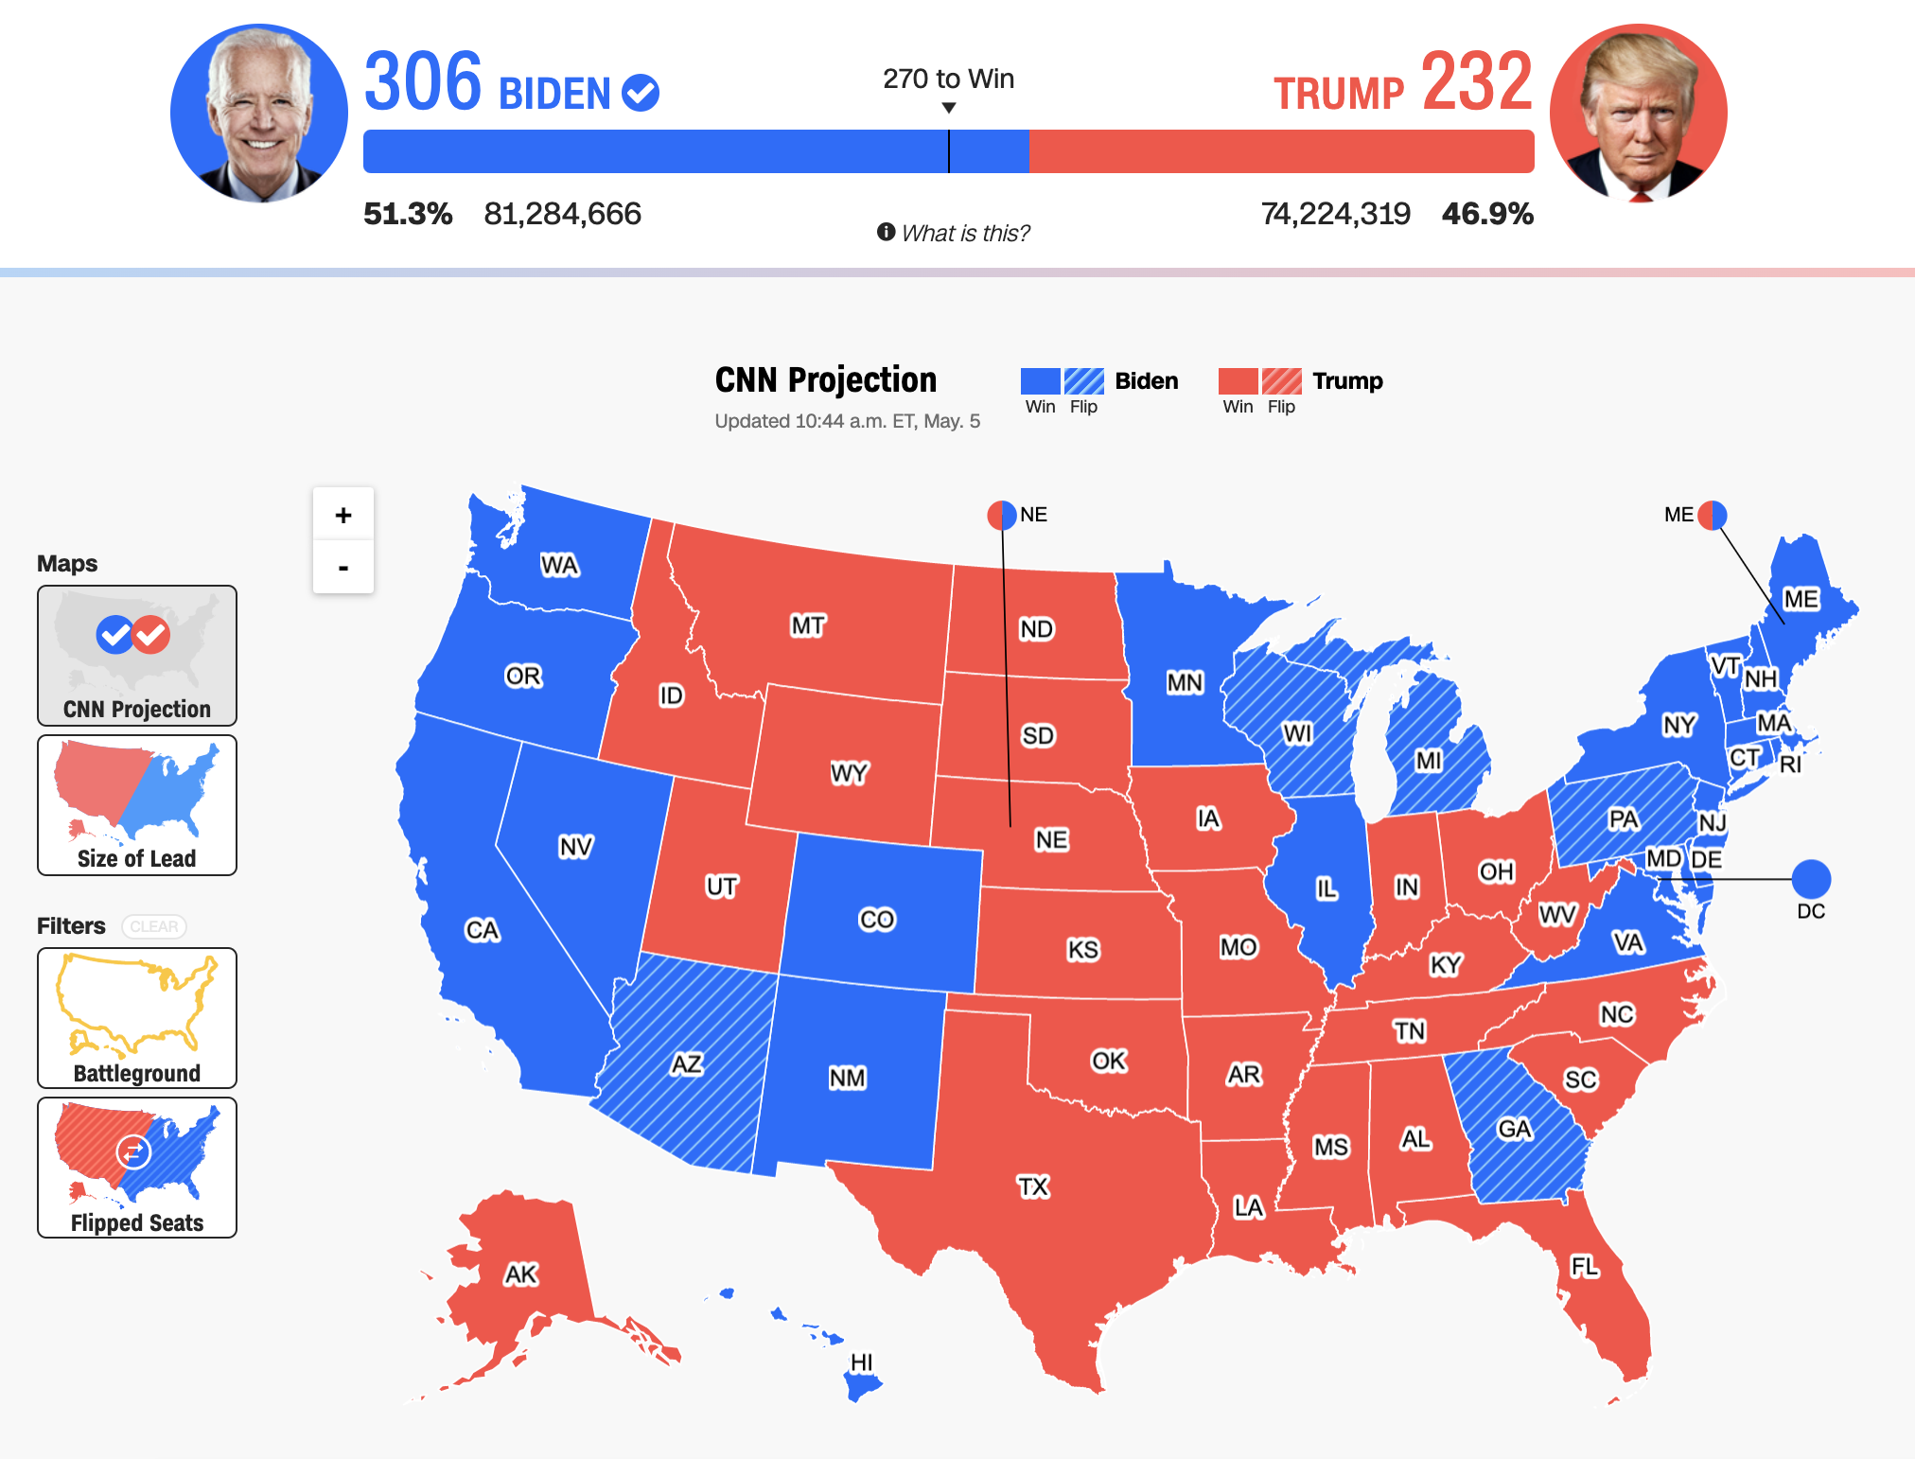
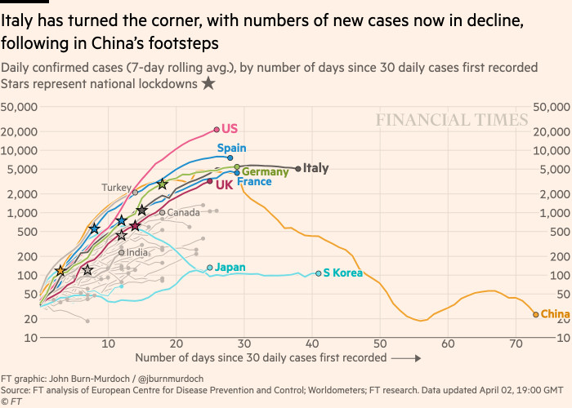
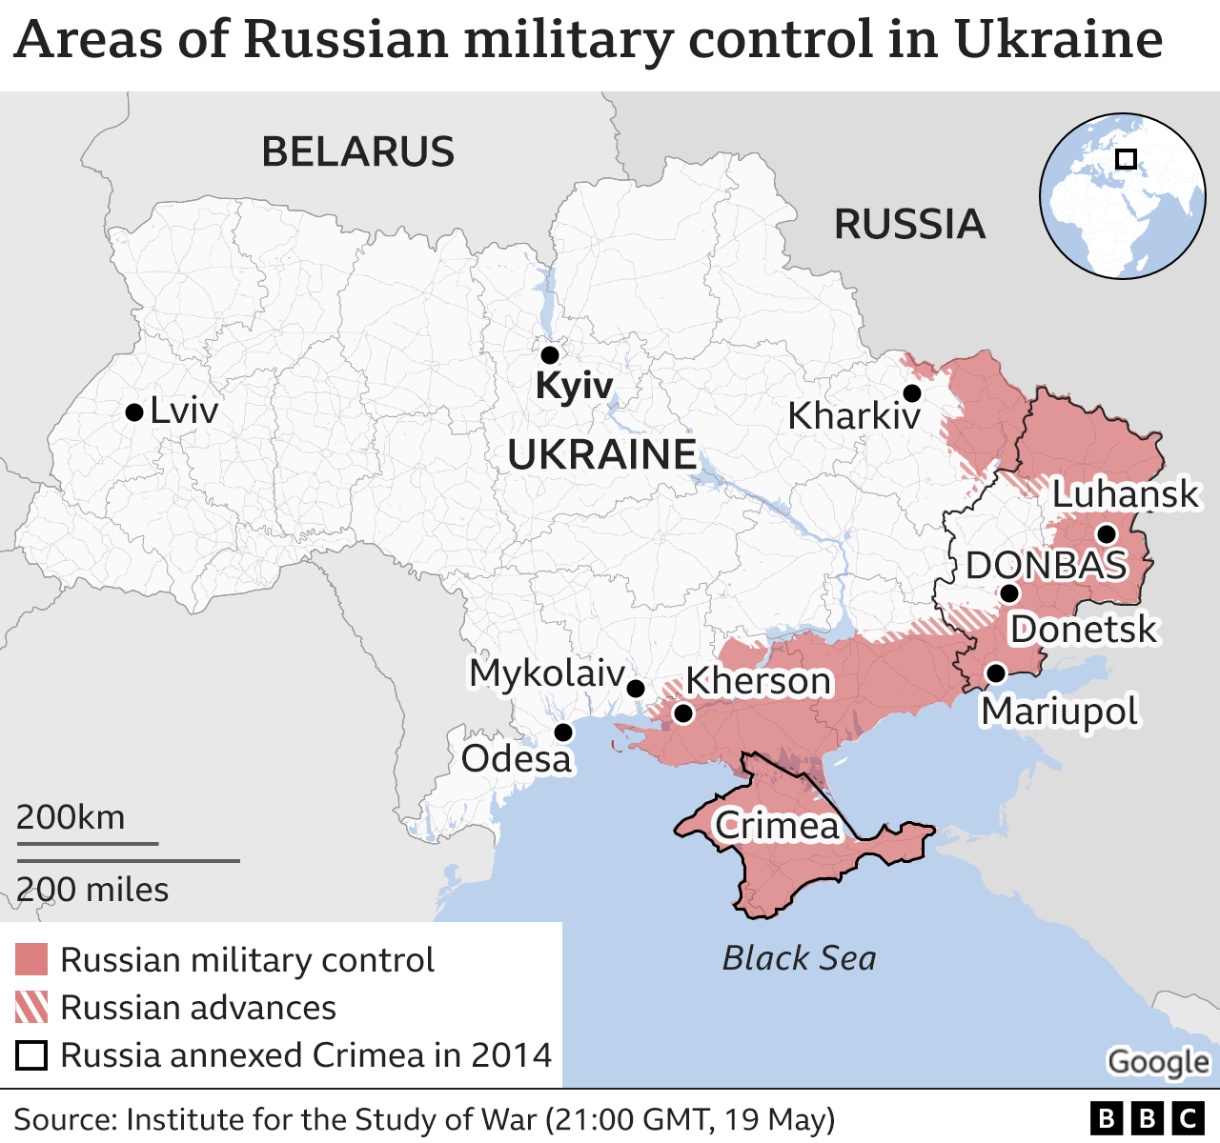
Visualizations inform the public and guide decision-making, policy, and business.
Politics
(CNN)
Health
(Financial Times)
Conflicts
(BBC)

Slide 3
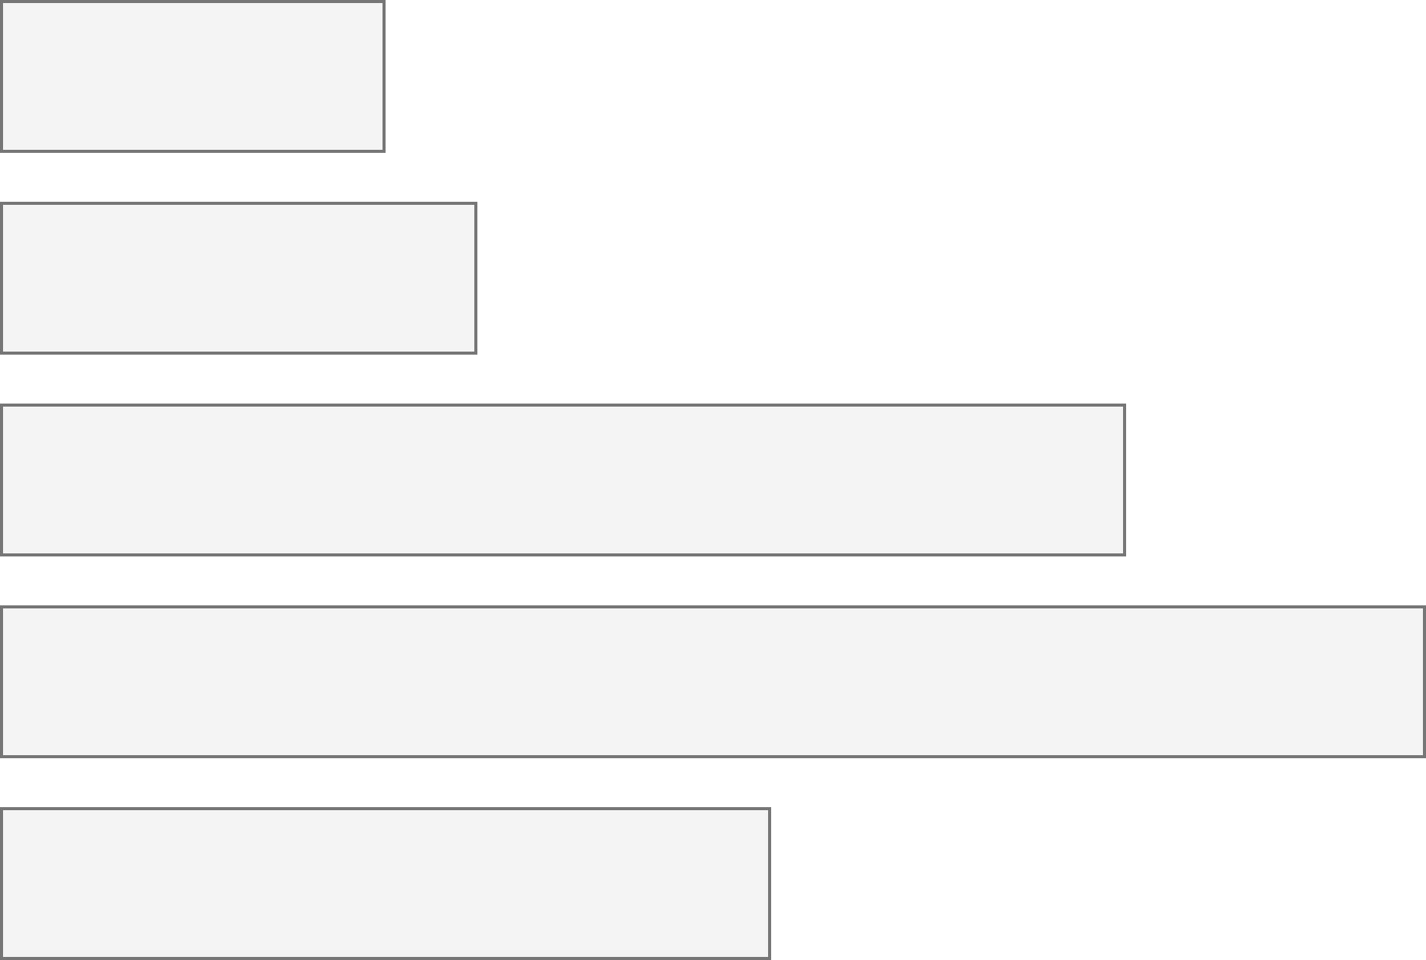
26% of people living in the United States self-report living with a disability that affects their daily life.
3.7%
Color Vision Deficiency
4.5%
Blindness, Low Vision
10.8%
Cognitive, Neurological
13.7%
Motor, Dexterity
7.4%
Vestibular, Motion
Source: Okoro et al. “Prevalence of Disabilities and Health Care Access by Disability Status and Type Among Adults”

Slide 4
Across >80,000 tests, most visualizations have about 320 accessibility errors each.
4

Slide 5
What does testing for accessibility look like?
5

Slide 6
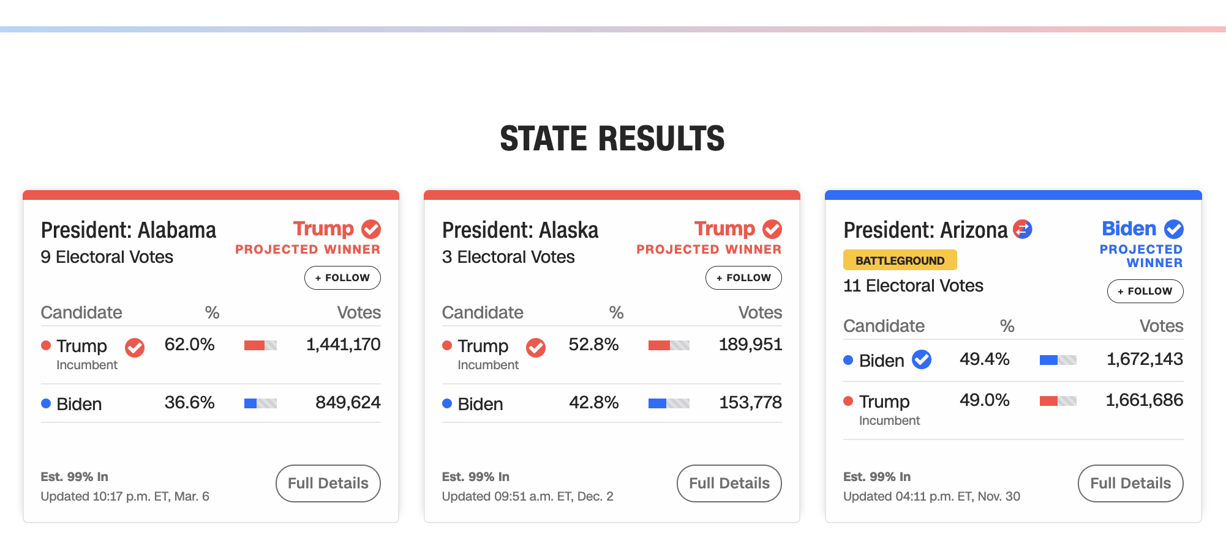
Let’s evaluate this one from CNN with Chartability.
6

Slide 7
Perceivable Failures
6 – Low contrast
57 - Content is only visual
50 - Color alone is used
1 - Meaningful elements can be distinguished
7

Slide 8
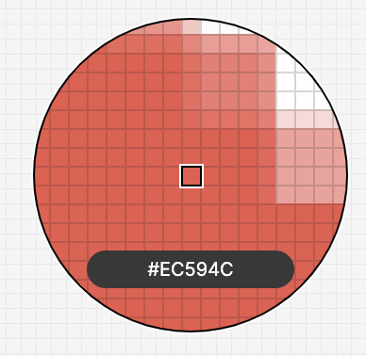
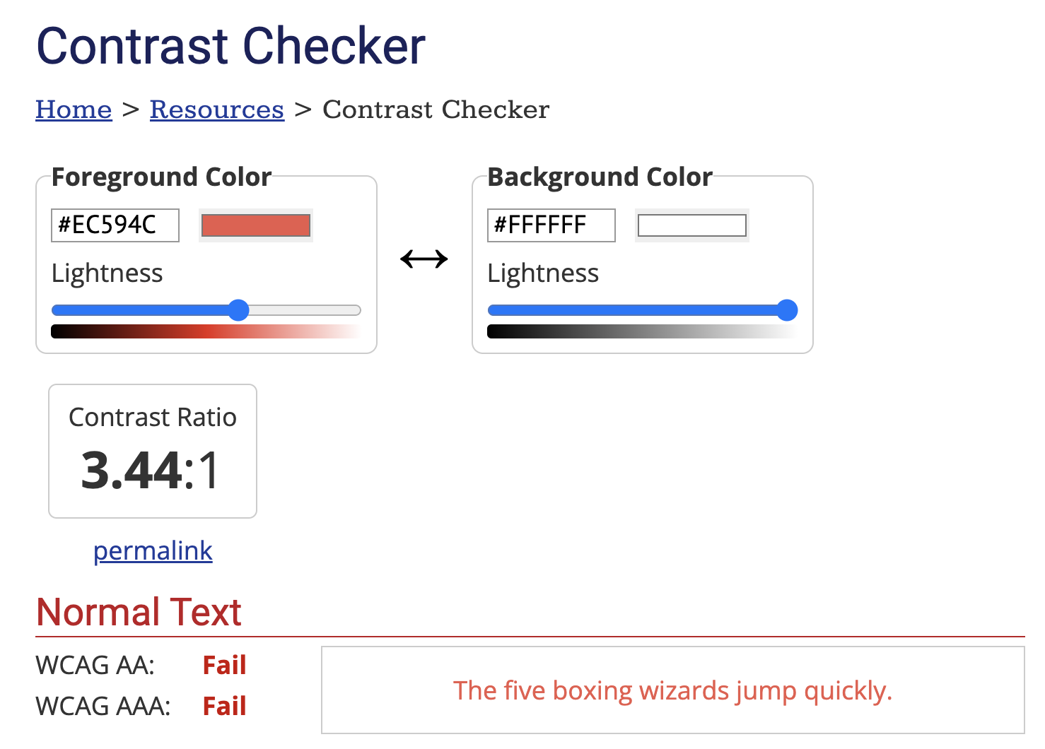
8

Slide 9
Perceivable Failures
6 – Low contrast
57 - Content is only visual
50 - Color alone is used
1 - Meaningful elements can be distinguished
9

Slide 10
Each state should announce to screen readers what state it is and who won it, not “image!”
10

Slide 11
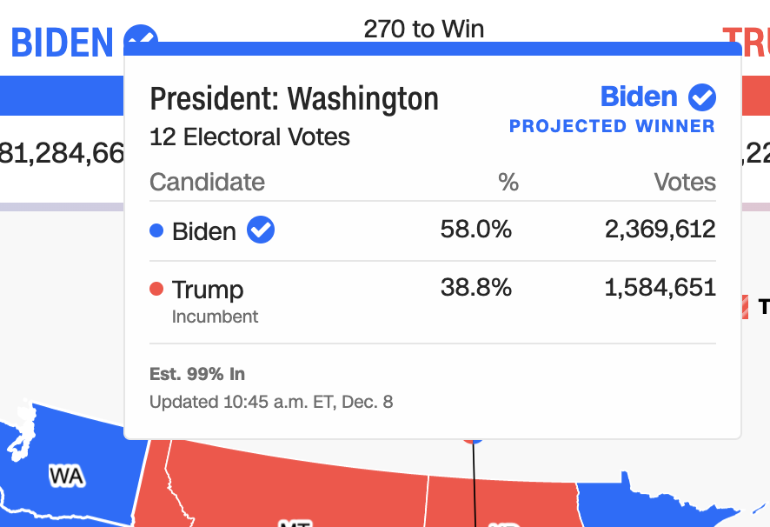
Operable Failures
54 - Interaction modality only has one input type
58 - No interaction cues or instructions
5 - Low contrast on interactive elements
4 - Keyboard focus indicator missing
4 - Complex actions have no alternative
18 - Target pointer interaction is too small
11

Slide 12
If a mouse can do something (like produce a tooltip), then there must be parity at least with a keyboard.
===
12

Slide 13
Operable Failures
54 - Interaction modality only has one input type
58 - No interaction cues or instructions
5 - Low contrast on interactive elements
4 - Keyboard focus indicator missing
4 - Complex actions have no alternative
18 - Target pointer interaction is too small
13

Slide 14
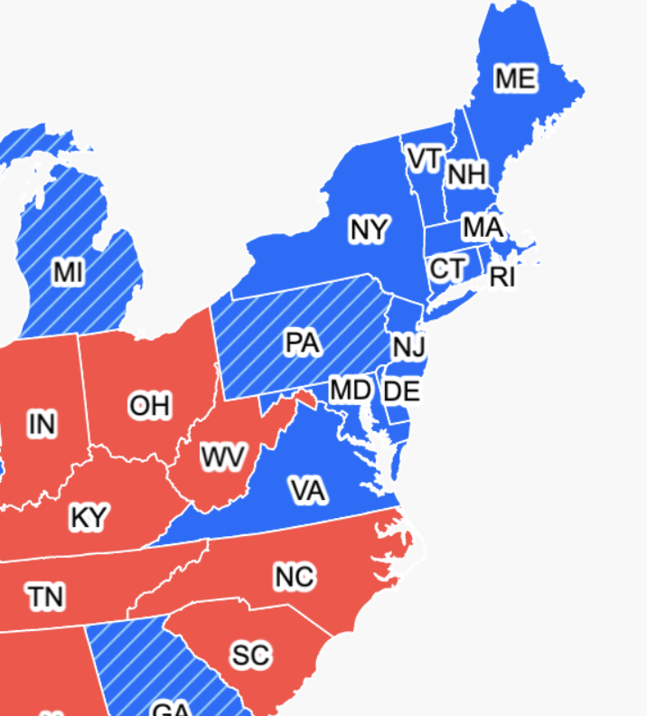
Expecting users to hover on something tiny is an accessibility design failure
14

Slide 15
Continue this for: Understandable,
Robust,
Compromising,
Assistive,
and Flexible
15

Slide 16
978 access failures found in ~60 minutes.
Robust:
275 - Does not conform to standards
82 - Semantically invalid
12 - Fragile technology support
Compromising:
54 - Information can only be reached through single process
61 - Information cannot be navigated according to narrative or structure
Assistive:
101 - Navigation and interaction is tedious
Flexible:
2 - User style change not respected
121 - User text adjustments are not respected
1 - Scrolling experiences cannot be adjusted or opted out of
Contrast and textures cannot be adjusted
Perceivable:
6 – Low contrast
57 - Content is only visual
50 - Color alone is used
3 - Meaningful elements can be distinguished
Operable:
54 - Interaction modality only has one input type
58 - No interaction cues or instructions
5 - Low contrast on interactive elements
4 - Keyboard focus indicator missing
4 - Complex actions have no alternative
18 - Target pointer interaction is too small
Understandable:
4 - Interactive context is not clear
6 - Metrics or variables are undefined
16
Notes:
Make sure to signal that this was from Chartability!!

Slide 17
Doing this work is hard.
17

Slide 18
Conjecture 1: we can’t build a more accessible world if we don’t know how to recognize accessibility barriers.
18

Slide 19
Conjecture 2: most practitioners don’t know how to recognize accessibility barriers because learning how is difficult and intimidating.
19

Slide 20
My hypothesis: if we can collect and synthesize existing knowledge for practitioners into a usable artifact, we can improve how they do this work.
20

Slide 21
Creators
21

Slide 22
Creators
Tools
22

Slide 23
Creators
Tools
Things
23

Slide 24
Creators
Tools
Things
Future Things
24

Slide 25
But how much of this is inaccessible?
Creators
Tools
Things
Future Things
25

Slide 26
97-99.9%
Creators
Tools
Things
Future Things
Source: World Wide Web Consortium. “The WebAIM Million.”
26

Slide 27
Dreaming of ideals
Creators
Tools
Things
Future Things
27
Notes:
Common, the way most people do this work

Slide 28
The knowledgeable “specialist” intervenes
Creators
Tools
Things
Future Things
28
Notes:
Common, the way most people do this work

Slide 29
We change our systems, laws, and environments
Creators
Tools
Things
Future Things
29

Slide 30
We give creators better tools
Creators
Tools
Things
Future Things
30

Slide 31
Chartability seeks to add knowledge as a tool to motivate practitioner behavior.
Creators
Knowledge
Created Things (now)
Future Things
31

Slide 32
What is Chartability?
32

Slide 33
A workbook!
33

Slide 34
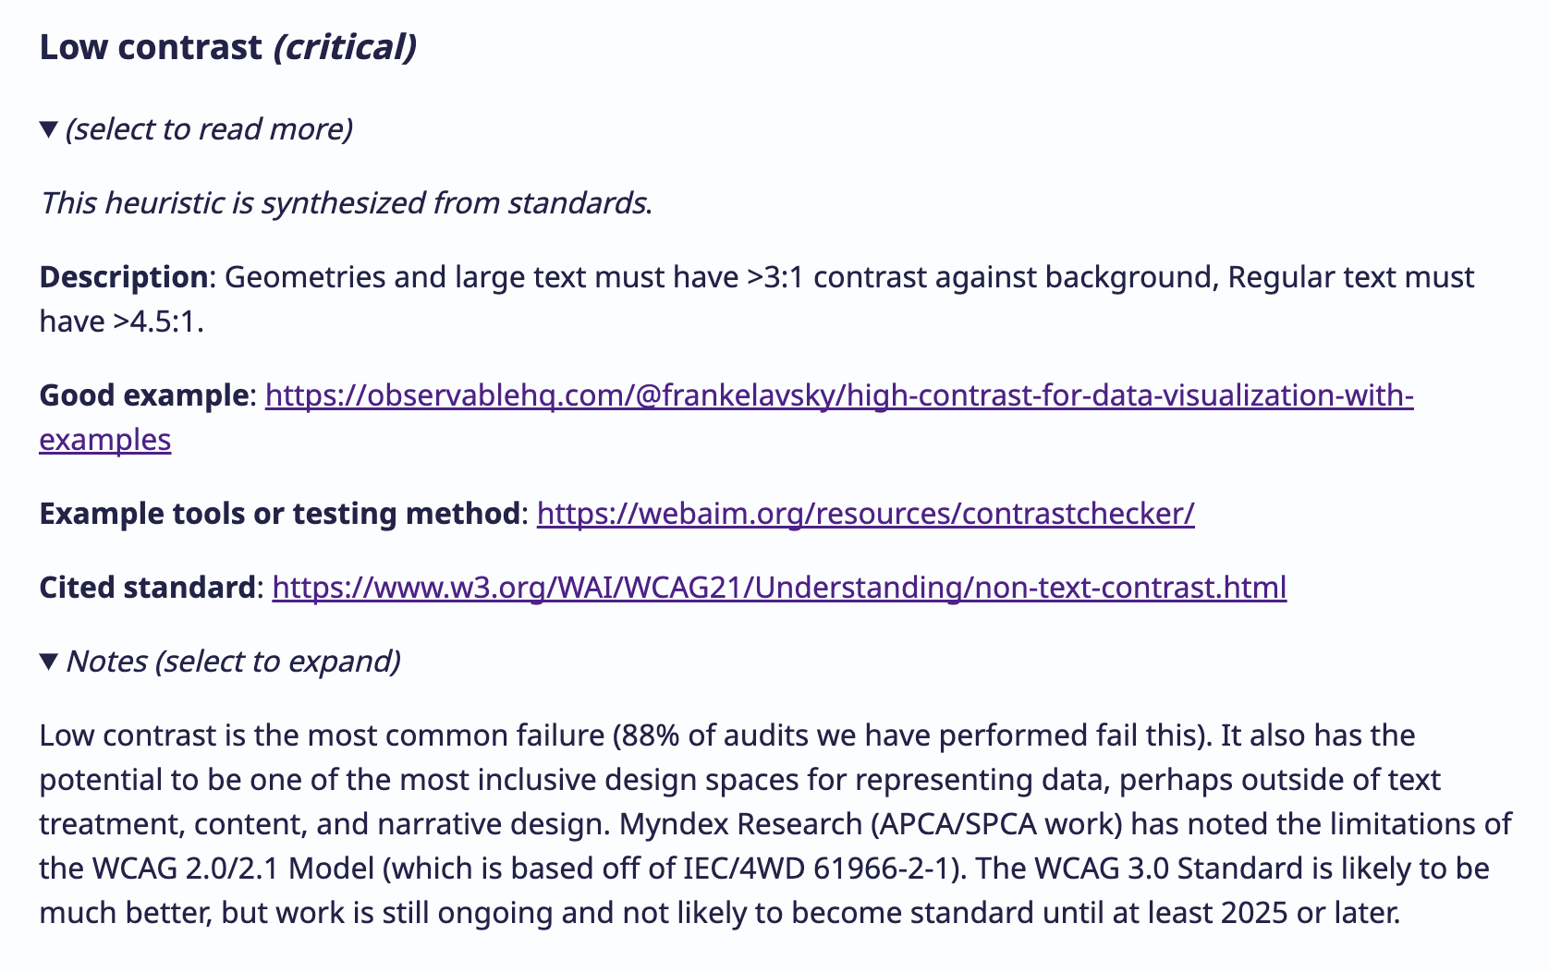
34

Slide 35
Heuristics
35

Slide 36
Examples
36

Slide 37
Automated and manual tools and techniques
37

Slide 38
More information
38

Slide 39
Why dream of knowledge and not an automated tool that solves everything?
39

Slide 40
Automated and manual tools and techniques
40

Slide 41
41

Slide 42
How did we make Chartability?
42

Slide 43
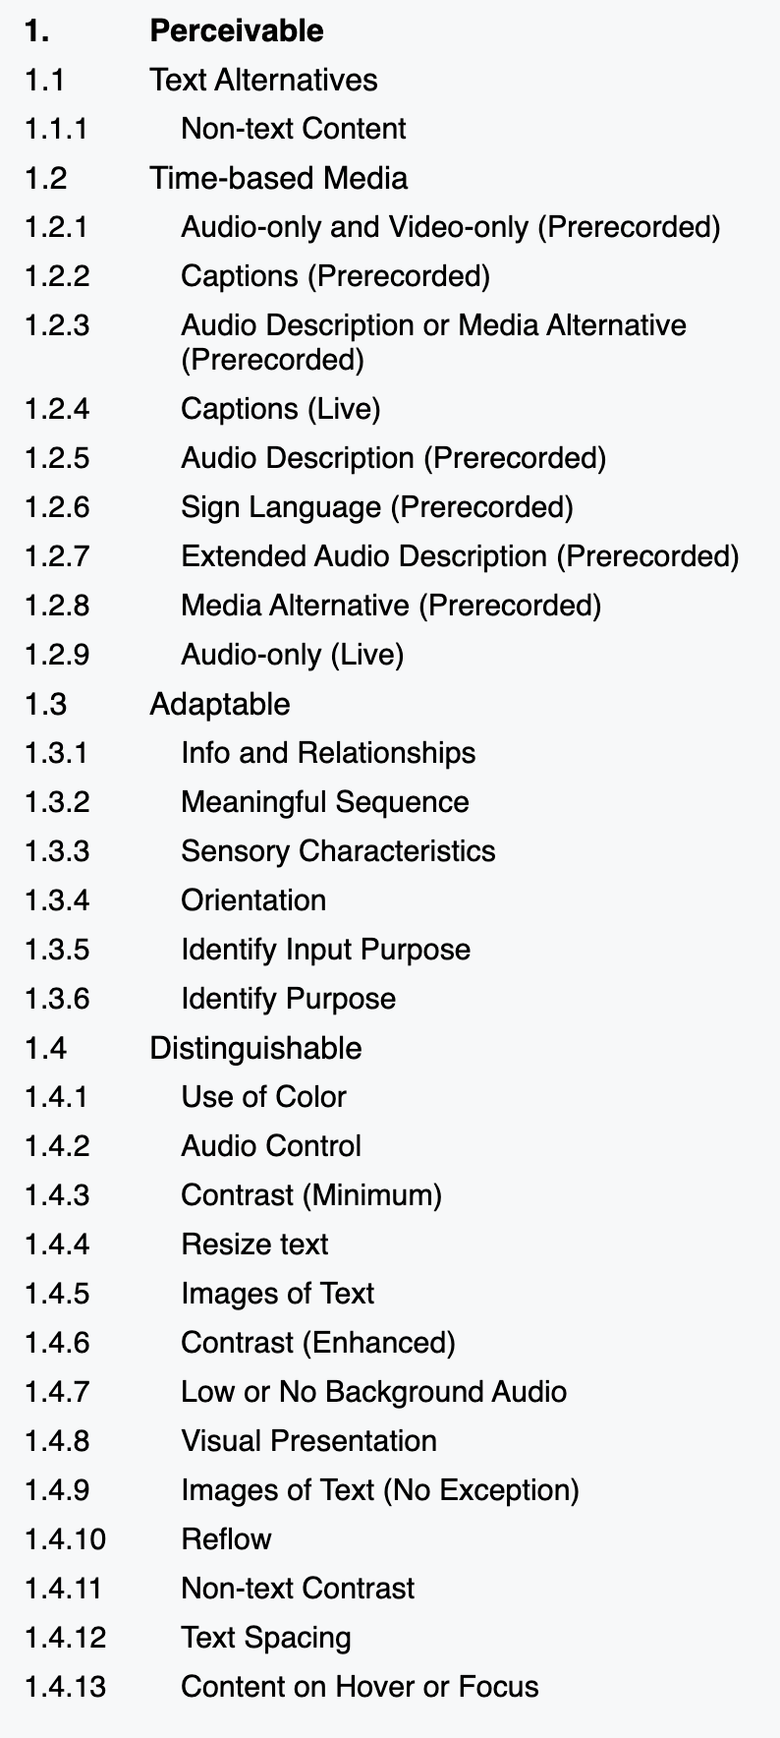
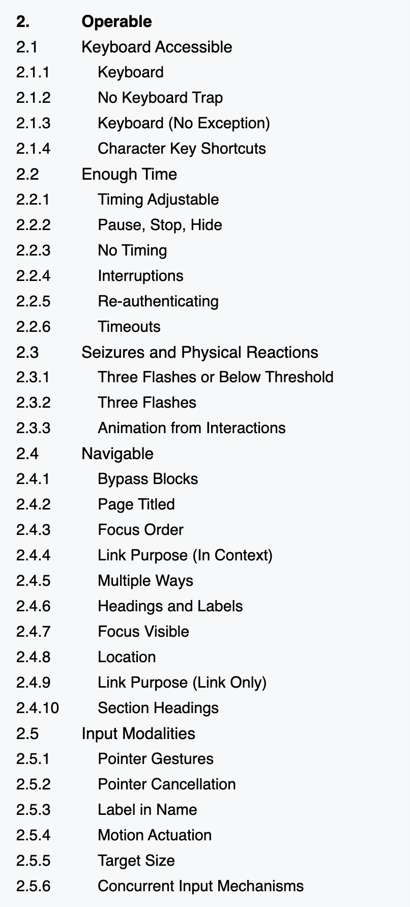
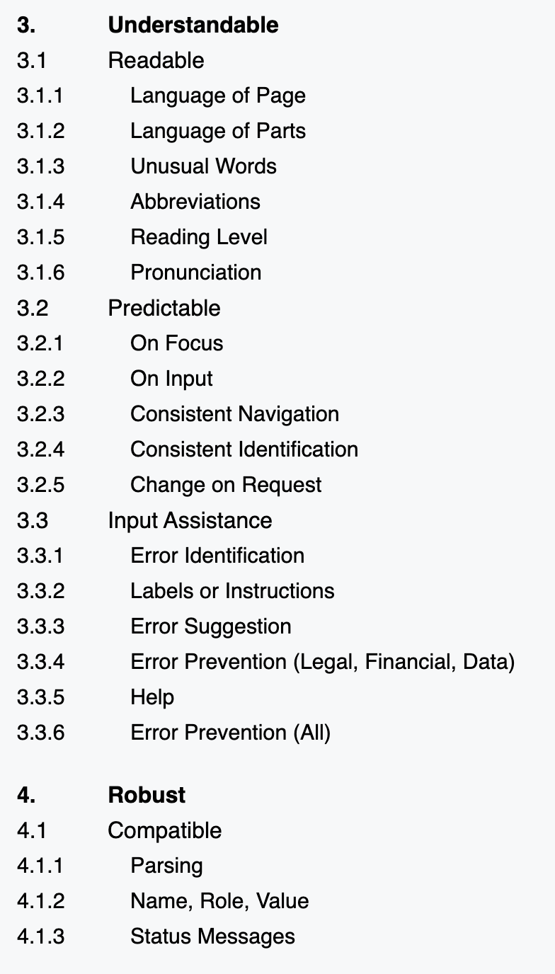
Web Content Accessibility Guidelines
43

Slide 44
Input data: a goldilocks problem
We lacked input data that was just right.
Web Standards
Academic Research
Practitioner Artifacts
Too broad for visualization.
Heavily focused on vision.
Technically specific.
44

Slide 45
Thematic analysis of standards, research, and practitioner artifacts produced 45 heuristics.
Coded Data
Web Standards
Academic Papers
45 Heuristics
Practitioner Artifacts
(all data tagged with 29 Codes)
45

Slide 46
26 of our heuristics neatly fit back in to WCAG’s 4 Principles
Perceivable (7)
Operable (7)
26 Simple Heuristics
Understandable (9)
Robust (3)
46

Slide 47
Perceivable:
Different ways of perceiving.
47
Notes:
Make more of a note!!!

Slide 48
Perceivable:
Different ways of perceiving.
Operable:
Different ways of interacting.
48
Notes:
Make more of a note!!!

Slide 49
Perceivable:
Different ways of perceiving.
Operable:
Different ways of interacting.
Understandable:
A minimum level of comprehension.
49
Notes:
Make more of a note!!!

Slide 50
Perceivable:
Different ways of perceiving.
Operable:
Different ways of interacting.
Understandable:
A minimum level of comprehension.
Robust:
Standards, semantics, and technological interoperability.
50
Notes:
Make more of a note!!!

Slide 51
But 19 were complex combinations of the first 4 and demanded new themes.
Perceivable (7)
Operable (7)
26 Simple Heuristics
Understandable (9)
Robust (3)
Compromising (7)
19 Complex Heuristics
Assistive (5)
Flexible (7)
51

Slide 52
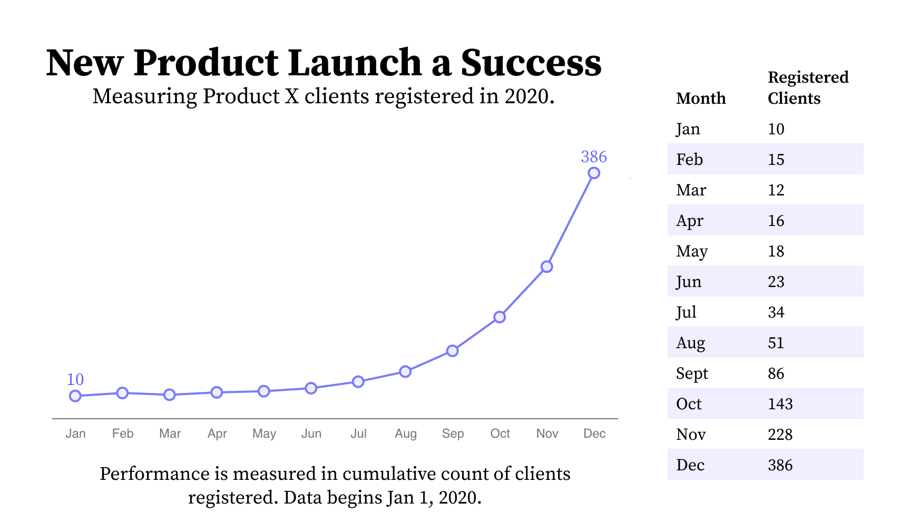
Compromising:
Heuristics that mix understandable and robust, evaluating the different ways people use and understand information during interaction.
52

Slide 53
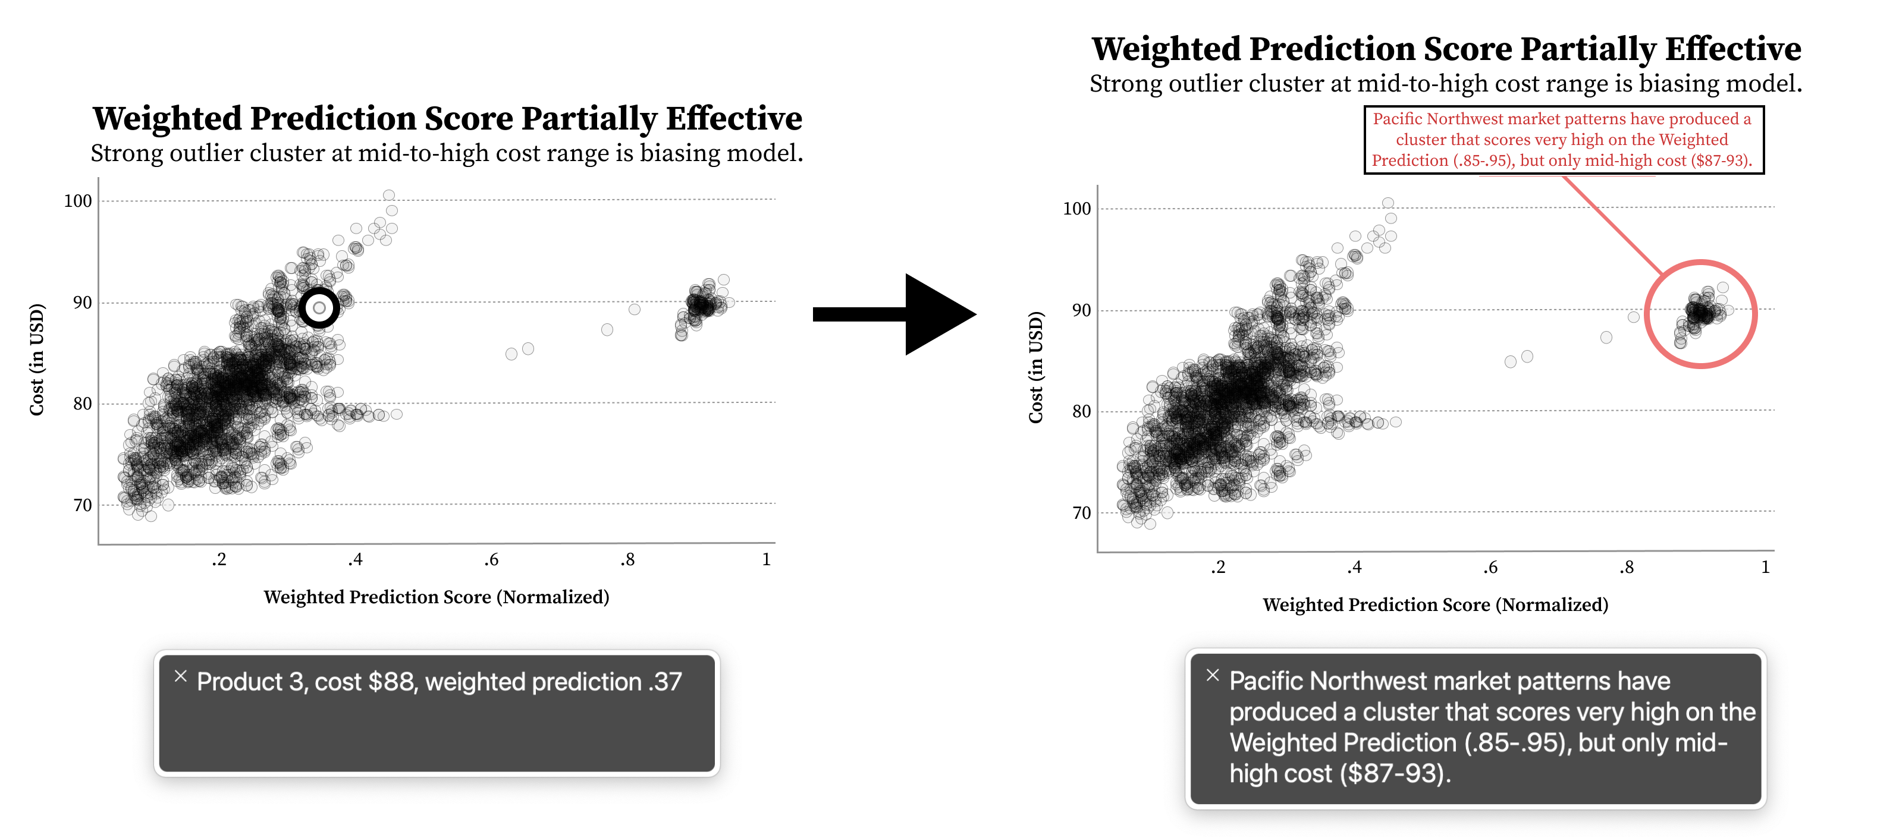
Assistive:
Heuristics that mix understandable and perceivable, focusing on the labor required for access.
53

Slide 54
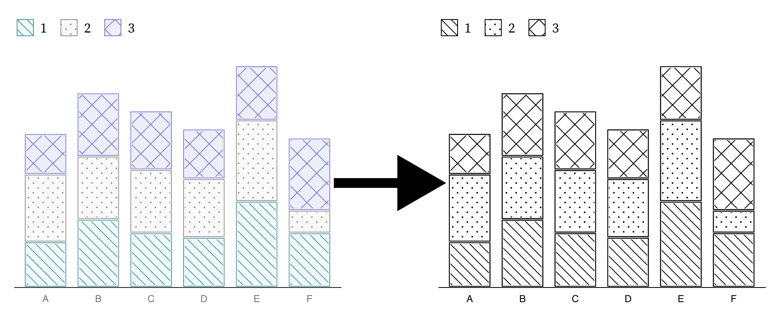
Flexible:
Heuristics that mix perceivable and robust, emphasizing the importance of adjustable and adaptive presentations.
54

Slide 55
How did we evaluate Chartability?
55

Slide 56
Most research evaluating heuristics measures consistency across evaluations or the effectiveness of the outcomes.
56

Slide 57
Can we find cases where practitioners found this work intimidating and are now more confident and willing?
57

Slide 58
“An organized set of heuristics and examples gave me the confidence I needed!”
58

Slide 59
5 stages of evaluation
4 Beta Tests
Early Advice
2 Demo Sessions
Professional Workshop
Practitioner Test + Interview
59

Slide 60
First 4 evaluations helped us discover critical heuristics and improve
Deep Feedback Sessions
Professional Workshop
Beta Testing
Early Advice
4 preliminary audits
4 experts and 6 PWD
14 experts, 5 with disabilities
50 participants
10 Critical Heuristics
60

Slide 61
#5: Testing Chartability in the wild
We chose to evaluate real projects being worked on by real teams. All participants are experts in data visualization.
61

Slide 62
The practitioner test
Pre-questions (likert)
Let them use Chartability while we observe (2 – 8hr sessions)
We ask post-questions
After the session, we separately audit their work for comparison
62

Slide 63
3 accessibility novices. Each with 1 project.
63

Slide 64
3 accessibility experts. 2 with a shared project.
64

Slide 65
Novices: 3 / 3 felt more confident auditing visualizations for accessibility after Chartability.
65

Slide 66
Expansive:
“Chartability helps me consider so much more than colorblindness”
66

Slide 67
Clarifying:
“I was overwhelmed by accessibility at first. But after trying Chartability, now I feel like I have a process.”
67

Slide 68
Experts: 3 / 3 intend to keep using Chartability in their own professional work.
68

Slide 69
Grounding:
“Chartability did a very good job of highlighting concerns that are often ignored or forgotten when auditing and designing/developing”
69

Slide 70
Goes beyond:
“Chartability goes beyond compliance. It is clearly focusing on a good experience.”
70

Slide 71
What other results are worth noting from Chartability’s use?
71

Slide 72
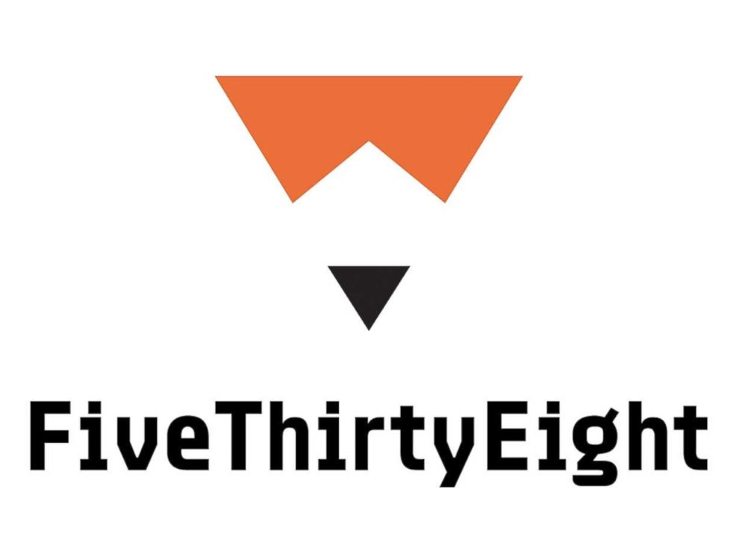
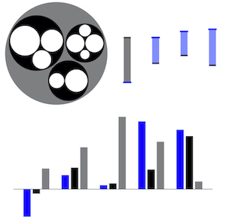
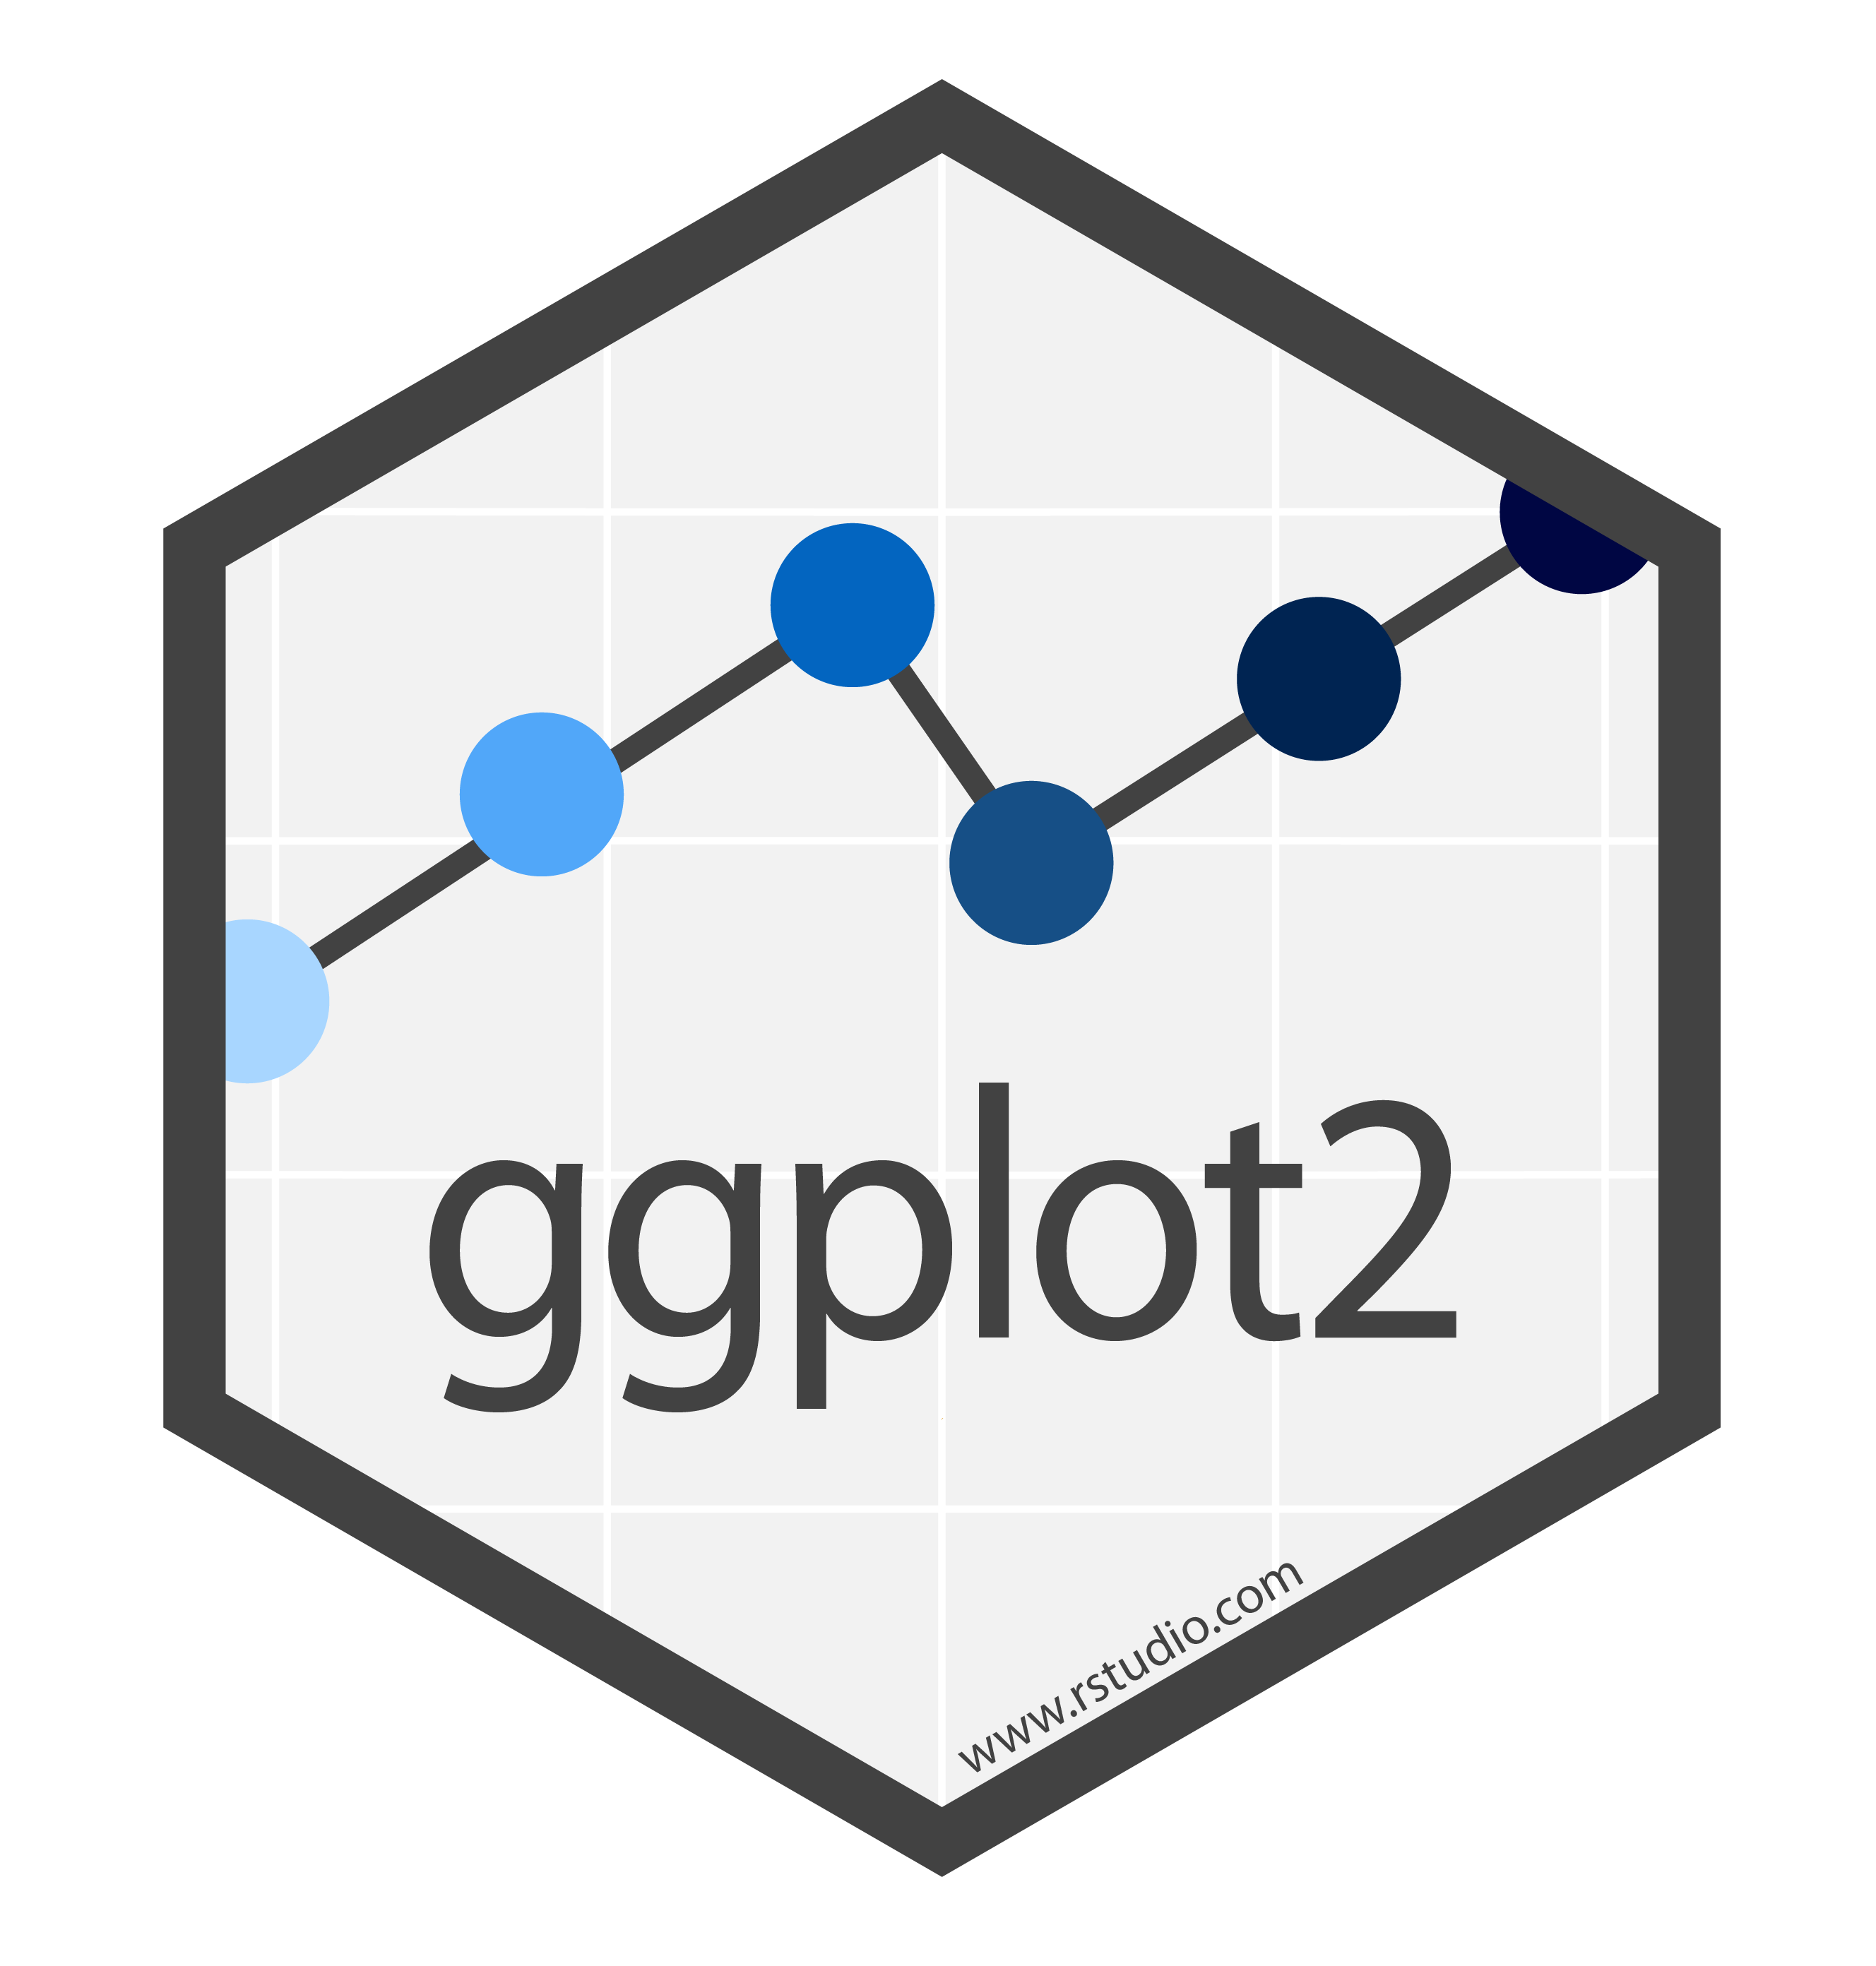
Chartability is well-travelled
72

Slide 73
Community Involvement has Improved Chartability
Chartability is now on Version 2, with 50 total heuristics (14 of which are critical).
73

Slide 74
Our challenge:
Can future research consider more than just visual disabilities?
74

Slide 75
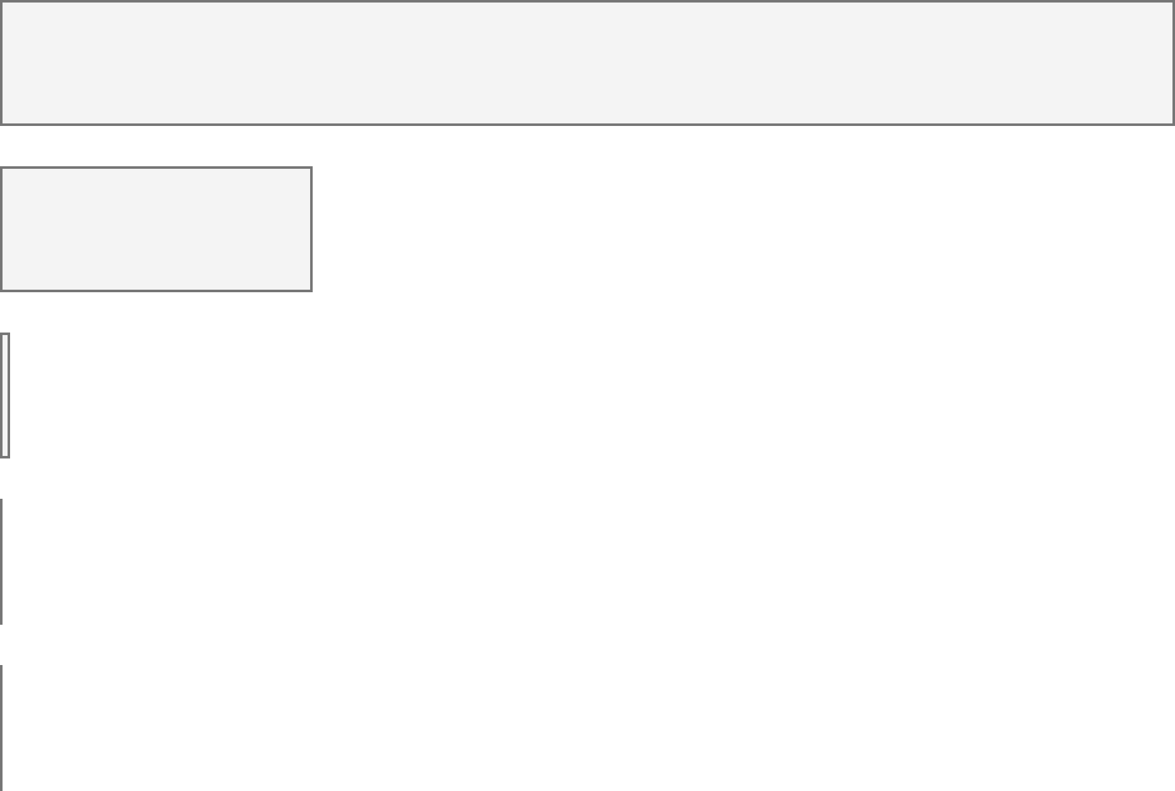
Disabilities in the US
Accessibility in Visualization Research
Color Vision Deficiency
3.7%
Color Vision Deficiency
233
Blindness, Low Vision
4.5%
Blindness, Low Vision
62
Cognitive, Neurological
10.8%
Cognitive, Neurological
2
Motor, Dexterity
13.7%
Motor, Dexterity
0
Vestibular, Motion
7.4%
Vestibular, Motion
0
75

Slide 76
Every area of disability affects data visualization work.
Visual design
3.7%
Color Vision Deficiency
Non-visual design
4.5%
Blindness, Low Vision
Narrative design, statistics, storytelling
10.8%
Cognitive, Neurological
13.7%
Motor, Dexterity
Interaction design, device considerations, performance
7.4%
Vestibular, Motion
Animation, transitions
76

Slide 77
My future work:
How do technical design materials influence practitioner behavior?
77

Slide 78
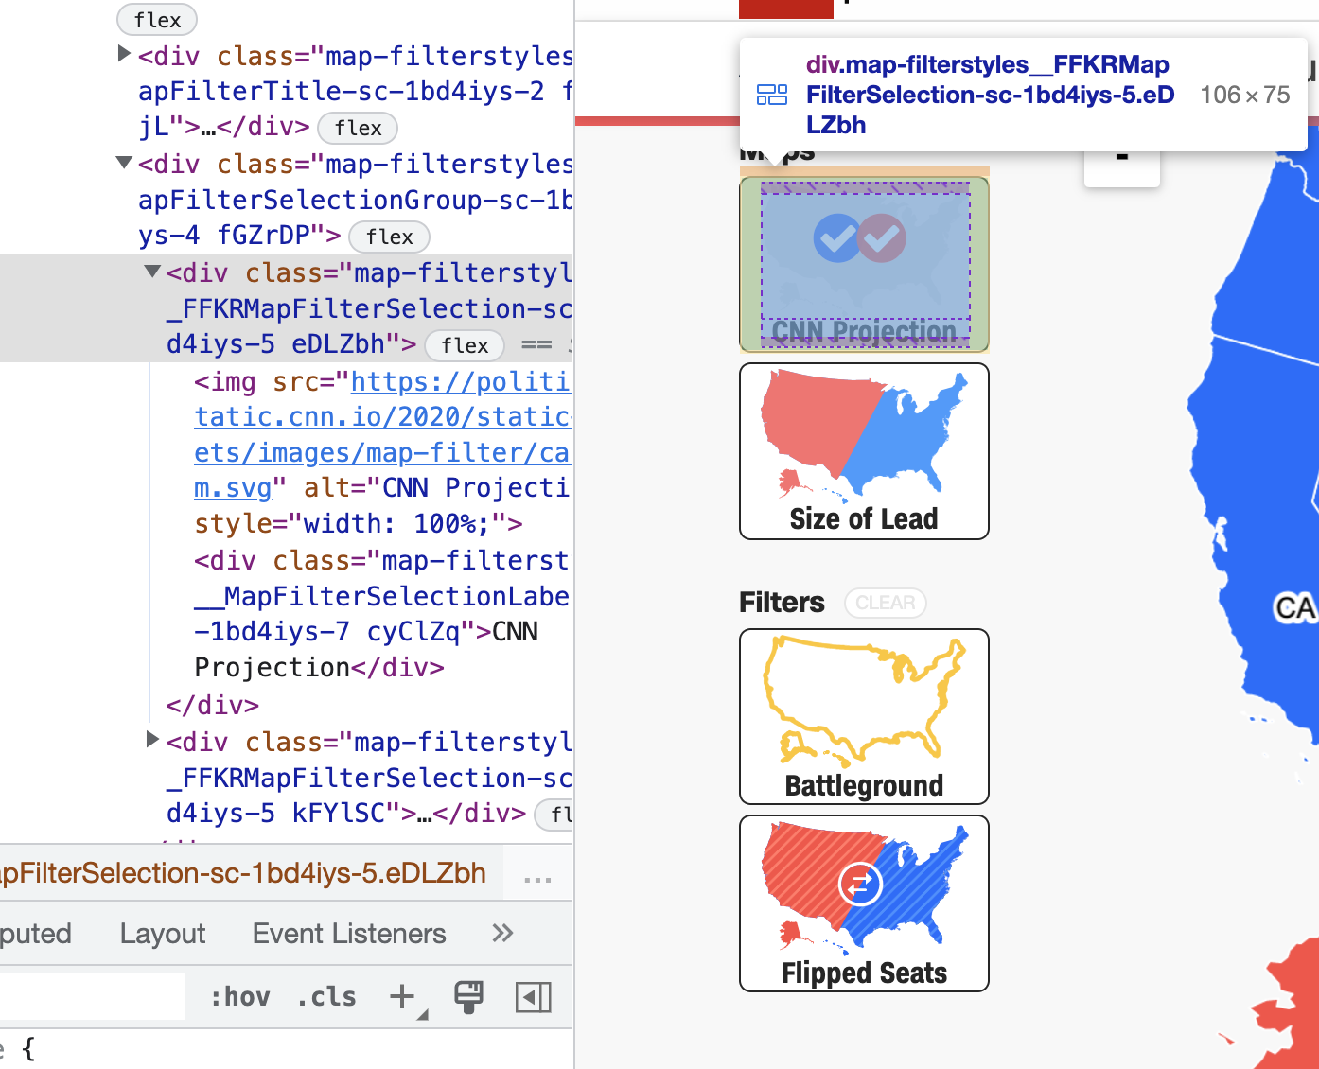
Why do practitioners use tools and materials that produce inaccessible outcomes?
78

Slide 79
How do tools shape how practitioners imagine the potential of their work?
79

Slide 80
CHARTABILITY
Frank Elavsky, Comm Talk, 2022 @FrankElavsky
frank.computer/chartability
How accessible is my visualization? Evaluating visualization accessibility with Chartability.
hcii.cmu.edu
axle-lab.com
dig.cmu.edu
by Frank Elavsky, Cynthia Bennett, Dominik Moritz

