Slide 1
Chartability How accessible is my visualization? Evaluating visualization accessibility with Chartability
Frank Elavsky, Cynthia Bennett, and Dominik Moritz
of Carnegie Mellon University

Slide 2
26% of people living in the United States self-report living with a disability that affects their daily life.

Slide 3
Research coverage of accessibility in visualization doesn’t reflect the reality of people living with disabilities.

Slide 4
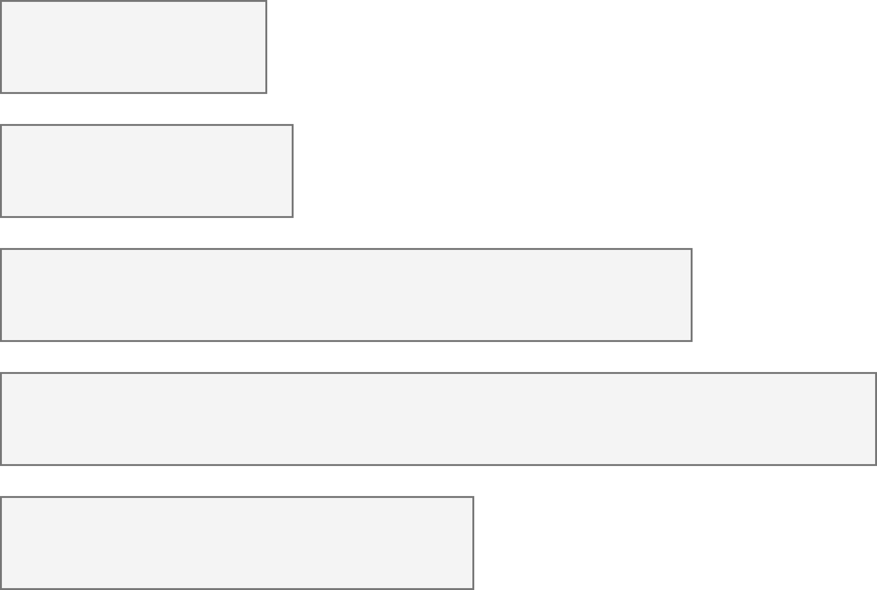
Disabilities in the US
Accessibility in Visualization Research
Color Vision Deficiency*
4.2%
Color Vision Deficiency
233
Blindness, Low Vision
4.5%
Blindness, Low Vision
62
Cognitive, Neurological
10.8%
Cognitive, Neurological
2
Motor, Dexterity
13.7%
Motor, Dexterity
0
Vestibular, Motion
7.4%
Vestibular, Motion
0
* CVD statistics are only for people of European Ancestry. Mean total Global and US numbers are not known.
Chartability, Elavsky et al

Slide 5
How can we build a more accessible world if we don’t know how to recognize inaccessibility?

Slide 6
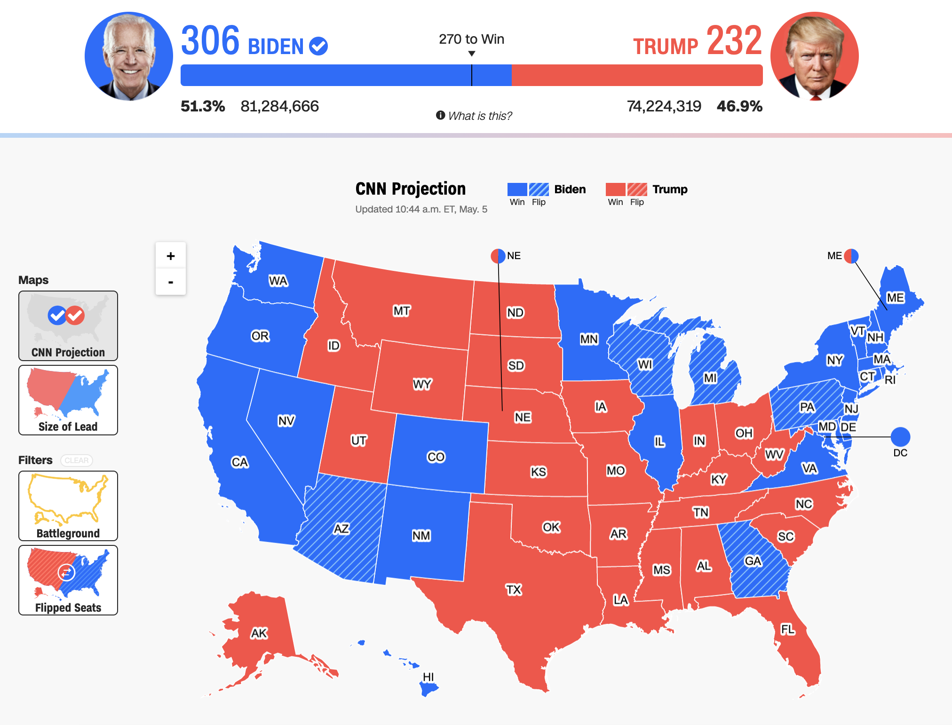
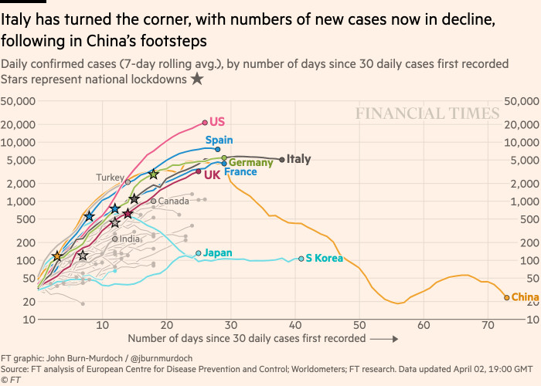
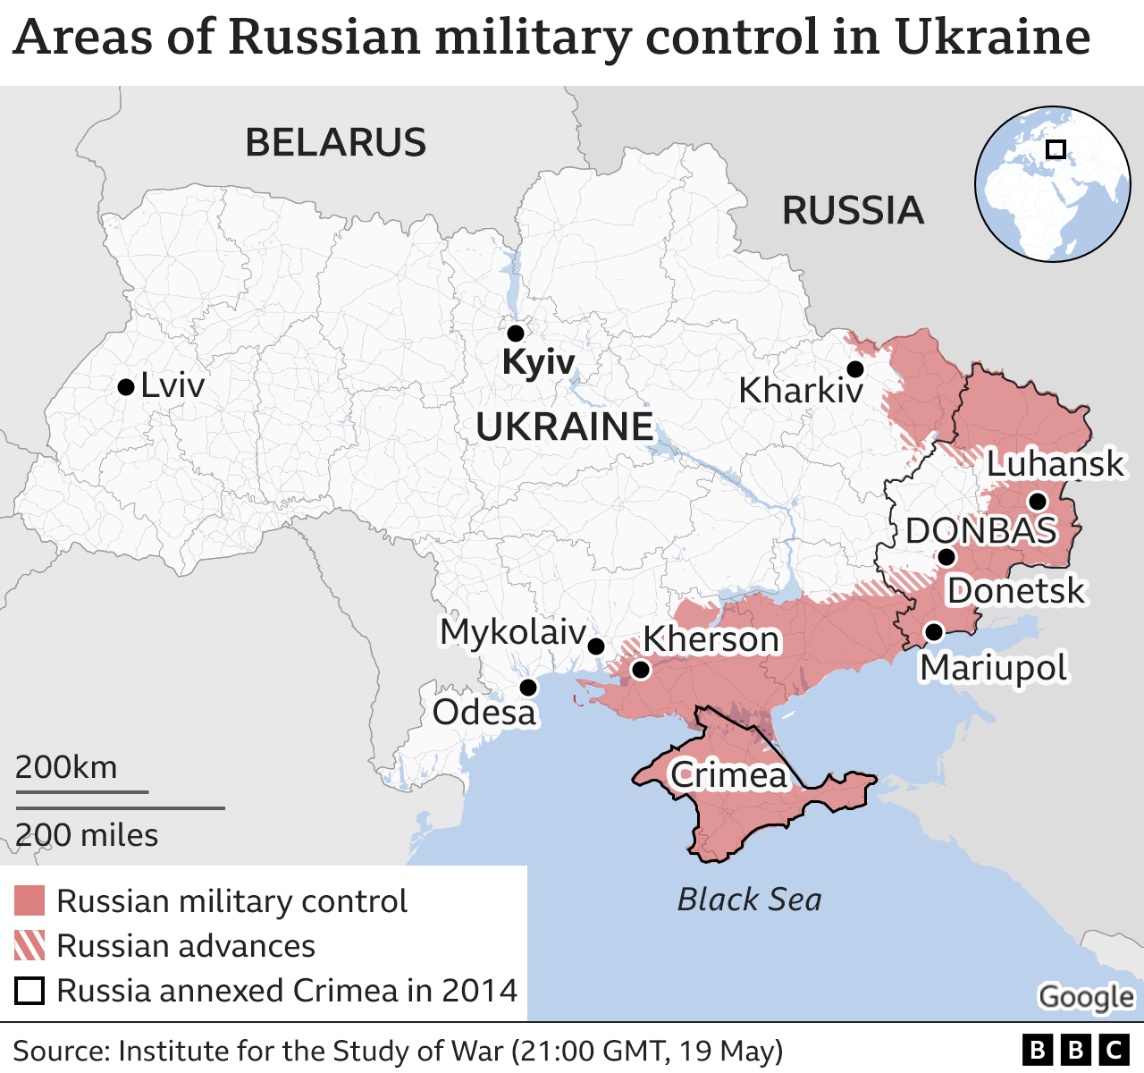
Visualization informs the public and guides decision-making, policy, and business.
Politics
(CNN)
Health
(Financial Times)
Conflicts
(BBC)
Chartability, Elavsky et al

Slide 7
It is important that visualization practitioners can recognize access barriers in their work.
Politics
(CNN)
Health
(Financial Times)
Conflicts
(BBC)
Chartability, Elavsky et al
7

Slide 8
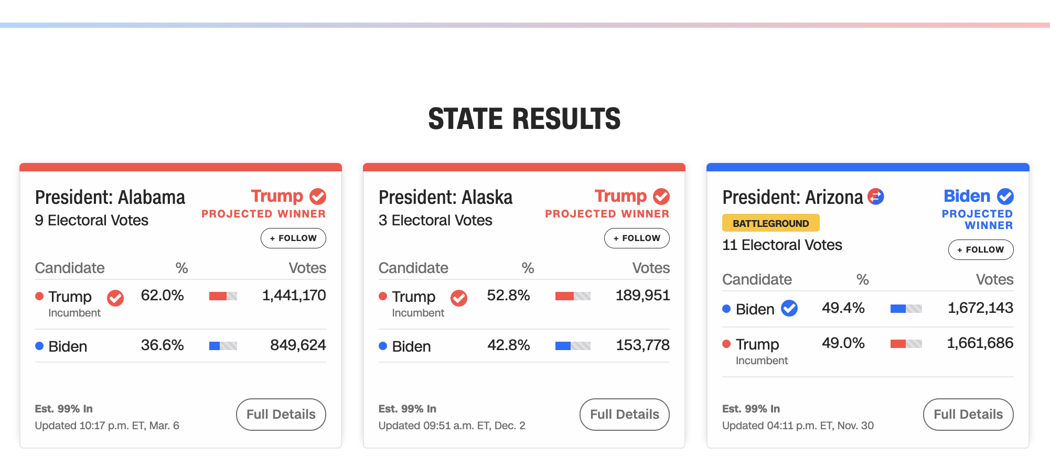
Let’s evaluate this one with Chartability.
Chartability, Elavsky et al

Slide 9
Perceivable Failures
6 – Low contrast
57 - Content is only visual
50 - Color alone is used
1 - Meaningful elements can be distinguished
Chartability, Elavsky et al

Slide 10
Perceivable Failures
6 – Low contrast
57 - Content is only visual
50 - Color alone is used
1 - Meaningful elements can be distinguished
Chartability, Elavsky et al

Slide 11
Perceivable Failures
6 – Low contrast
57 - Content is only visual
53 - Color alone is used
1 - Meaningful elements can be distinguished
Chartability, Elavsky et al

Slide 12
Perceivable Failures
6 – Low contrast
57 - Content is only visual
50 - Color alone is used
3 - Meaningful elements can be distinguished
Chartability, Elavsky et al

Slide 13
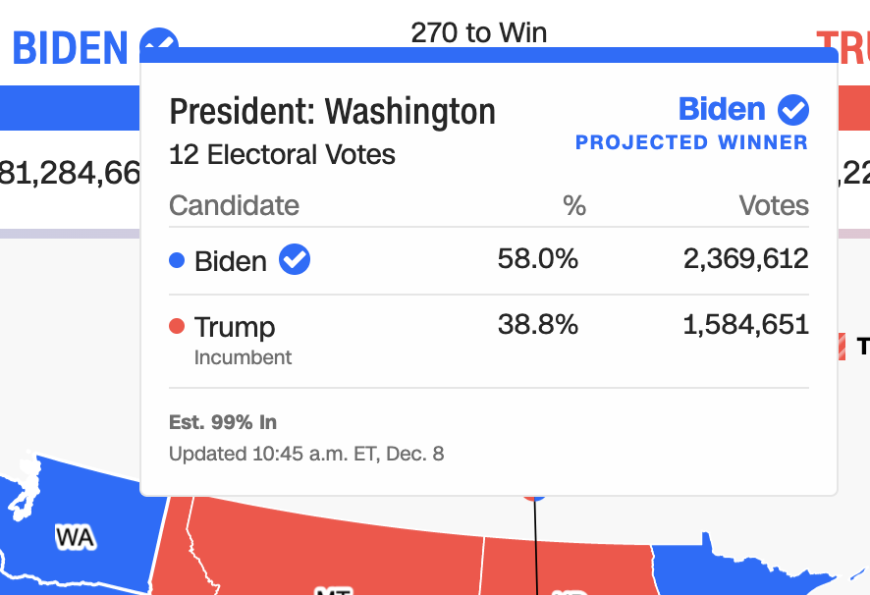
Operable Failures
54 - Interaction modality only has one input type
58 - No interaction cues or instructions
5 - Low contrast on interactive elements
4 - Keyboard focus indicator missing
4 - Complex actions have no alternative
18 - Target pointer interaction is too small
Chartability, Elavsky et al

Slide 14
Operable Failures
54 - Interaction modality only has one input type
58 - No interaction cues or instructions
5 - Low contrast on interactive elements
4 - Keyboard focus indicator missing
4 - Complex actions have no alternative
18 - Target pointer interaction is too small
Chartability, Elavsky et al

Slide 15
Operable Failures
54 - Interaction modality only has one input type
58 - No interaction cues or instructions
5 - Low contrast on interactive elements
4 - Keyboard focus indicator missing
4 - Complex actions have no alternative
18 - Target pointer interaction is too small
Chartability, Elavsky et al

Slide 16
Operable Failures
54 - Interaction modality only has one input type
58 - No interaction cues or instructions
5 - Low contrast on interactive elements
4 - Keyboard focus indicator missing
4 - Complex actions have no alternative
18 - Target pointer interaction is too small
Chartability, Elavsky et al

Slide 17
Operable Failures
54 - Interaction modality only has one input type
58 - No interaction cues or instructions
5 - Low contrast on interactive elements
4 - Keyboard focus indicator missing
4 - Complex actions have no alternative
18 - Target pointer interaction is too small
Chartability, Elavsky et al

Slide 18
Operable Failures
54 - Interaction modality only has one input type
58 - No interaction cues or instructions
5 - Low contrast on interactive elements
4 - Keyboard focus indicator missing
4 - Complex actions have no alternative
18 - Target pointer interaction is too small
Chartability, Elavsky et al

Slide 19
Continue this for: Understandable,
Robust,
Compromising,
Assistive,
and Flexible
Chartability, Elavsky et al

Slide 20
978 access failures found in ~60 minutes.
Robust:
275 - Does not conform to standards
82 - Semantically invalid
12 - Fragile technology support
Compromising:
54 - Information can only be reached through single process
61 - Information cannot be navigated according to narrative or structure
Assistive:
101 - Navigation and interaction is tedious
Flexible:
2 - User style change not respected
121 - User text adjustments are not respected
1 - Scrolling experiences cannot be adjusted or opted out of
Contrast and textures cannot be adjusted
Perceivable:
6 – Low contrast
57 - Content is only visual
50 - Color alone is used
3 - Meaningful elements can be distinguished
Operable:
54 - Interaction modality only has one input type
58 - No interaction cues or instructions
5 - Low contrast on interactive elements
4 - Keyboard focus indicator missing
4 - Complex actions have no alternative
18 - Target pointer interaction is too small
Understandable:
4 - Interactive context is not clear
6 - Metrics or variables are undefined
Chartability, Elavsky et al
20

Slide 21
Our problem:
Learning how to identify an “inaccessible” visualization is hard.

Slide 22
Our research question:
Can we explore how to reduce the difficulty of this work?

Slide 23
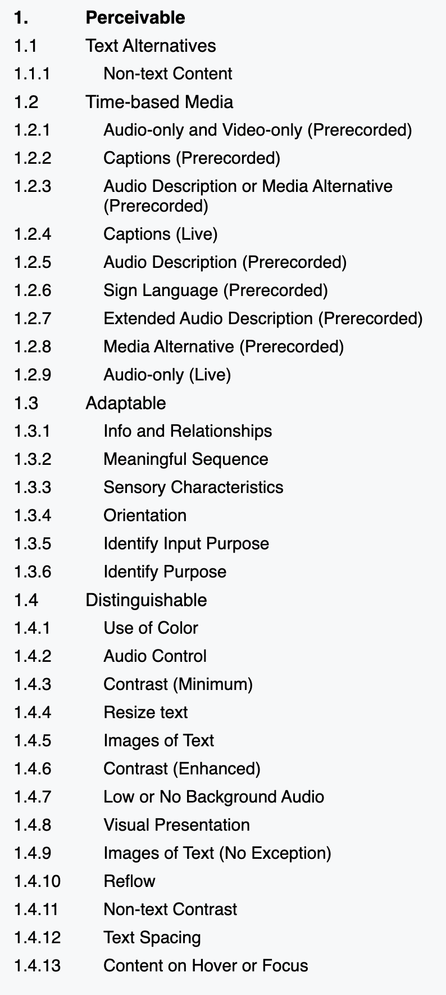
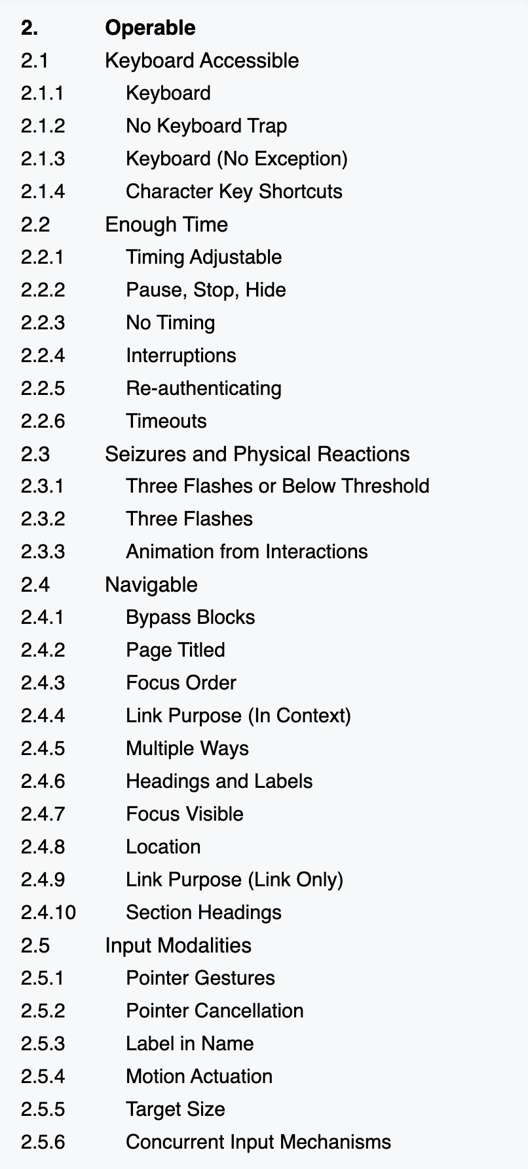
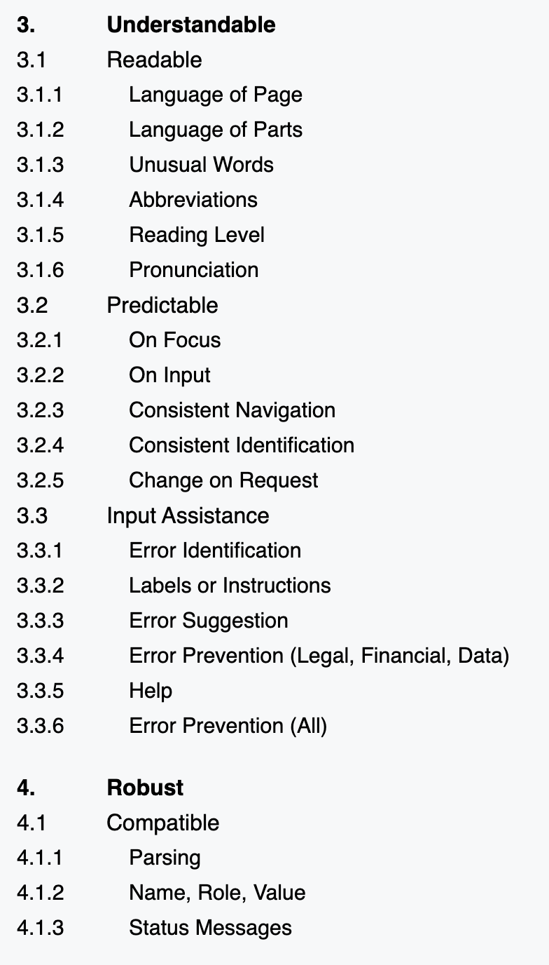
Standards are overwhelming and leave a lot of gaps for evaluating interactive data visualizations.
All 78 criteria in WCAG must be interpreted for data visualization work.
Chartability, Elavsky et al

Slide 24
Can we organize knowledge to fill the gaps left by standards?

Slide 25
Input data: a goldilocks problem
We lacked input data that was just right.
Too broad for visualization.
Heavily focused on vision.
Technically specific.
Web Standards
Academic Research
Practitioner Artifacts
Chartability, Elavsky et al

Slide 26
Thematic analysis of standards, research, and practitioner artifacts produced 45 heuristics.
Coded Data
Web Standards
Academic Papers
45 Heuristics
Practitioner Artifacts
(all data tagged with 29 Codes)
Chartability, Elavsky et al

Slide 27
Not every heuristic fit neatly back in to accessibility principles, demanding new principles be theorized.
Perceivable (7)
Operable (7)
26 Simple Heuristics
Understandable (9)
Robust (3)
Compromising (7)
19 Complex Heuristics
Assistive (5)
Flexible (7)
Chartability, Elavsky et al

Slide 28
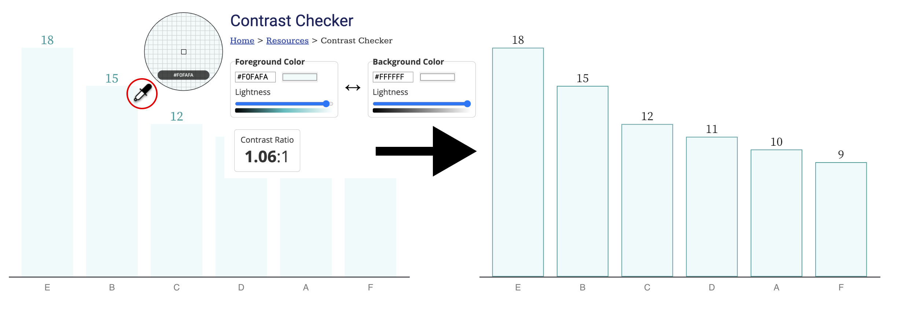
Perceivable:
Heuristics that focus on different ways of perceiving.
Chartability, Elavsky et al

Slide 29
Operable:
Heuristics that focus on different ways of interacting.
Chartability, Elavsky et al

Slide 30
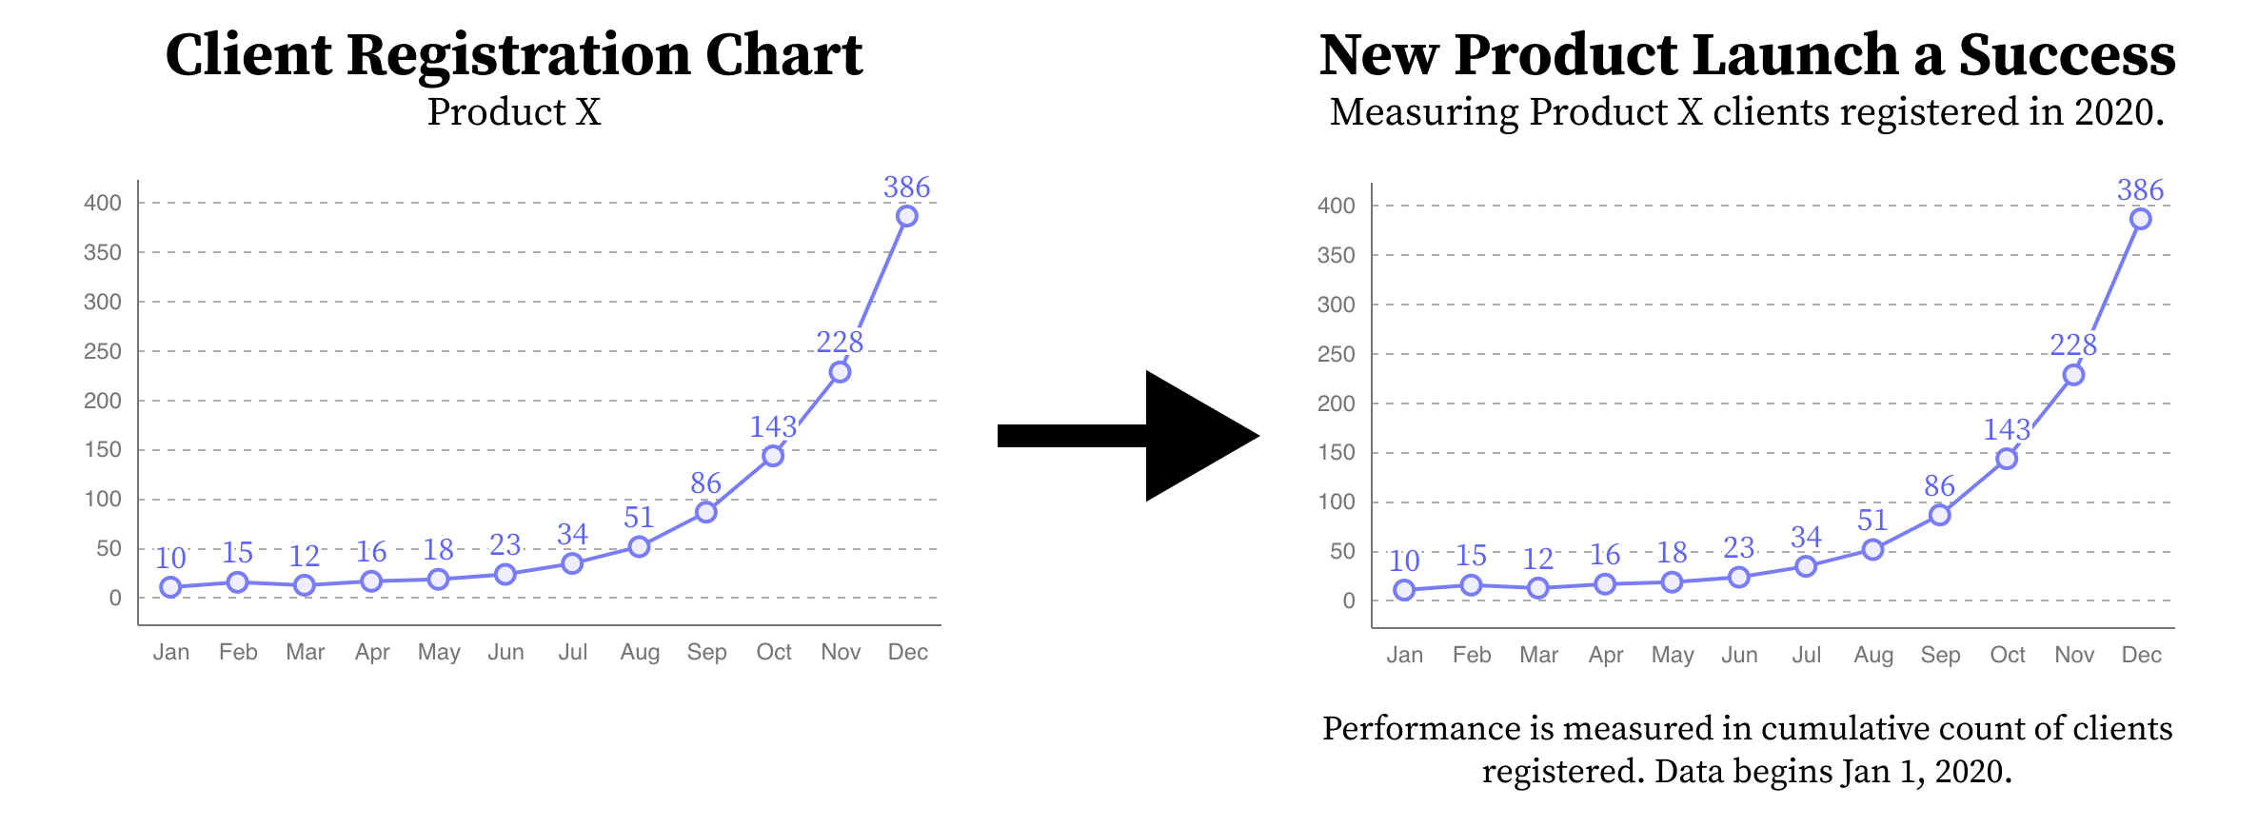
Understandable:
Heuristics that focus on a minimum level of comprehension.
Chartability, Elavsky et al

Slide 31
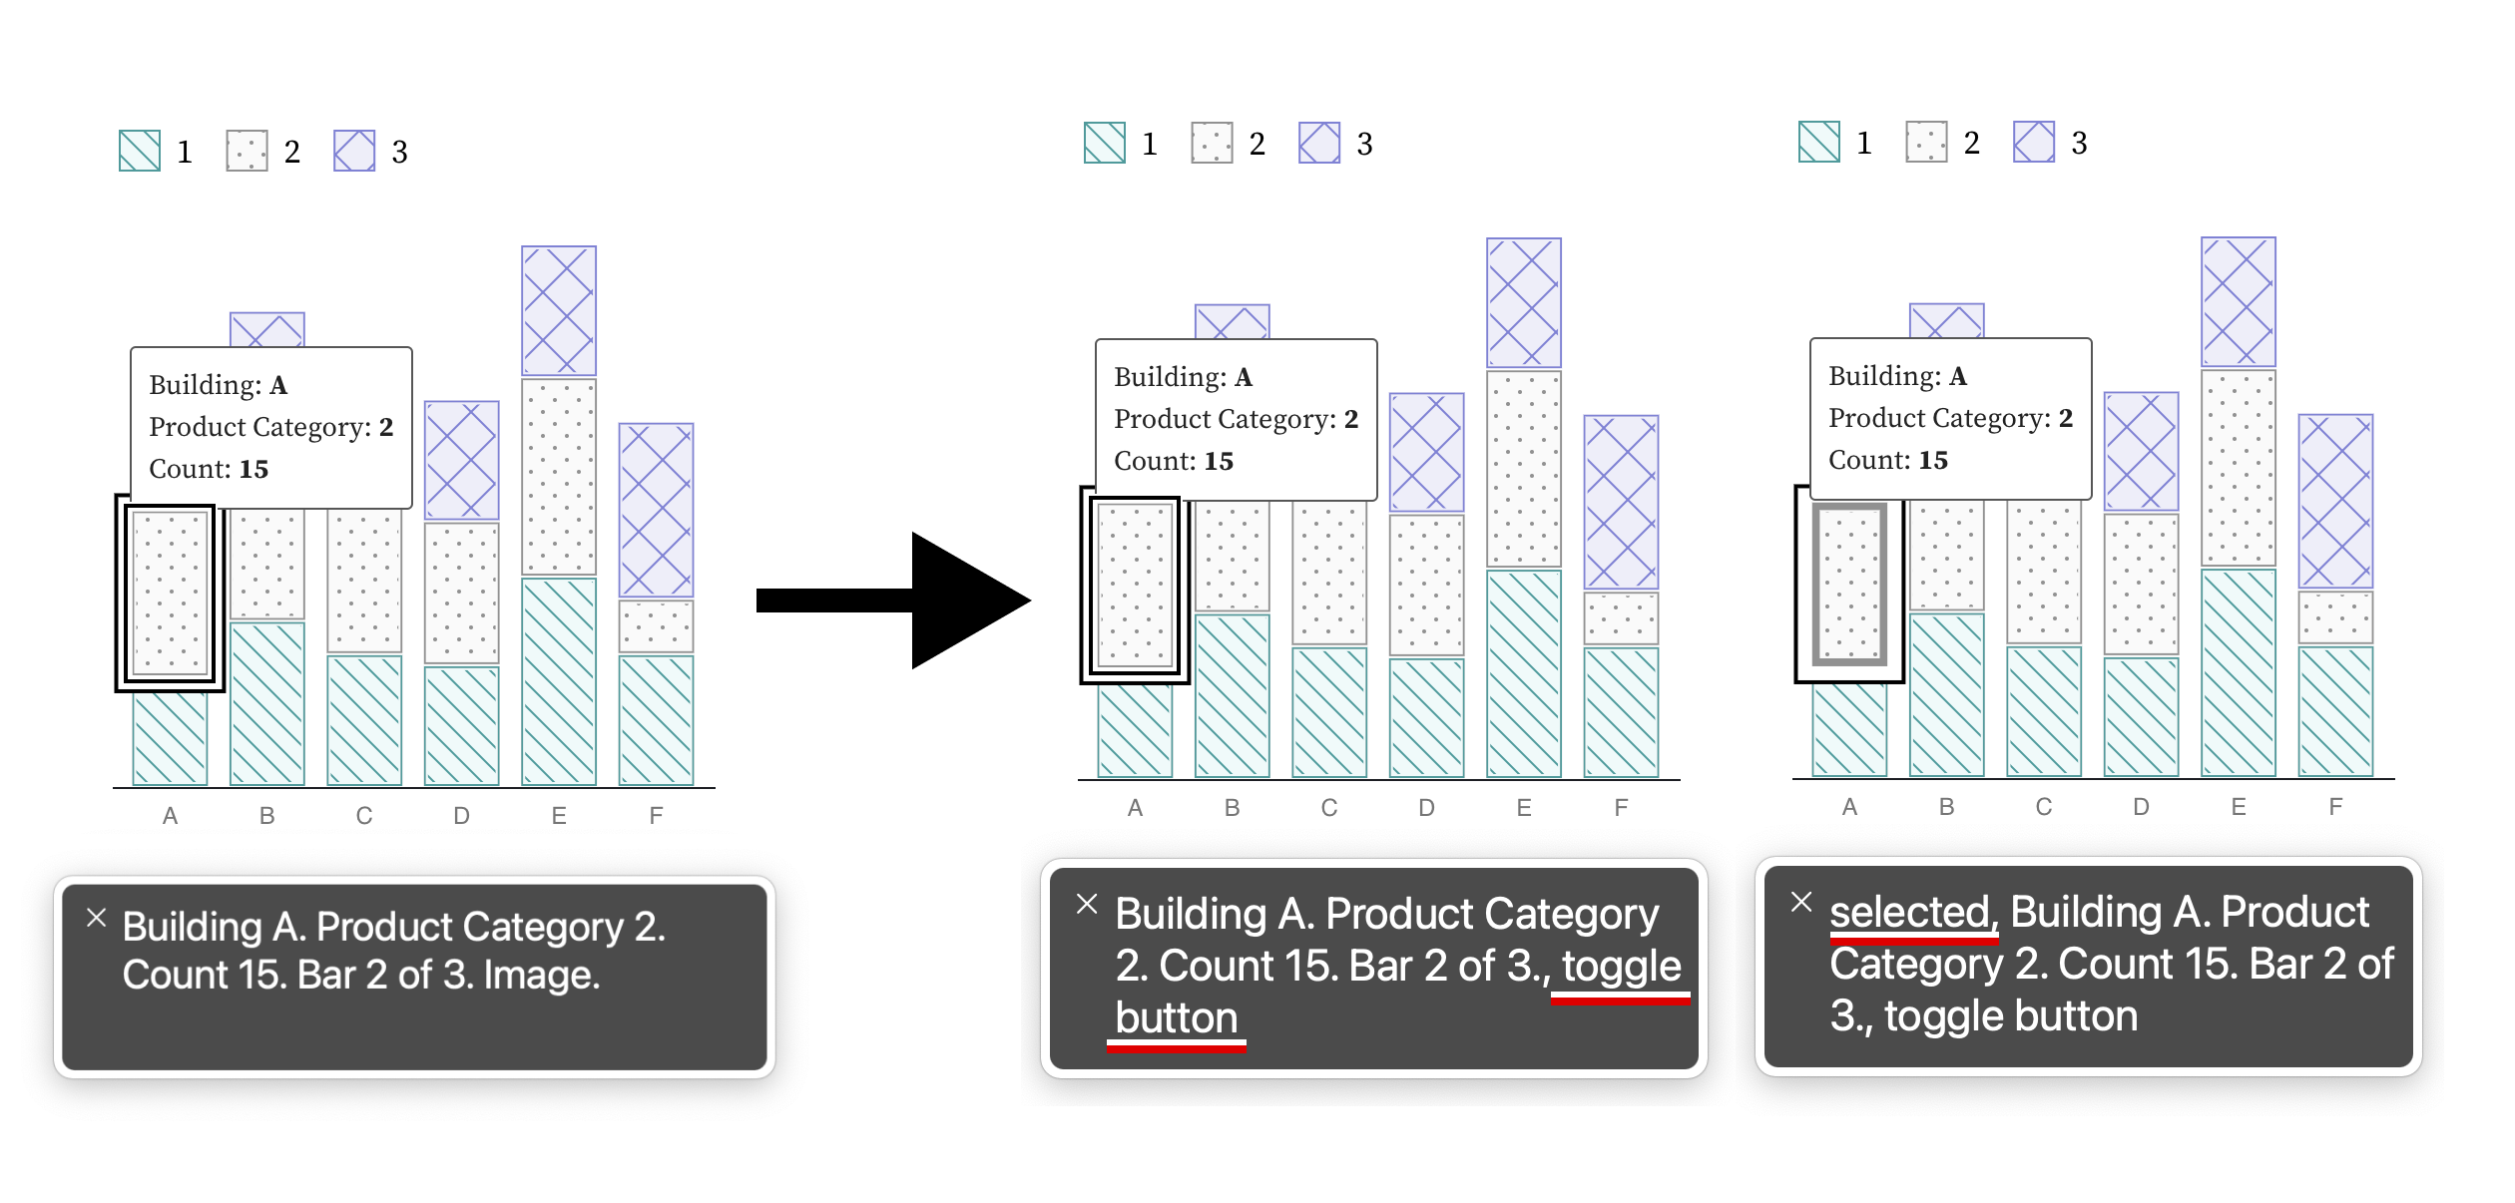
Robust:
Heuristics that focus on standards, semantics, and technological interoperability.
Chartability, Elavsky et al

Slide 32
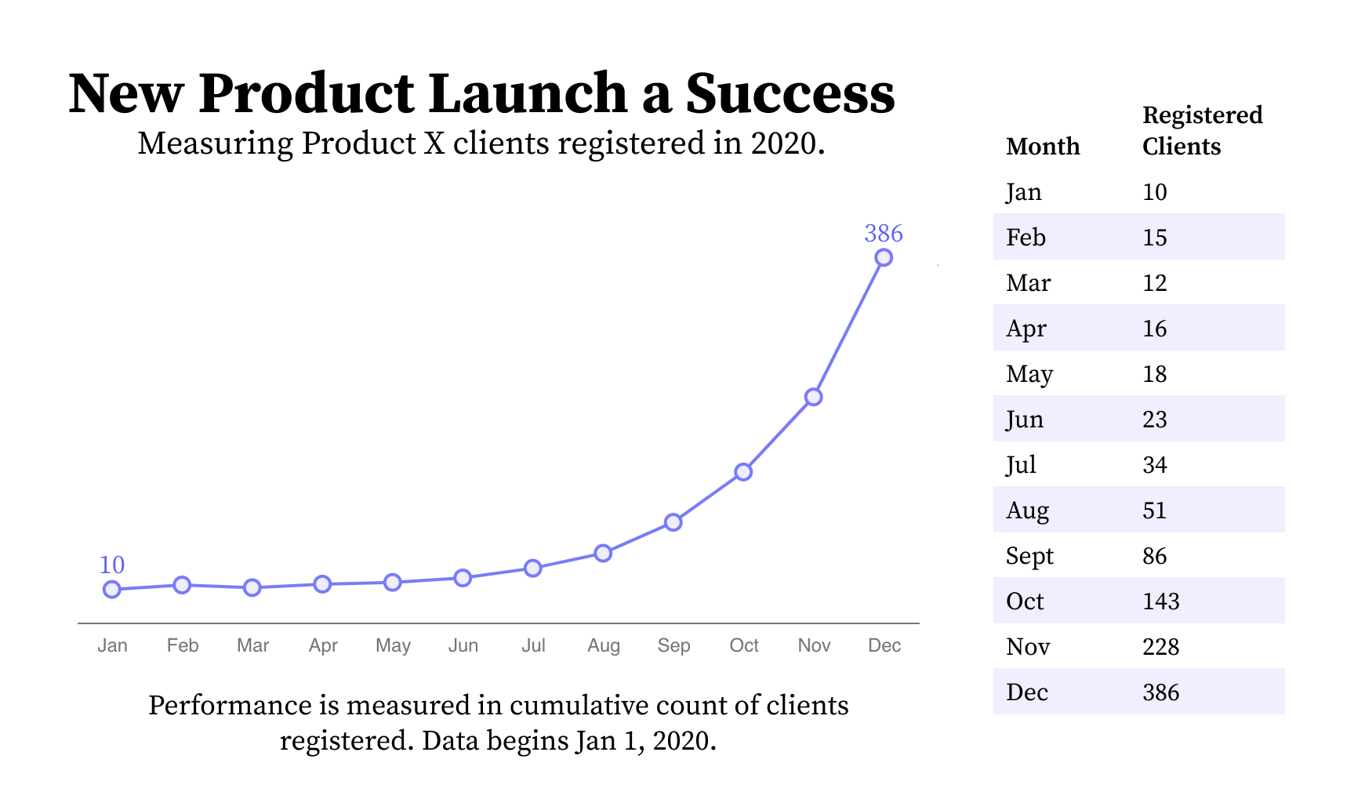
Compromising:
Heuristics that mix understandable and robust, evaluating the different ways people use and understand information during interaction.
Chartability, Elavsky et al

Slide 33
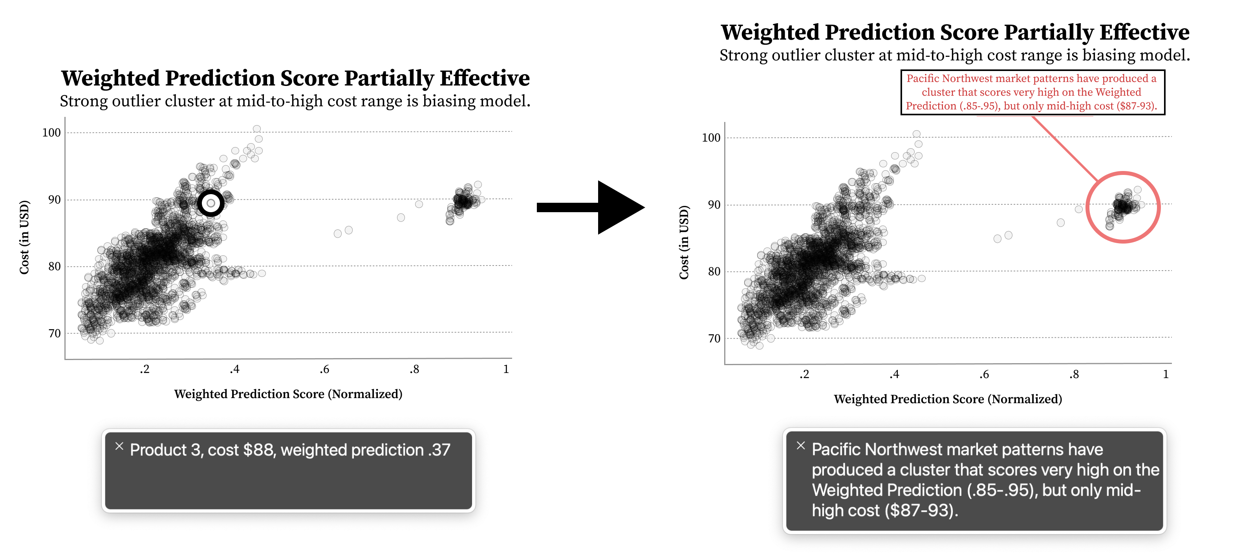
Assistive:
Heuristics that mix understandable and perceivable, focusing primarily on the labor required for access.
Chartability, Elavsky et al

Slide 34
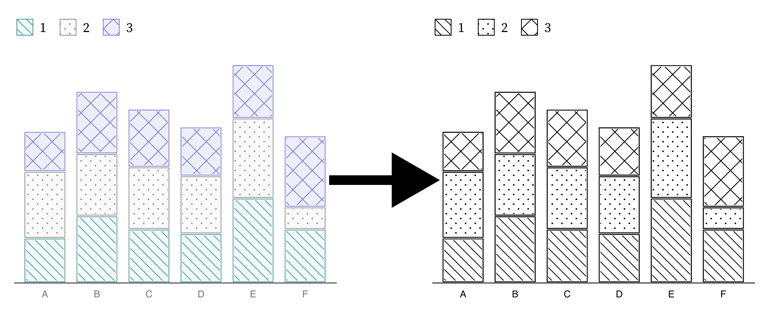
Flexible:
Heuristics that mix perceivable and robust, emphasizing the importance of adjustable and adaptive presentations.
Chartability, Elavsky et al

Slide 35
Early pre-evaluations helped us discover critical heuristics
Professionals and community members with disabilities offered us early feedback on the most important heuristics in Chartability.
Deep Feedback Sessions
Professional Workshop
Beta Testing
Early Advice
4 preliminary audits
4 experts and 6 PWD
14 experts, 5 with disabilities
50 participants
10 Critical Heuristics
Chartability, Elavsky et al

Slide 36
How do we evaluate a set of heuristics in a complex domain?

Slide 37
We tested Chartability in the wild
We chose to evaluate real projects being worked on by real teams. All participants are experts in data visualization.
3 accessibility novices. Each with 1 project.
3 accessibility experts. 2 with a shared project.
Chartability, Elavsky et al

Slide 38
Novices: 3 / 3 felt more confident auditing visualizations for accessibility after Chartability.
Chartability, Elavsky et al

Slide 39
“Audits are slow, but help me focus and prioritize.”
Chartability, Elavsky et al

Slide 40
“Chartability helps me consider so much more than colorblindness”
Chartability, Elavsky et al

Slide 41
“I was overwhelmed by accessibility at first. But after trying Chartability, now I feel like I have a process.”
Chartability, Elavsky et al

Slide 42
Experts: 3 / 3 intend to keep using Chartability in their own professional work.
Chartability, Elavsky et al

Slide 43
“Chartability did a very good job of highlighting concerns that are often ignored or forgotten when auditing and designing/developing”
“Depending on the day I might not remember everything. I am more confident in consistency between different auditing sessions.”
Chartability, Elavsky et al

Slide 44
“Chartability goes beyond compliance. It is clearly focusing on a good experience.”
Chartability, Elavsky et al

Slide 45
“We need more resources. Learning how to use assistive technologies and auditing tools is very hard.”
Chartability, Elavsky et al

Slide 46
“We need more examples. Some tests are obvious, but it would be helpful to see what good and bad look like.”
Chartability, Elavsky et al

Slide 47
What other results are worth noting from Chartability’s use?

Slide 48
Community Involvement has Improved Chartability
Chartability is now on Version 2, with 50 total heuristics (14 of which are critical).
Chartability, Elavsky et al

Slide 49
Chartability is well-travelled
Chartability, Elavsky et al

Slide 50
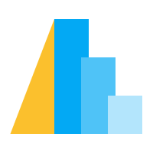
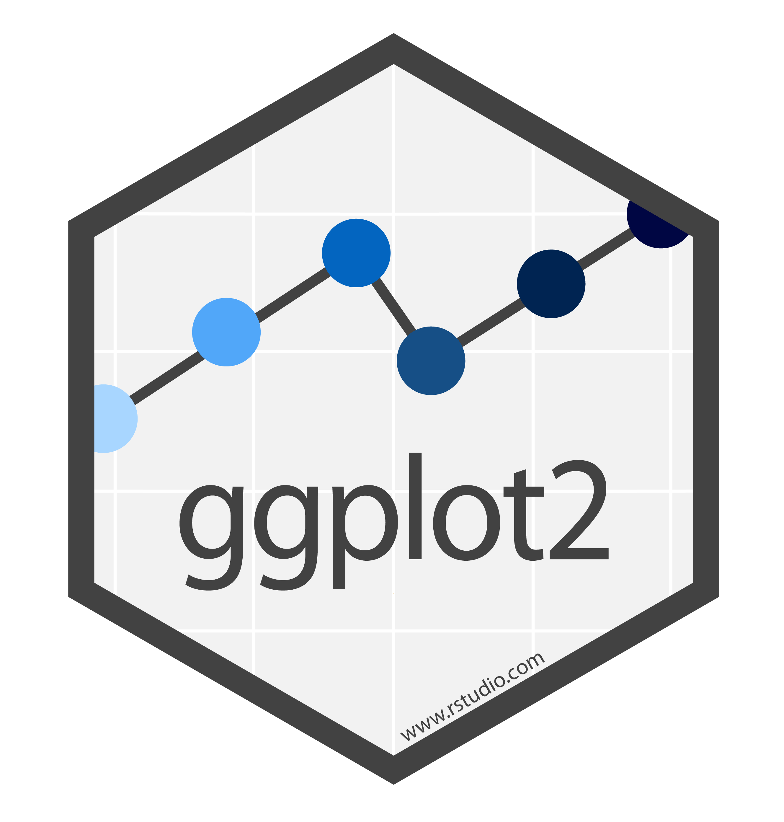
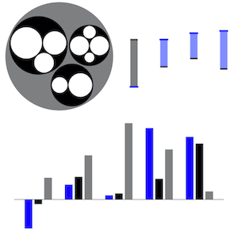
Chartability has breadth
Chartability, Elavsky et al

Slide 51
Our challenge:
Can future research consider more than just visual disabilities?

Slide 52
Comprehensive accessibility research could significantly impact the future of data visualization.

Slide 53
Accessibility Considerations
Areas of visualization practice affected
Visual design
4.2%
Color Vision Deficiency*
Non-visual design
4.5%
Blindness, Low Vision
Narrative design, statistics, storytelling
10.8%
Cognitive, Neurological
Motor, Dexterity
Interaction design, device considerations, performance
13.7%
Vestibular, Motion
7.4%
Animation, transitions
* CVD statistics are only for people of European Ancestry. Mean total Global and US numbers are not known.
Chartability, Elavsky et al

Slide 54
Cognitive and neurological accessibility affect all areas of visualization practice
Visual design
Non-visual design
Narrative design, statistics, storytelling
10.8%
Cognitive, Neurological
Interaction design, device considerations, performance
Animation, transitions
* CVD statistics are only for people of European Ancestry. Mean total Global and US numbers are not known.
Chartability, Elavsky et al

Slide 55
Disability is intersectional
Visual design
Non-visual design
4.5%
Blindness, Low Vision
Narrative design, statistics, storytelling
Interaction design, device considerations, performance
Animation, transitions
* CVD statistics are only for people of European Ancestry. Mean total Global and US numbers are not known.
Chartability, Elavsky et al

Slide 56
Visualization research and practice must reflect the intersectionality of disability
Visual design
4.2%
Color Vision Deficiency*
Non-visual design
4.5%
Blindness, Low Vision
Narrative design, statistics, storytelling
10.8%
Cognitive, Neurological
Motor, Dexterity
Interaction design, device considerations, performance
13.7%
Vestibular, Motion
7.4%
Animation, transitions
* CVD statistics are only for people of European Ancestry. Mean total Global and US numbers are not known.
Chartability, Elavsky et al

Slide 57
CHARTABILITY
Chartability, Elavsky et al, 2020 @FrankElavsky
frank.computer/chartability
How accessible is my visualization? Evaluating visualization accessibility with Chartability.
hcii.cmu.edu
axle-lab.com
dig.cmu.edu
by Frank Elavsky, Cynthia Bennett, Dominik Moritz

Slide 58
A lot we couldn’t fit in the paper!
(Testing in the wild comes at the cost of intellectual property concerns.)
Chartability, Elavsky et al

Slide 59
Citations for the % disability figure
Counts of papers: my own, plus https://doi.org/10.1111/cgf.14298
% CVD: https://doi.org/10.1364/josaa.29.000313
% Motor, Blind, Cognitive: https://www.cdc.gov/ncbddd/disabilityandhealth/infographic-disability-impacts-all.html
% vestibular: https://doi.org/10.3233%2FVES-130498

