Slide 1
How to Build Inclusive Data Experiences And why our data work must be made accessible. Frank Elavsky, Carnegie Mellon University and Fizz Studio

Slide 2
These slides: tinyurl.com/inclusive_data_experiences

Slide 3
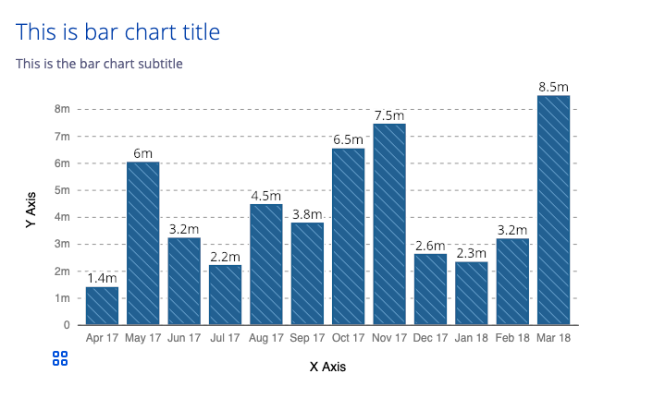
What do I do?
I am researching data interaction and accessibility at Carnegie Mellon and Apple.
I organize DataVizA11y and am an invited expert in W3C’s ARIA Working Group.
I was previously a Staff Data Experience Engineer on Visa’s DX Team.
I authored Chartability, a community-driven effort to establish heuristics for evaluating the accessibility of data experiences.
www.github.com/visa/visa-chart-components

Slide 4
Before we begin.
If you post screenshots of this talk or slides around on Twitter or wherever (and please do), remember:
Add alt text to your post!

Slide 5
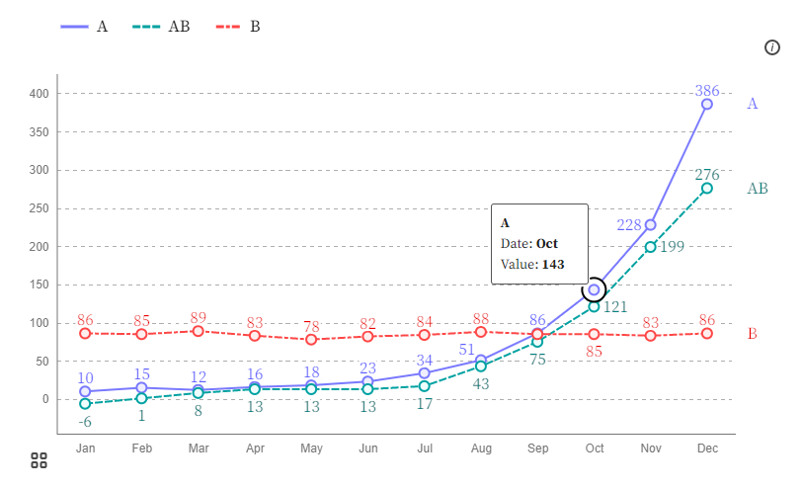
Some Definitions:
Data representation: representing data in a structured, symbolic way.
Visualization: is a visual data representation.
Data experience: is the space of interaction between a person’s sensory experience and a data representation’s meaning and function.

Slide 6
Is a “Chart” a Data Experience?
Yes!
We interact with charts in many different ways.
We call these modalities:
Sensory (sight, touch, sound)
Device (mouse, touchscreen, keyboard)
The quality of a data experience is measured by evaluating the robustness of these modalities.

Slide 7
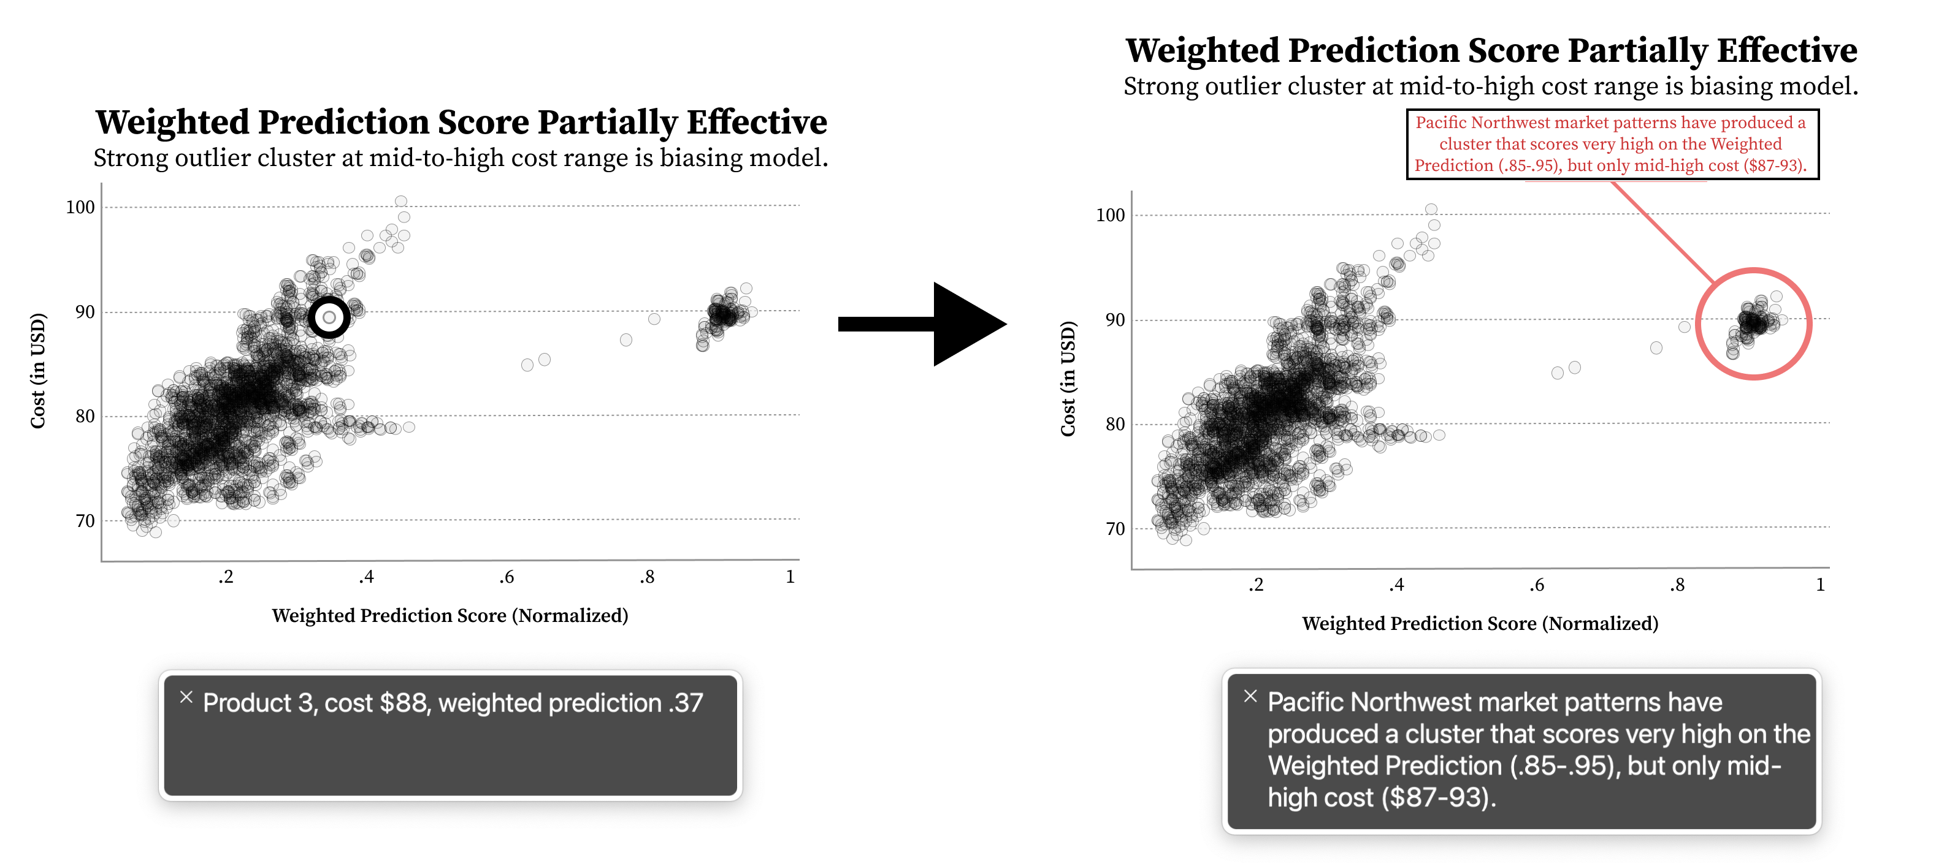
Some materials have more potential, like Text!
A text annotation that calls out an important feature of a visual is much easier to make accessible than all the other finer parts of a chart or graph.

Slide 8
Data is painful. Data Experiences shouldn’t be.
Sarah’s video on Twitter

Slide 9
What is Accessibility (a11y)?
The qualities that make an experience open or usable to all.
The knowledge and skills to break down barriers specifically for people with disabilities.

Slide 10
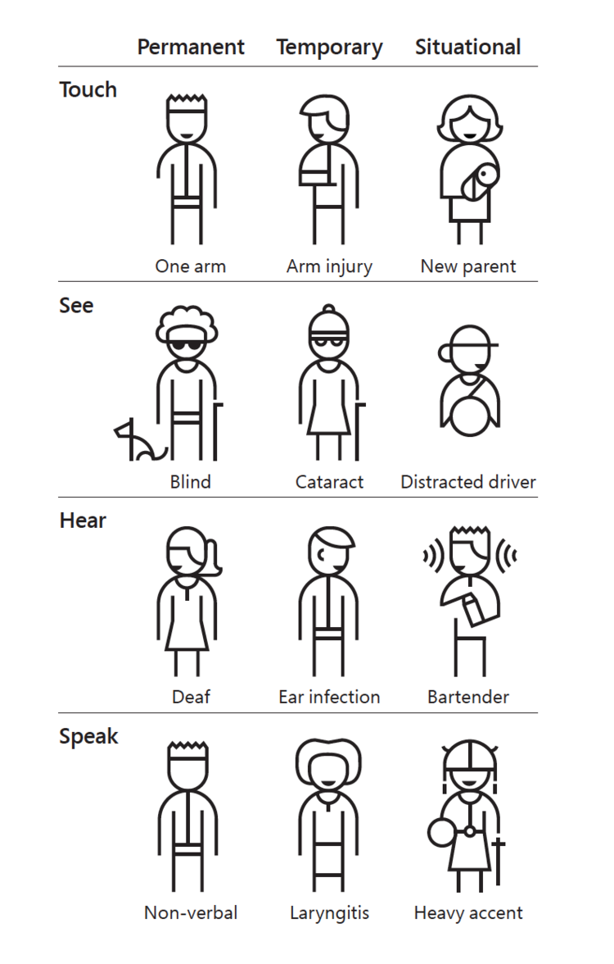
Disability is multi-dimensional
Some disabilities are permanent. Others are temporary or situational.
Source: https://www.microsoft.com/design

Slide 11
We have all already experienced a disabling limitation at some point in our lives – even if just temporarily or situationally.

Slide 12
Accessibility is personal for all of us.

Slide 13
And in tension: The specific barriers that people who live with disabilities face cannot be substituted by our experiences.

Slide 14
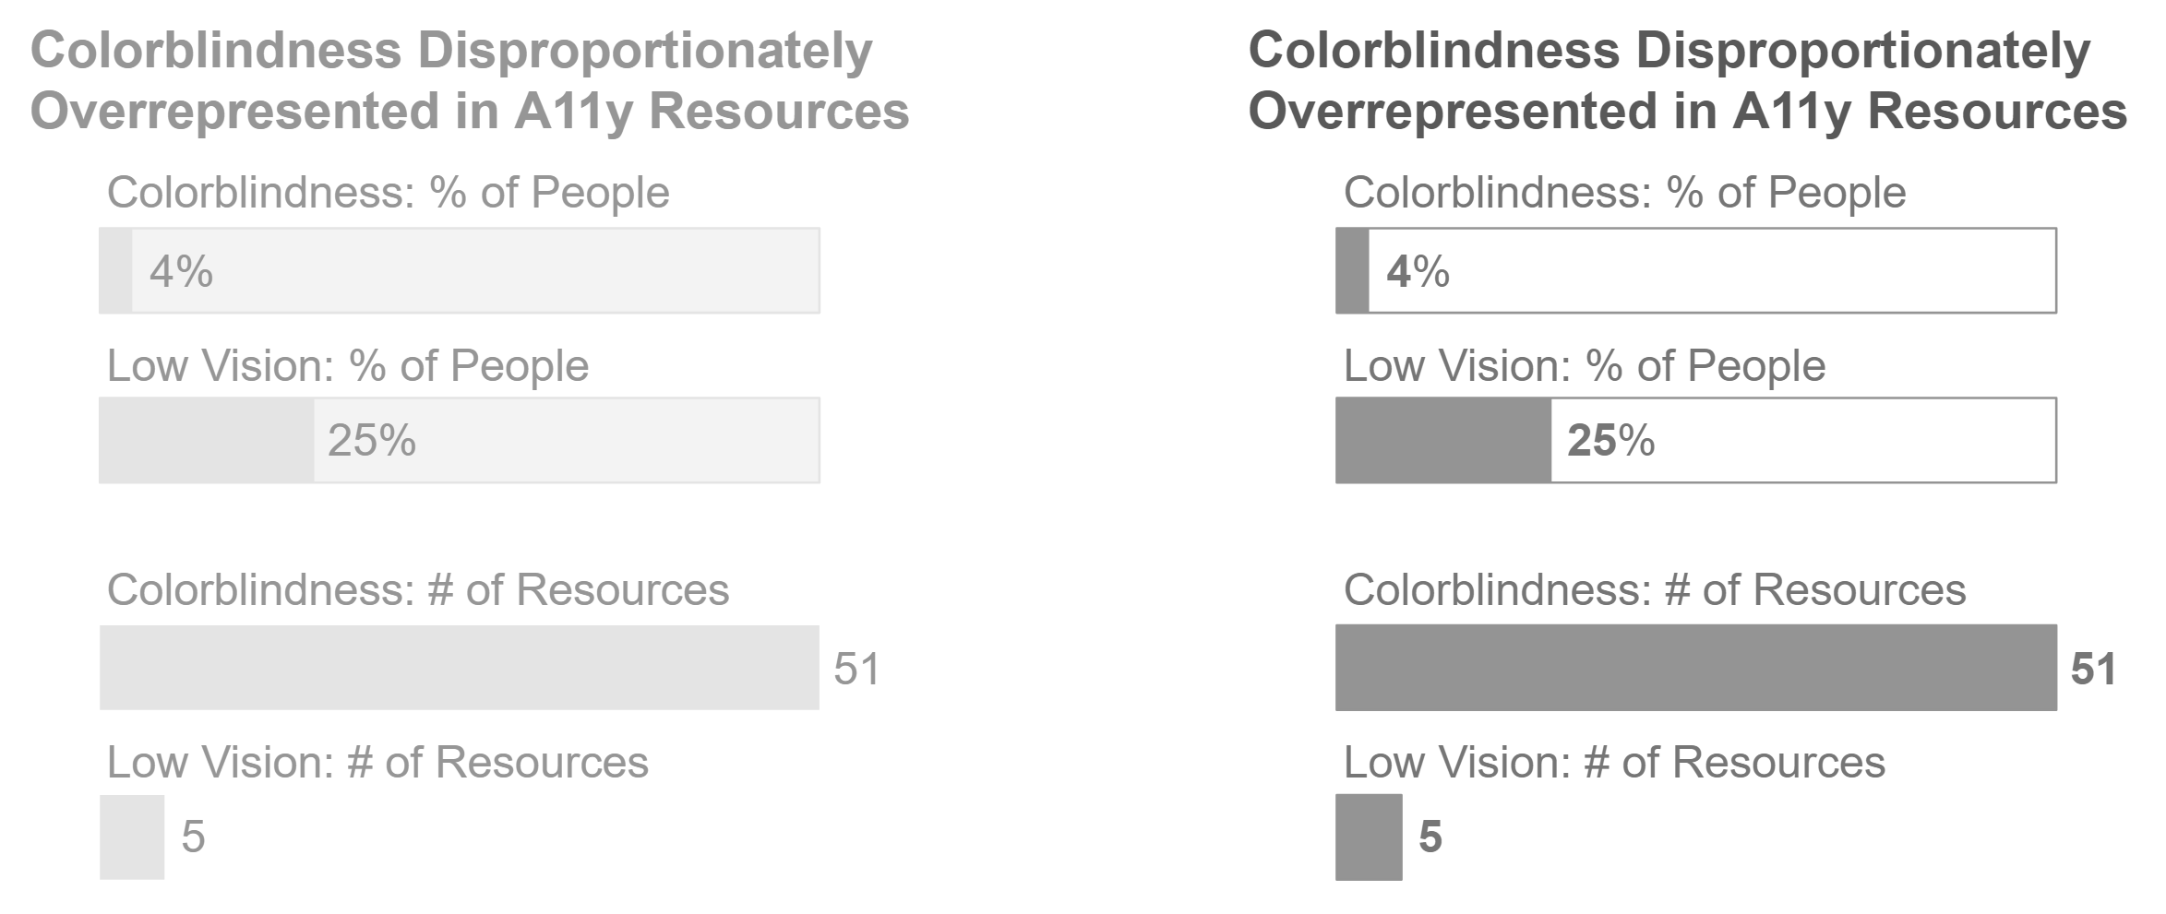
Uncorrected or uncorrectable moderate-severe visual impairment affects ~28% of people globally

Slide 15
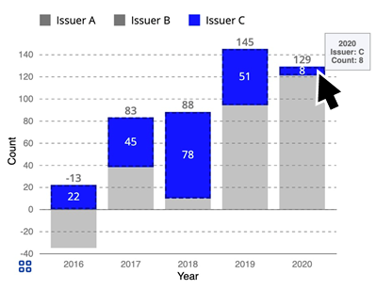
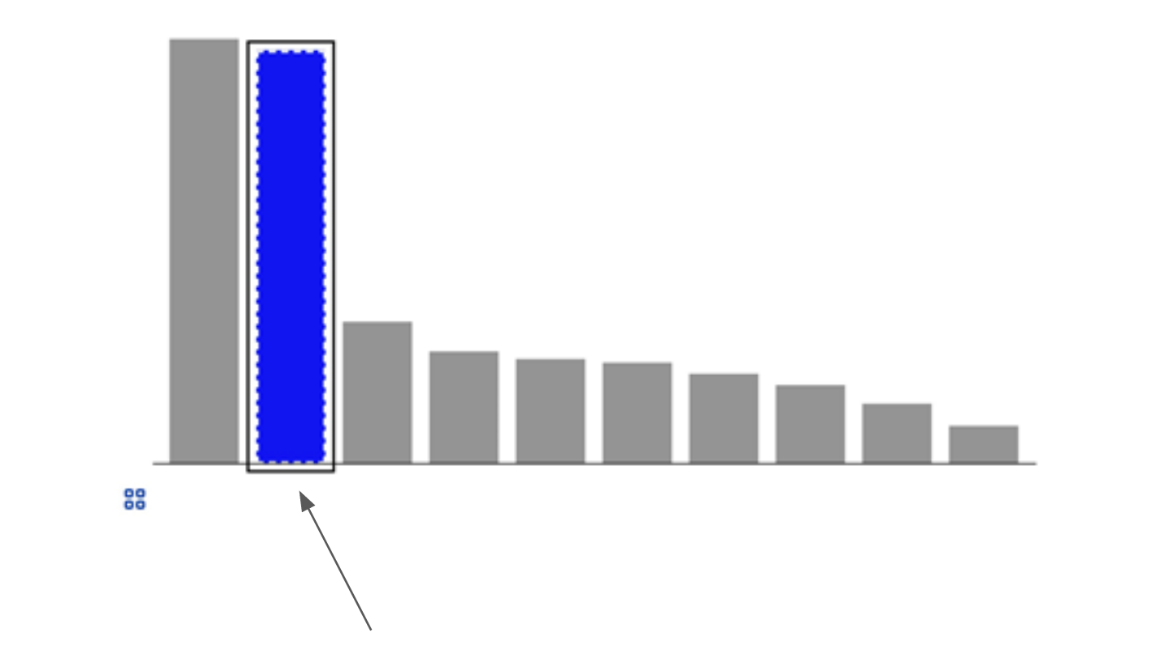
Motor impairment and functional disability (13-15%)

Slide 16
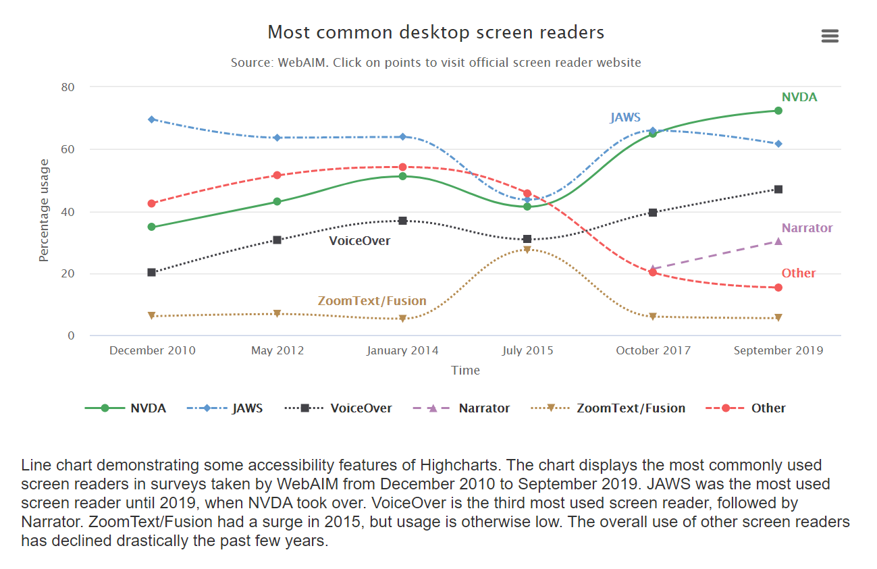
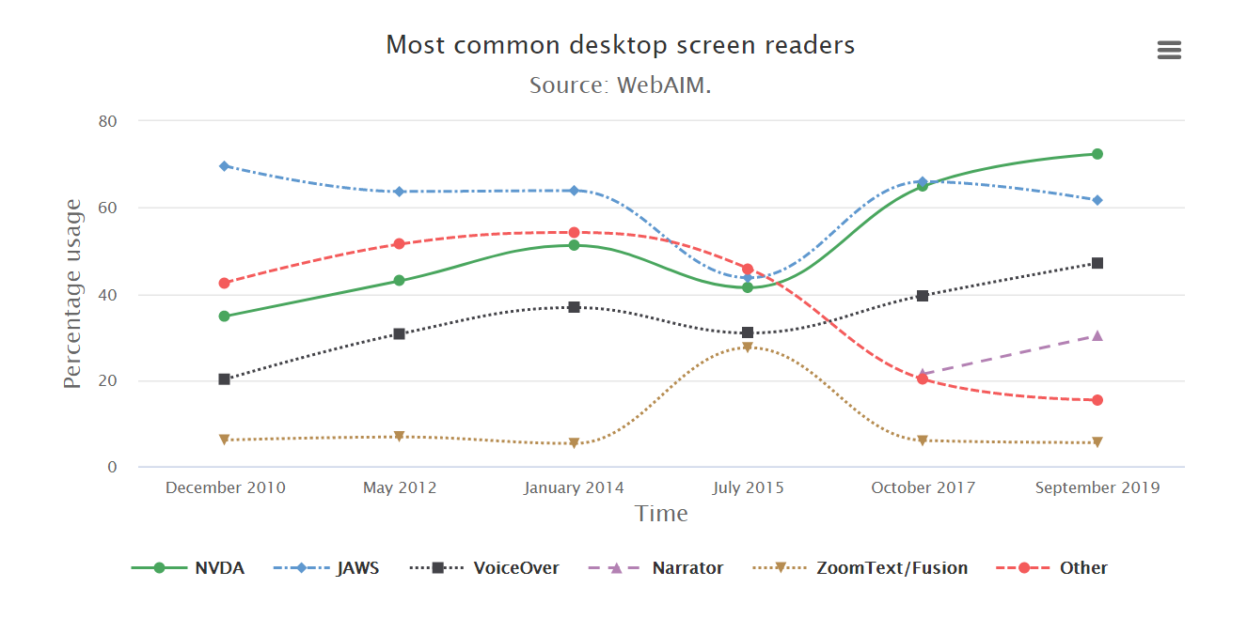
Cognitive and attention impairment (11-13%)
Source: Highcharts example (an accessibility-focused charting library).

Slide 17
Roles Involved in Data Work
Engineers
Designers
Analysts
Data work really is a special medium and often involves many collaborators.
It assembles so many people together for the goal of making sense out of difficult information.
Managers
Researchers
Editors
Auditors
Users/Readers

Slide 18
Our problem arises: How can we include people in our work if our tools and environments aren’t accessible to them?

Slide 19
Are people with disabilities only ever our “audience,” “readers” or “users?” Why haven’t we made a space for them to be equal coworkers and peers?

Slide 20
The limited Roles for People With Disabilities
Engineers
Designers
Analysts
People with disabilities are often given only two roles in the ecosystem of a data experience:
Auditing or using, but most often just the latter.
Managers
Researchers
Editors
Auditors
Users/Readers

Slide 21
“My Coworkers are already making charts and graphs, I’d rather meet them there than expect both of us to learn sonification”
- A good, blind friend who wants a common medium for data work

Slide 22
Making my case: Data Representation is already an assistive technology
Taking data (something hard to understand) and turning it into a representation or experience that is easier to understand is an assistive act.

Slide 23
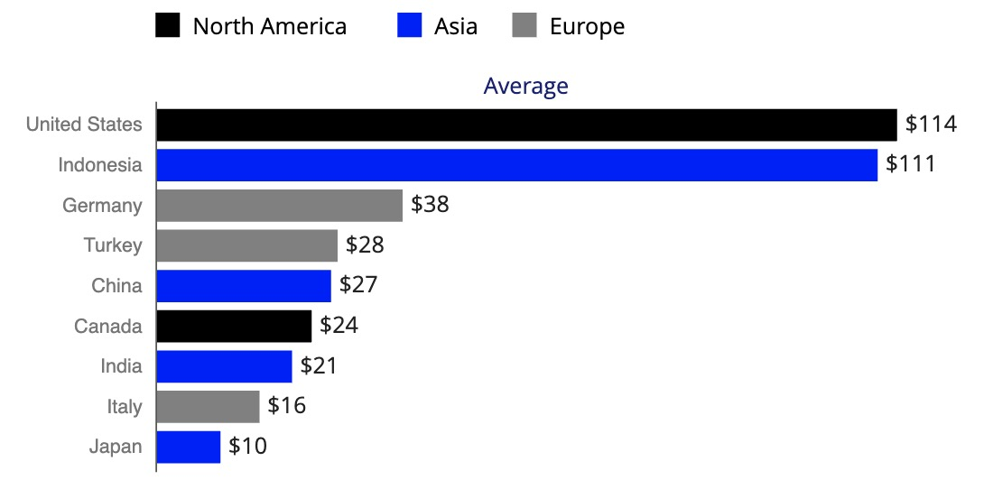
Data visualization is a hopeful starting point
Taking data and making it into a chart helps break down cognitive barriers. And if our primary motivation is to break down barriers for understanding data, why not keep going?
Region | Country | Value
North America | United States | $114
Asia | Indonesia | $111
Europe | Germany | $38
Europe | Turkey | $28
Asia | China | $27
… | … | …

Slide 24
We *could* start elsewhere
Some strategies are attempting to center data experiences in non-visual ways.
I think this work is great and shouldn’t be seen as right or wrong compared to an approach that starts with data visualizations (this just isn’t a topic we aren’t going to discuss today).

Slide 25
“So, What do I do First?”
How do we make charts and graphs accessible, in order to be inclusive?

Slide 26
Step 1: Recognize when something is inaccessible You can’t invite co-workers to a space that doesn’t work!

Slide 27
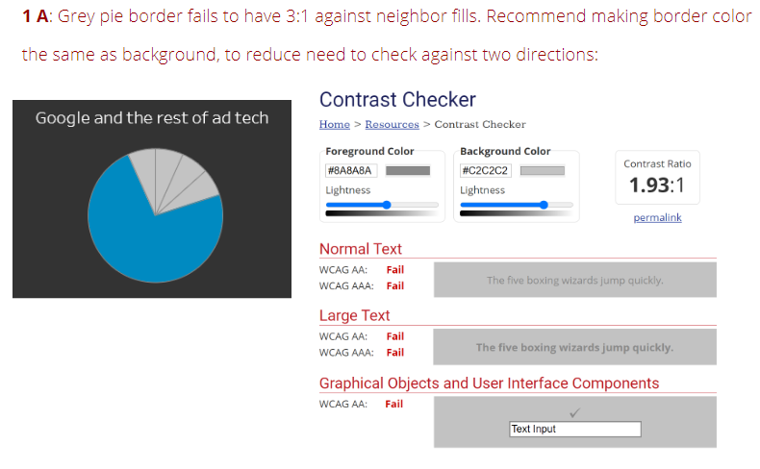
Evaluation!
The practice of evaluating something according to a consistent set of standards is called an audit.
Anyone can learn how to audit! Designers, engineers, managers, analysts, scientists… really, anyone.

Slide 28
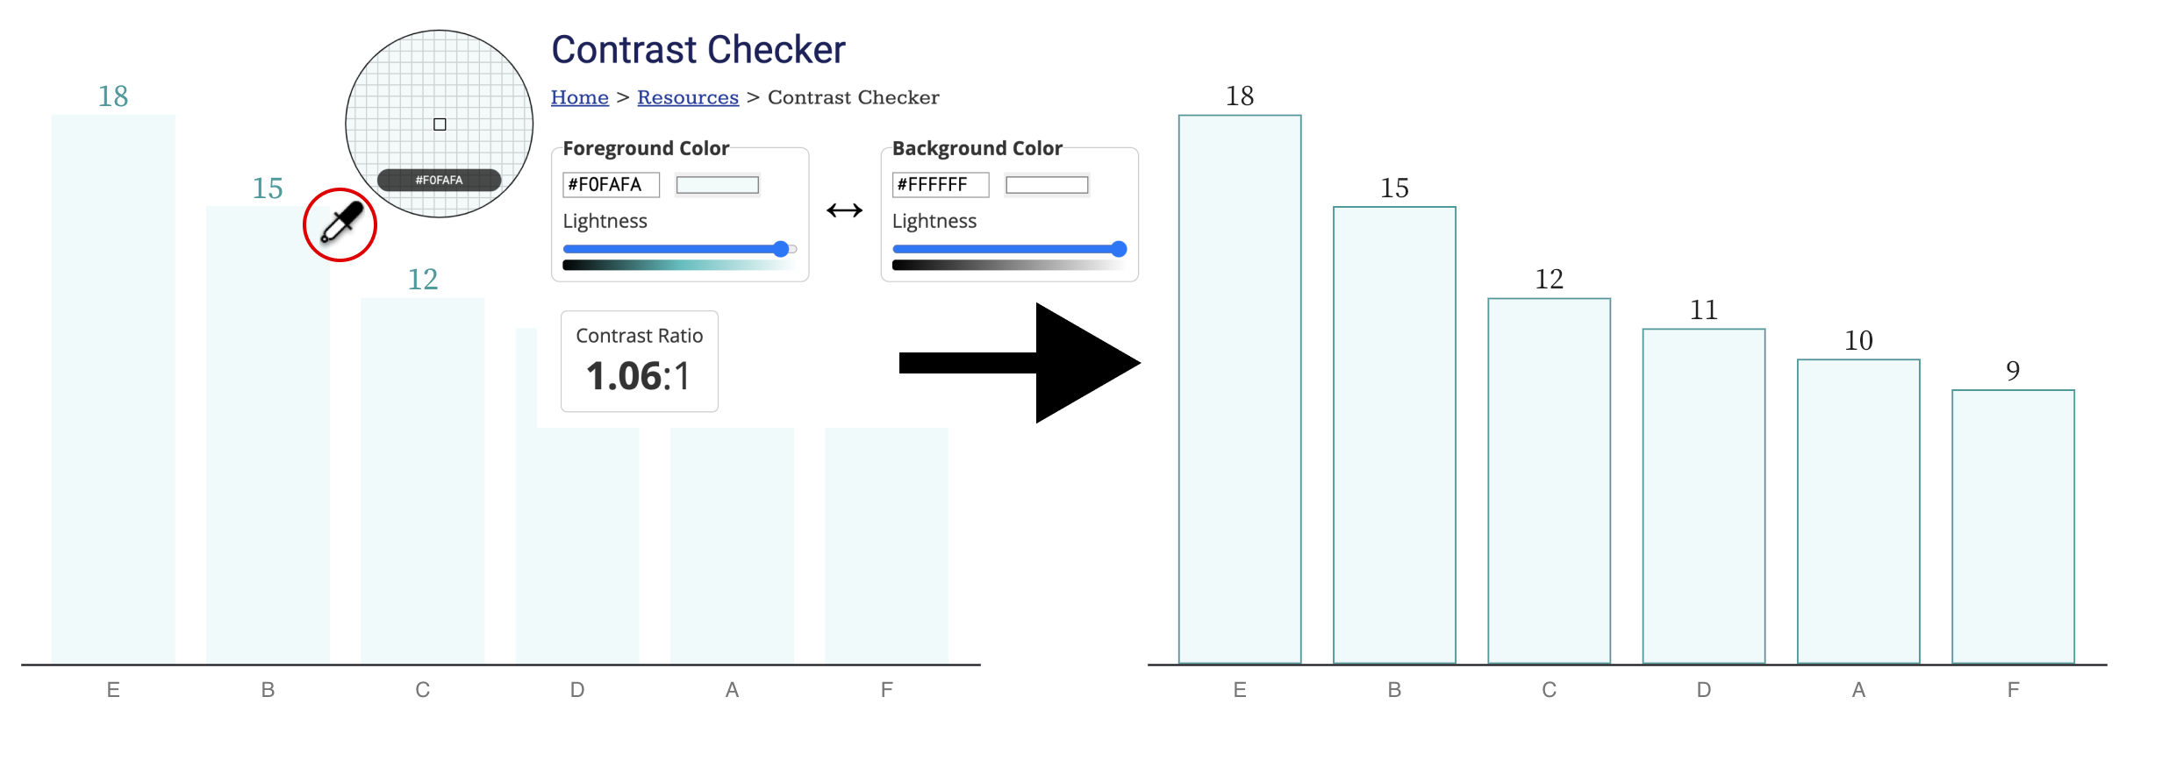
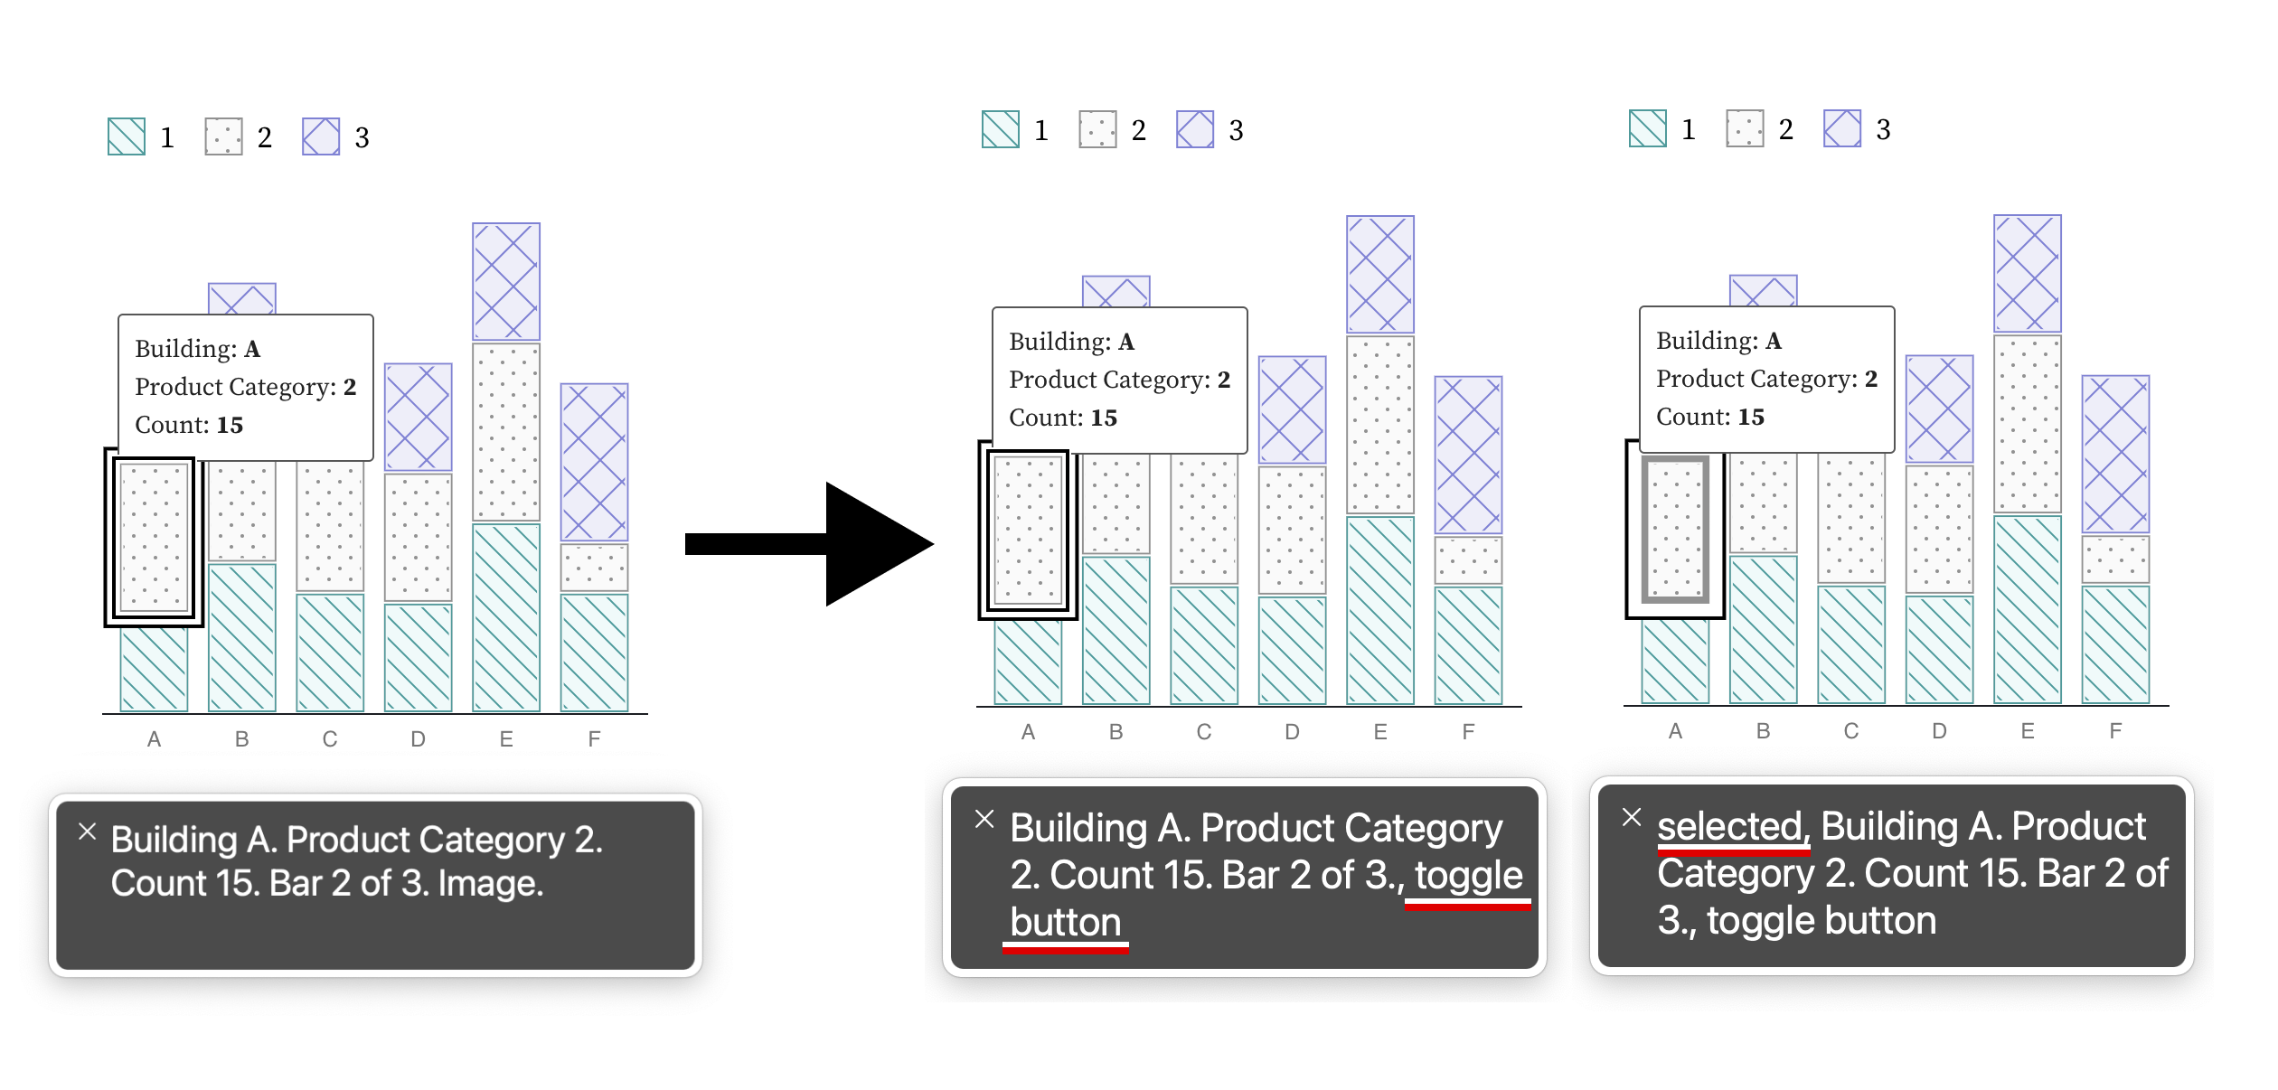
My Prior work: Chartability
My prior research is about a whole workbook I assembled to help people do this evaluation work!
(Yes, even you.) I’ll make a big announcement about the latest updates and our paper soon, but for now you can check it out at:
chartability.fizz.studio

Slide 29
Practice Evaluating Contrast! (5mins) Go to: webaim.org/resources/contrastchecker/
Text we are testing: HELLO! This is TEXT.
Foreground color (the text color): #F1BECD
Background color (the slides background): #FCEEDF
What is the resulting contrast ratio?

Slide 30
An Example Data Experience Contrast Evaluation
Grey text fails. 1.81:1
Purple text fails. 2.47:1
Purple geometry (no border) fails. 2.63:1
Green geometry (with border) fails. 1.98:1
Green text fails. 2.59:1
Example chart audited using WCAG 2.1 contrast standards and Chartability.

Slide 31
Why standards? (part 1/2)
Standards are not only tried and true (and influence policy worldwide) but are also the already-spoken needs of people with disabilities.
Doing what is standard is the bare minimum already asked of us.

Slide 32
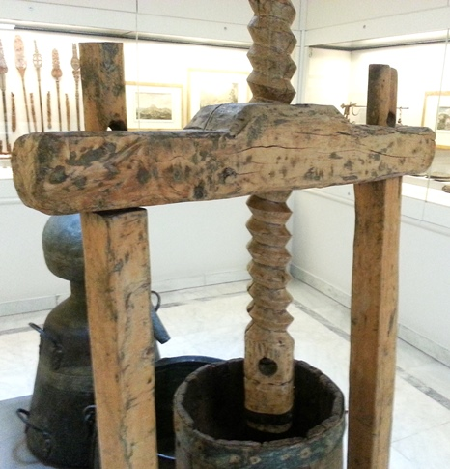
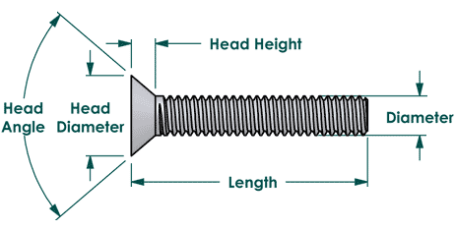
Why standards? (part 2/2)
Industrial standards are what separates any given hex code from a Pantone color or a wood fastener from a Philips screw. These allow for consistent experiences at scale.

Slide 33
The State of a11y Standards: WCAG
Web Content Accessibility Guidelines (or WCAG) is currently adopted in policy in some form or another by governments for 55% of the world’s population.
It is the biggest and best set of standards out there.
WCAG homepage and WCAG policy adoption internationally

Slide 34
Practice Using Assistive Technology (5mins) Go to: frankelavsky.github.io/assessing_chart_interactivity/
Mac users:
Use VoiceOver (following along)
PC users:
- Use a keyboard or use an existing screen reader (like NVDA or JAWS)

Slide 35
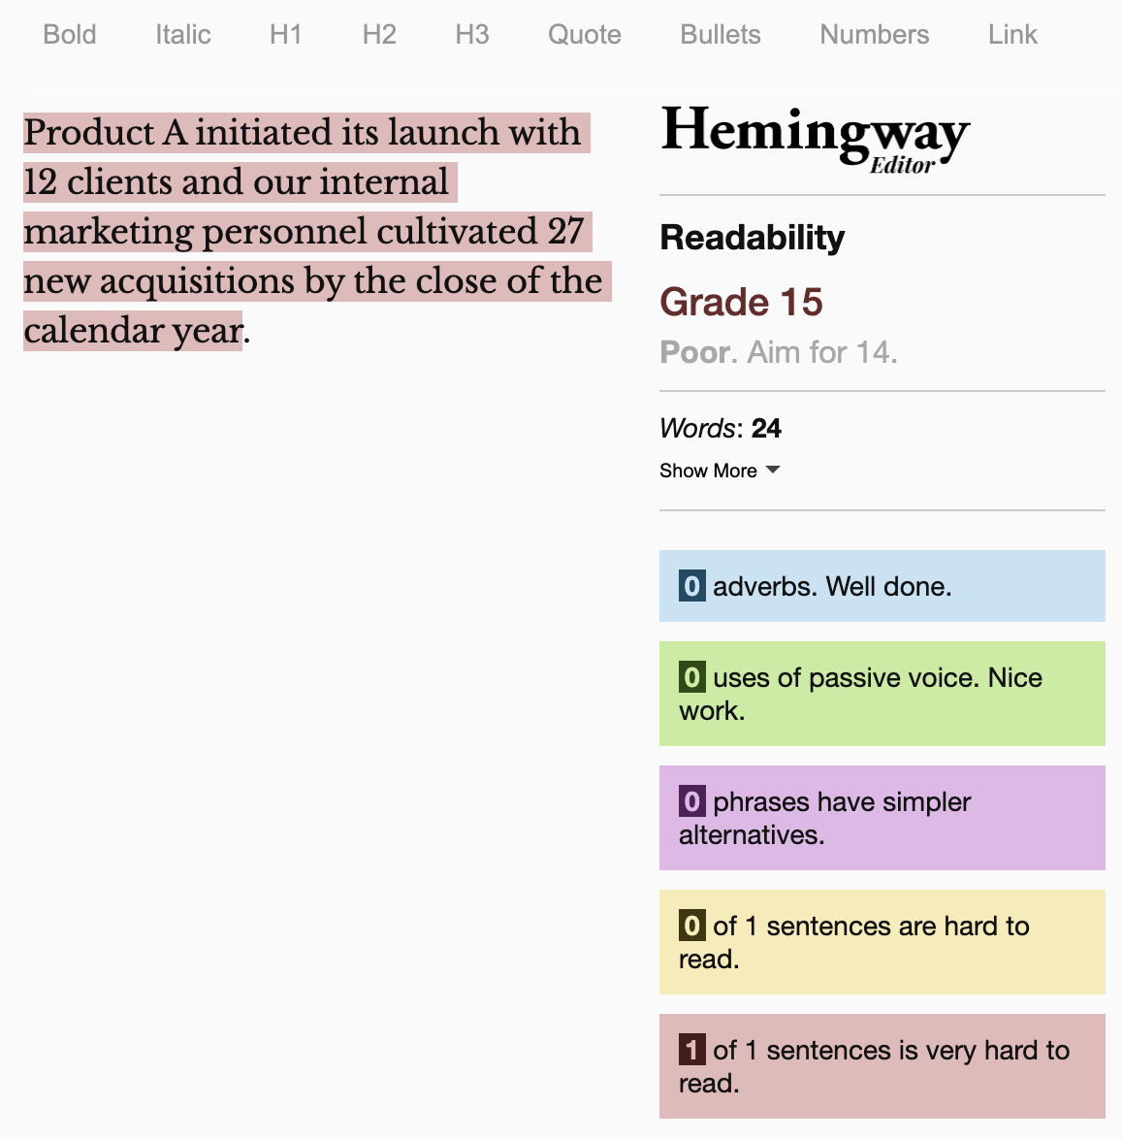
Practice Checking Reading level (5mins) Go to: frankelavsky.github.io/assessing_chart_interactivity/
Copy the text from the subtitle and paste it into the Hemingway App: hemingwayapp.com/
Try to shorten and edit this to reading level 9.

Slide 36
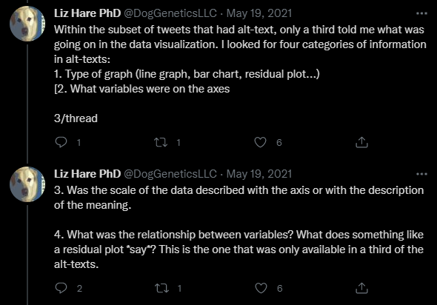
Final Advice: Make Connections
Invite people, hire people, and find where they are already speaking and doing work.
Liz has been an amazing partner and teacher and is really involved on Twitter!

Slide 37
What we covered Today
Learn:
What is accessibility?
What are the dimensions of disability?
Why does access matter for inclusion?
What is “data work?”
Practice:
Check contrast levels.
Use a keyboard.
Use a screen reader.
Improve the reading level of a description.

Slide 38
resources:
Follow me on twitter for news about my work (@FrankElavsky).
About the group I am a part of: github.com/dataviza11y/Why-We-Exist
Our Group’s resources for visualization and accessibility.
Visa Chart Components: https://developer.visa.com/pages/chart-components
Chartability Workbook: fizz.studio/files/chartability-worksheet
Chartability Slides: fizz.studio/files/chartability-deck
Chartability Website: chartability.fizz.studio/

Slide 39
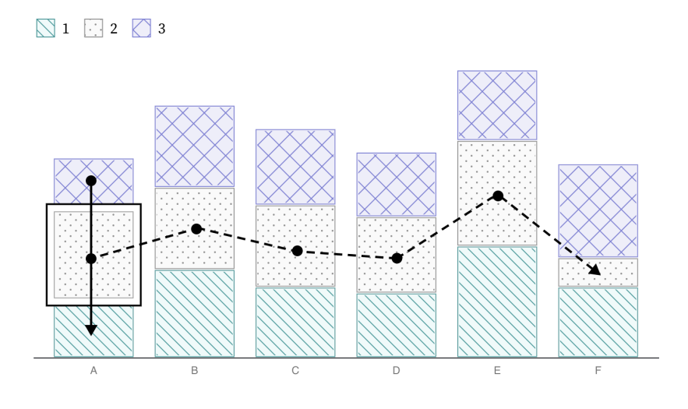
Bonus advice: Work on 1 new skill at a time
My current deep dive has been interaction paradigms for keyboard and touch access. I’m still learning and studying!

Slide 40
THANKS
Get in touch at:
@FrankElavsky on Twitter
fje@cmu.edu

